Slide 1
Addressing Firearm Violence In Medical Education
Karen Sheehan, MD, MPH
Professor of Pediatrics, Medical Education, and Preventive Medicine
ksheehan@luriechildrens.org
@karensheehanmd

Slide 2
Addressing Firearm Violence Injury In Medical Education
Karen Sheehan, MD, MPH
Professor of Pediatrics, Medical Education, and Preventive Medicine
ksheehan@luriechildrens.org
@karensheehanmd

Slide 3
Objectives
Epidemiology of firearm injury in the United States
How to engage trainees in firearm injury prevention research, education, and advocacy

Slide 4
Disclosures
I have nothing to disclose.
The data presented in this webinar are from epidemiologic sources. When outcomes and associations are presented by race, race is a social construct.

Slide 5
A little about me
NU/CMH/Lurie Children’s lifer
Trained as a Pediatric Emergency Medicine physician, now practice general pediatrics
Have worked for 30 years on preventing injury and violence
Teach PH 414: Injury and Violence Prevention in the MPH Program
Associate Chair, Advocacy, Department of Pediatrics
Serve as a group leader for NU Area of Scholarly Concentration (AOSC) and mentor many students on their research
Formerly led FSM’s Health and Society Element Group
Created and co-direct, Community Health Advocacy Initiative (CHAI)

Slide 6
Where to start to learn about the epidemiology of firearm injury?

Slide 7
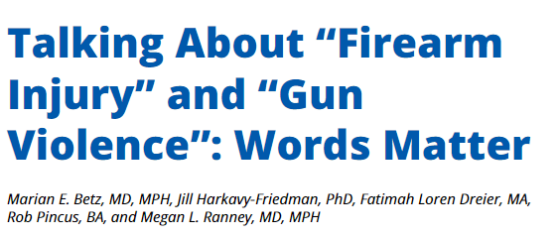
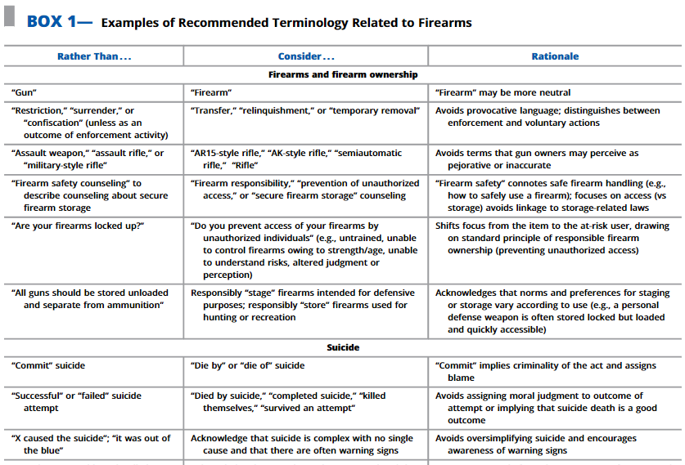
https://ajph.aphapublications.org/doi/10.2105/AJPH.2021.306525

Slide 8
CDC’s Injury Center (NCIPC)
https://www.cdc.gov/injury/index.html

Slide 10
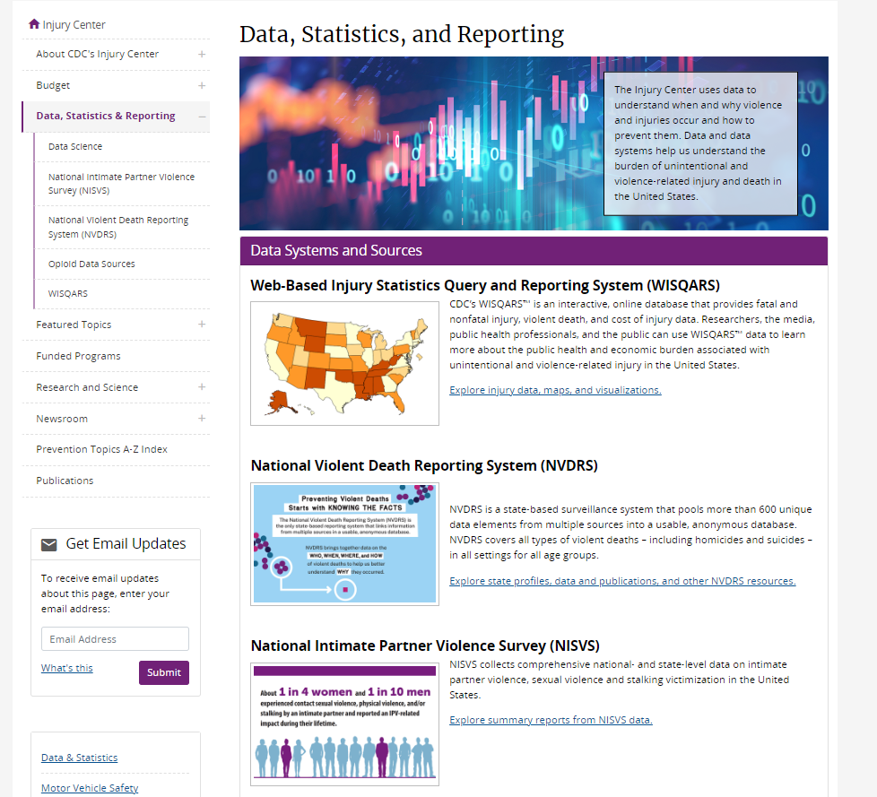
https://www.cdc.gov/injury/data-statistics-reporting.html

Slide 11
https://www.cdc.gov/injury/data-statistics-reporting.html

Slide 12
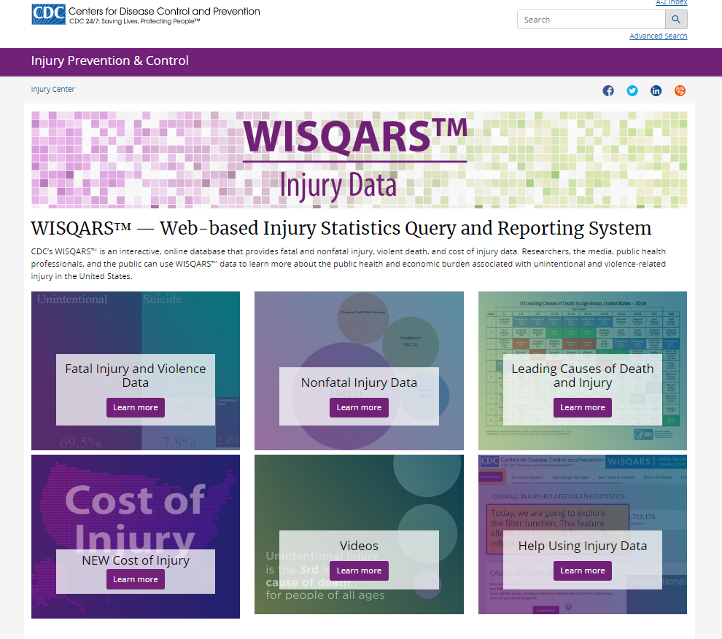
https://www.cdc.gov/injury/wisqars/index.html

Slide 13
https://www.cdc.gov/injury/wisqars/index.html

Slide 14
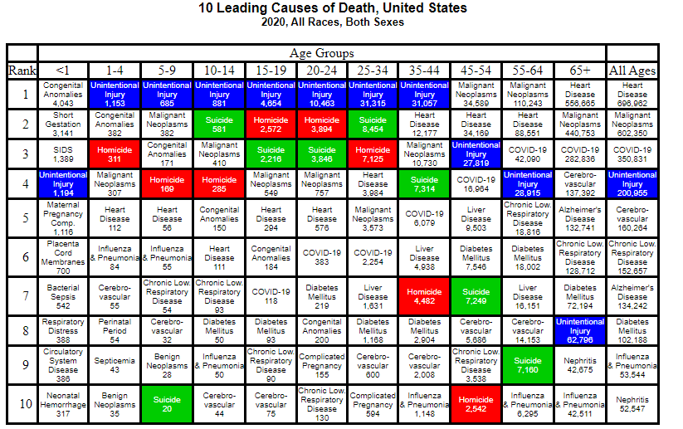
https://wisqars.cdc.gov/cgi-bin/broker.exe

Slide 15
https://www.cdc.gov/injury/wisqars/index.html

Slide 16
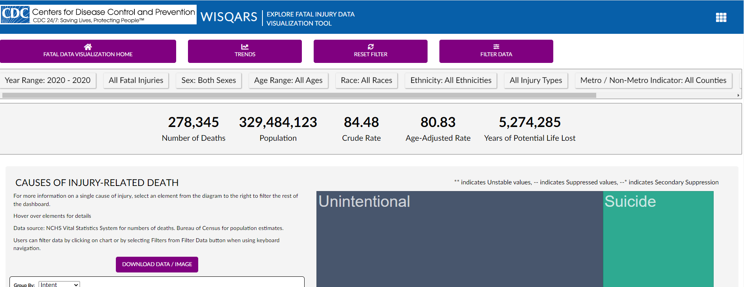

Slide 18
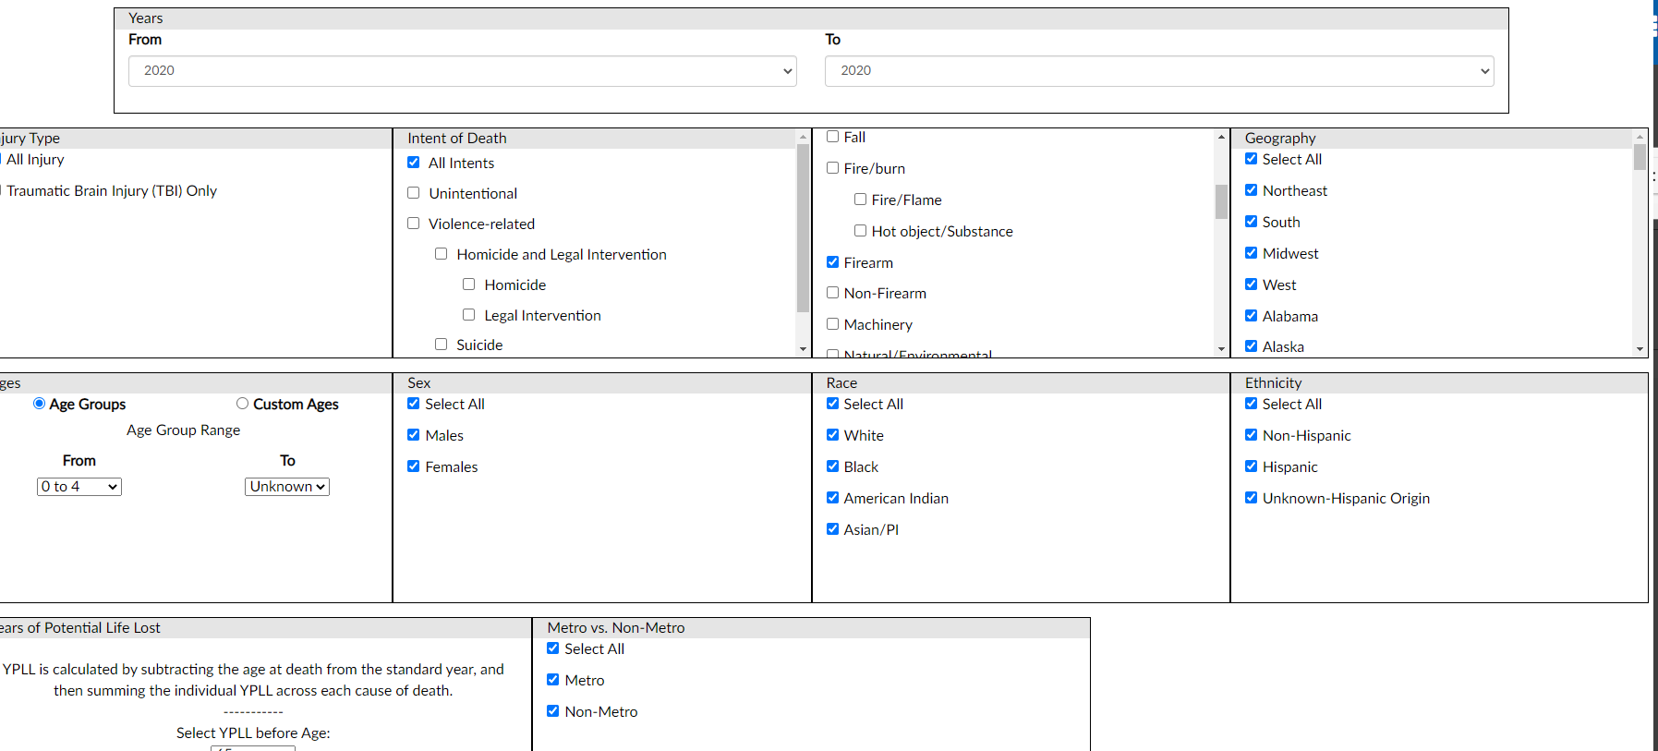

Slide 19
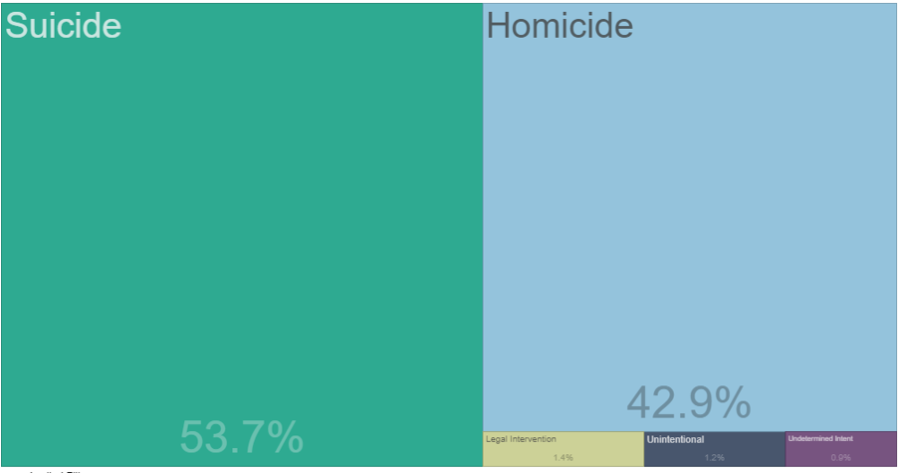
45,222 U.S. Firearm Deaths, 2020 All Ages, All Races, All Sexes

Slide 20
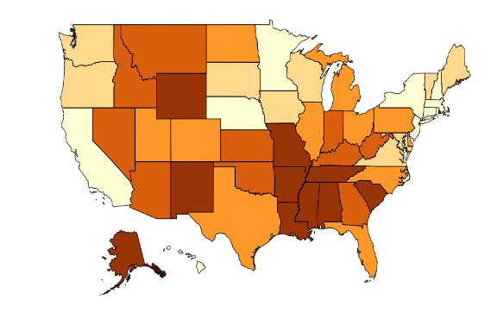
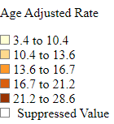
Firearm Death Rate, All Intents, 2020 per 100,000, All Ages, All Races, All Sexes

Slide 21
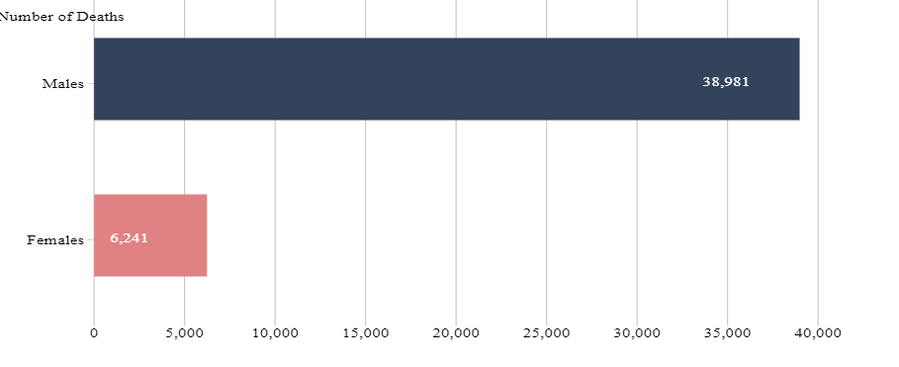
U.S. Firearm Deaths by Sex, 2020 All Races

Slide 22
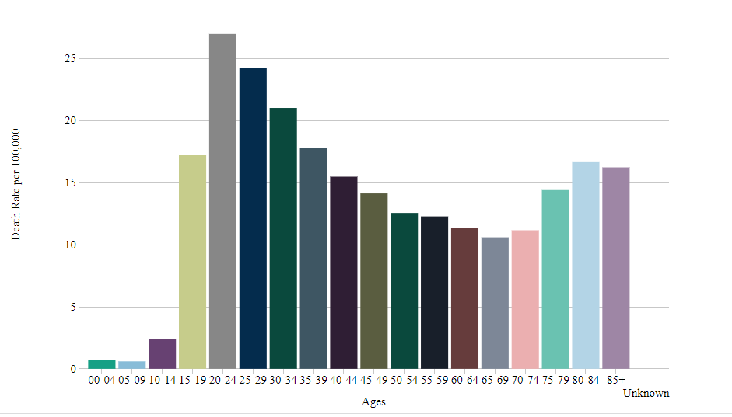
U.S. Firearm Death Rate by Age, 2020 All Races, All Sexes

Slide 23
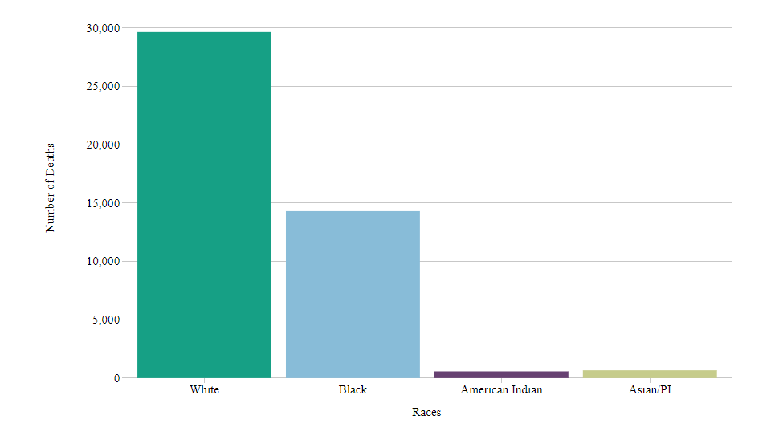
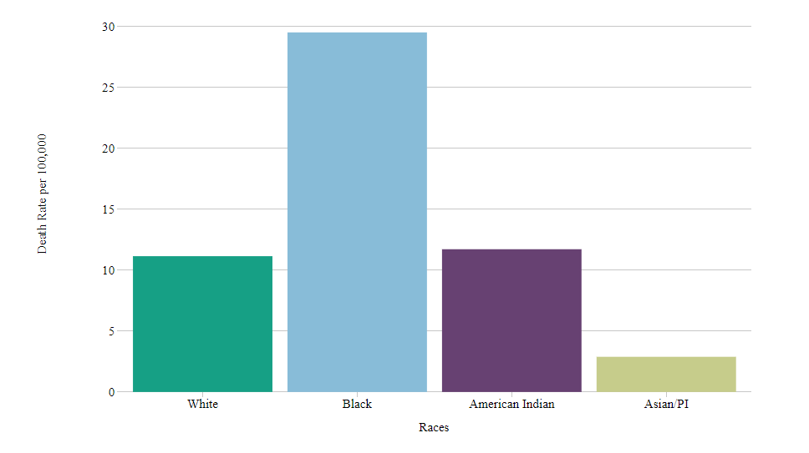
U.S. Firearm Deaths By Race, 2020 Numbers and Rates, All Ages, All Sexes

Slide 24
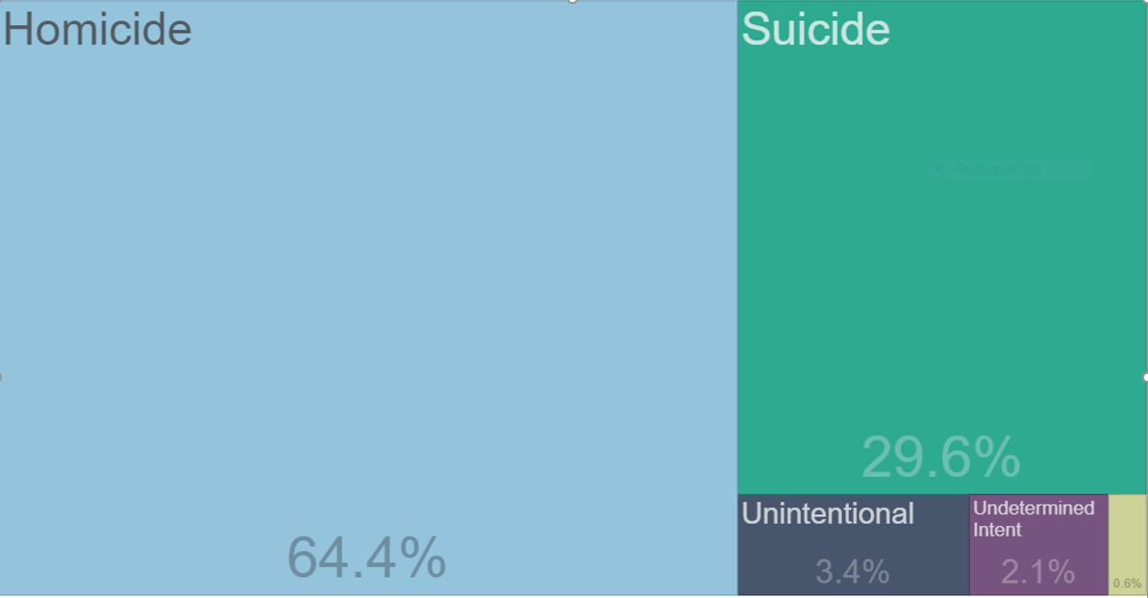
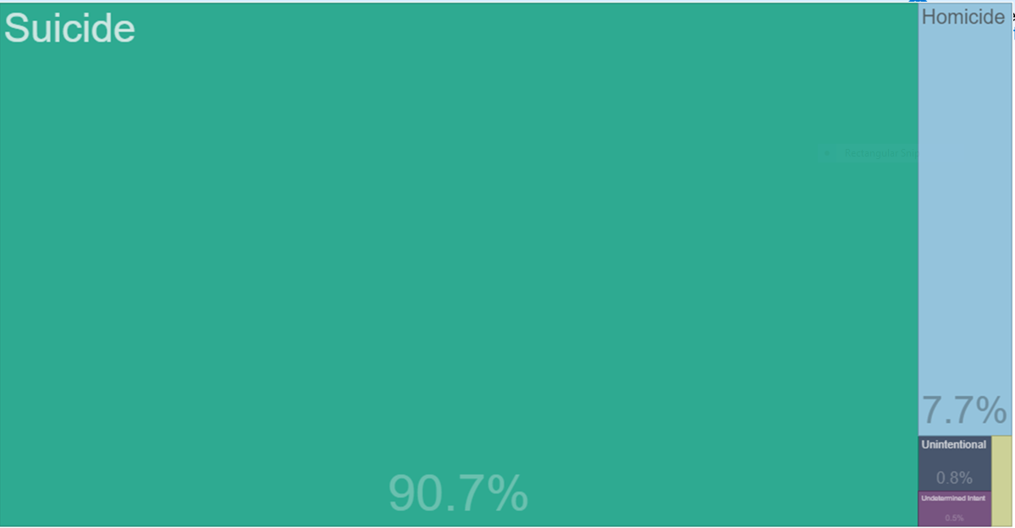
Intent of Firearm Death Varies by Age, 2020
0-19 years
4,368 deaths
65-85+ years
7,135 deaths

Slide 25
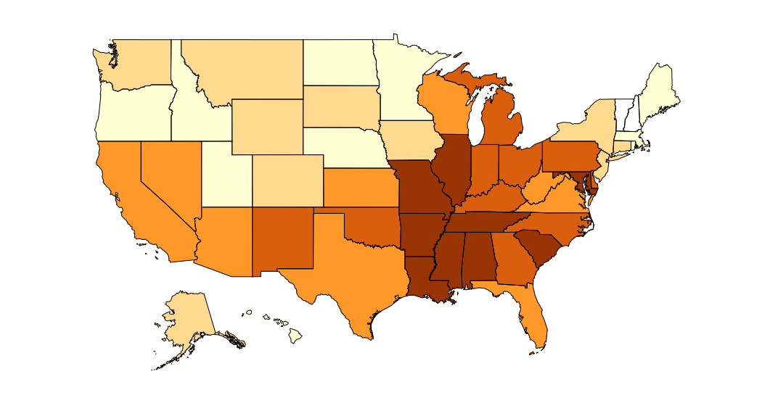
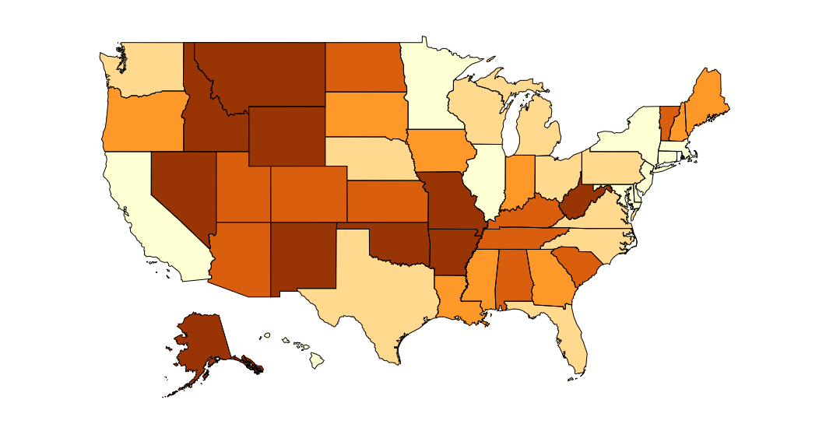
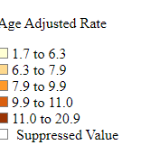
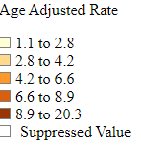
2020 U.S. Firearm Homicide & Suicide Death Rates All Races, All Sexes
Homicide
Suicide

Slide 26
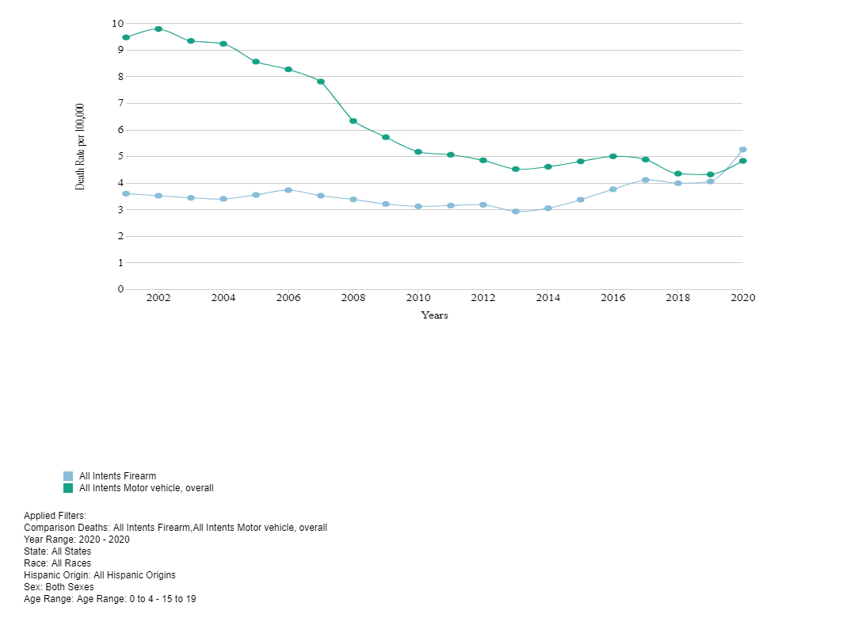
US, Firearm vs. MVC, 0-19 years

Slide 27
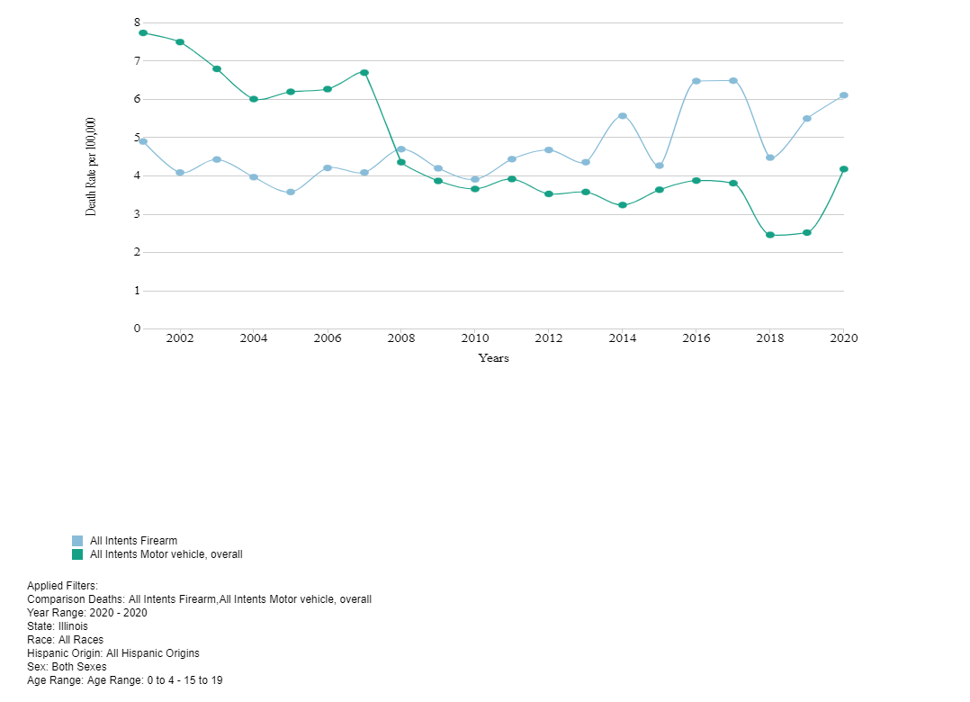
Illinois, Firearm vs. MVC, 0-19 years

Slide 28
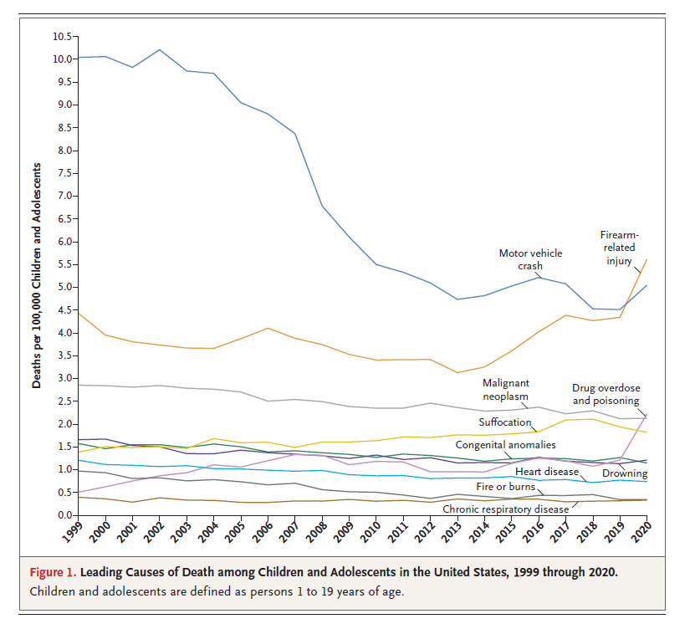
Mortality Rates (Deaths per 100,000 to 2016.
Goldstick et al
https://www.nejm.org/doi/full/10.1056/nejmc2201761
Cunningham RM et al. N Engl J Med 2018;379:2468-2475
Notes:
Figure 1 Mortality Rates (Deaths per 100,000 Children and Adolescents) for the 10 Leading Causes of Death in the United States from 1999 to 2016. Data were obtained from the Wide-ranging Online Data for Epidemiologic Research (WONDER) system of the Centers for Disease Control and Prevention (CDC), known as CDC WONDER,² according to the codes of the International Classification of Diseases, 10th Revision (ICD-10),³ for the leading causes of death among children and adolescents. Age was restricted to children and adolescents 1 to 19 years of age.

Slide 29
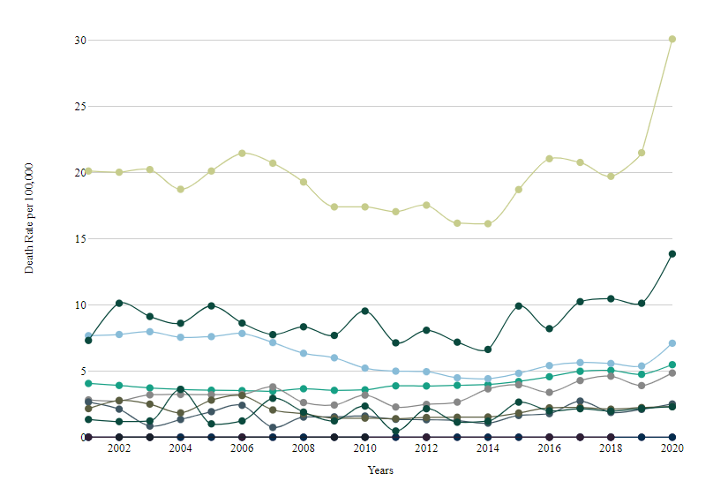
All Intents, U.S., Firearm Deaths, 0-24 years All Sexes, All Races & Ethnicities

Slide 30
Suicide and Homicide Rates, United States 2011-2020
Suicide
Rate (age-adjusted) per 100,000
Source: CDC, 2021
Notes:
Suicides consistently outnumber homicides. Historically, the homicide rate has not consistently shown the upward trend that we see with the suicide rate. However, the homicide rate did increase from 2019 to 2020 with rates of 6 and 7.8, respectively.
SOURCE: Centers for Disease Control and Prevention, National Center for Health Statistics. (2021). 1999-2020 Wide Ranging Online Data for Epidemiological Research (WONDER), Underlying Cause of Death files [Data file]. Retrieved from https://wonder.cdc.gov/Deaths-by-Underlying-Cause.html

Slide 31
Means of Suicide among Males by Age, United States 2020
Source: CDC, 2021
Notes:
Firearms remain a consistent means of suicide for men over time. For men over the age of 65, firearms are used in over three-quarters of suicide deaths.
SOURCE: Centers for Disease Control and Prevention, National Center for Injury Prevention and Control. (2021). Web-based Injury Statistics Query and Reporting System (WISQARS) [online]. Retrieved from www.cdc.gov/injury/wisqars

Slide 32
Means of Suicide among Females by Age, United States 2020
Source: CDC, 2021
Notes:
The means of suicide used by women changes with age. While younger women are most likely to die by suffocation, poisoning becomes a more common means of suicide as women age.
SOURCE: Centers for Disease Control and Prevention, National Center for Injury Prevention and Control. (2021). Web-based Injury Statistics Query and Reporting System (WISQARS) [online]. Retrieved from www.cdc.gov/injury/wisqars

Slide 33
Rates of Suicide by Race/Ethnicity, United States 2011-2020
Rate (age-adjusted) per 100,000
Source: CDC, 2021
Notes:
Since 2011, the age-adjusted suicide death rate has increased for all races and ethnicities. For American Indian and Alaska Native populations, the age-adjusted suicide death rate increased from 16.5 per 100,000 in 2011 to 23.9 per 100,000 in 2020.
SOURCE: Centers for Disease Control and Prevention, National Center for Health Statistics. (2021). 1999-2020 Wide Ranging Online Data for Epidemiological Research (WONDER), Multiple Cause of Death files [Data file]. Retrieved from http://wonder.cdc.gov/ucd-icd10.html

Slide 34
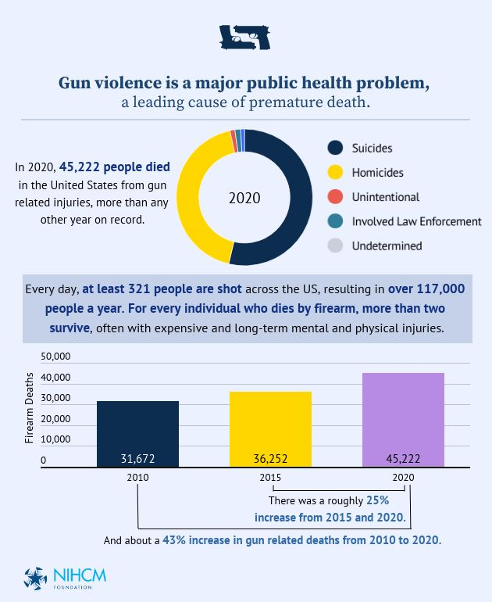
National Institute for Health Care Management
https://nihcm.org/

Slide 35
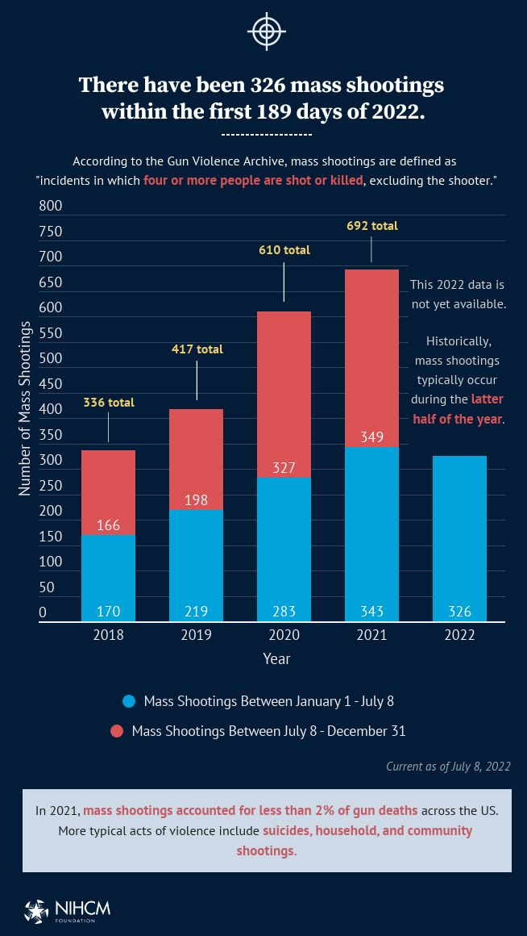
https://nihcm.org/

Slide 36
Data Check in
Firearm injury deaths are a leading cause of mortality across all age groups but the intent varies
Younger people: homicide
Older people: suicide
Firearms are now the leading cause of death for youth less than 19 years!
Males are disproportionately impacted
There is geographic variation in the firearm death rate
A larger number of people who identify as white die of firearm violence but members of minoritized communities are disproportionately affected
A lot of data can be pulled readily from WISQARS but there are increasing number of organizations that have prepared slides with enhanced graphics
Non-fatal data is not easily obtainable
But there is hope on the horizon to address this preventable injury

Slide 37
How can we address the Firearm Injury Health Crisis?

Slide 38
Public Health Approach to Violence Prevention
Primary Prevention Orientation
Efforts are focused on preventing violence before it occurs
Data-driven
Considers risk and resilience factors
Collaborative
Multi-sector approach
Population-based
Seeks community wide or “environmental” solutions

Slide 39
Factors Affecting the
Frequency of Violent
Events
Incidence
of Violence
Injury
Outcomes
Factors Affecting
the Severity of Violent Incidents
KKC

Slide 40
Socioecological
Framework
Community
(cultural values, norms, built environment)
Organizational
(workplace, school)
Interpersonal (family, friends, social networks)
Individual
(knowledge, attitudes, skills)
Public Policy
( universal insurance , oppressive policies such as redlining)
Modified from NAP

Slide 41
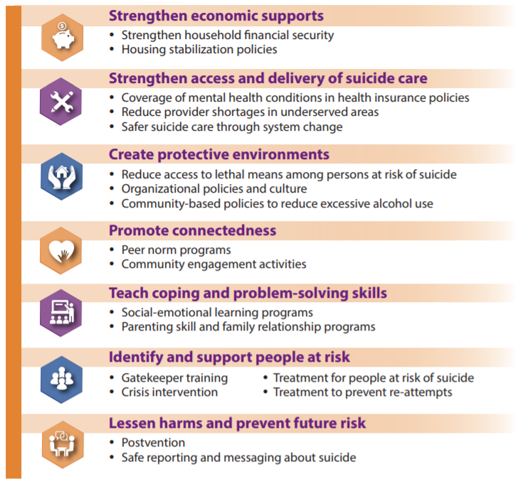
Suicide Prevention Framework
https://www.cdc.gov/violenceprevention/pdf/suicide-factsheet.pdf

Slide 42
How to engage trainees in firearm injury prevention research

Slide 43
Secondary Databases
WISQARS
https://wisqars.cdc.gov/data/explore-data/home
Behavioral Risk Factor Surveillance System
https://www.cdc.gov/brfss/index.html
Youth Risk Behavior Survey
https://www.cdc.gov/healthyyouth/data/yrbs/index.htm
Fragile Families & Child Wellbeing Study
https://fragilefamilies.princeton.edu/data-and-documentation/data-contents-overview
Gun Violence Archive
https://www.gunviolencearchive.org/
National Violent Death Reporting System
https://www.cdc.gov/violenceprevention/datasources/nvdrs/index.html
And many more

Slide 44
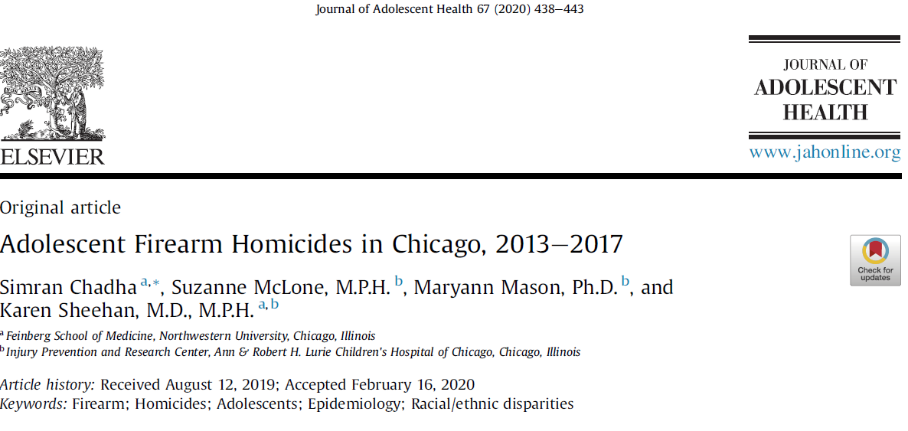

Slide 45
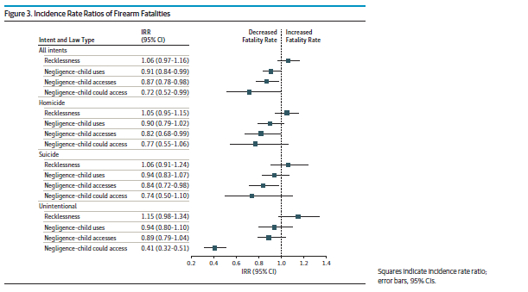

Slide 46
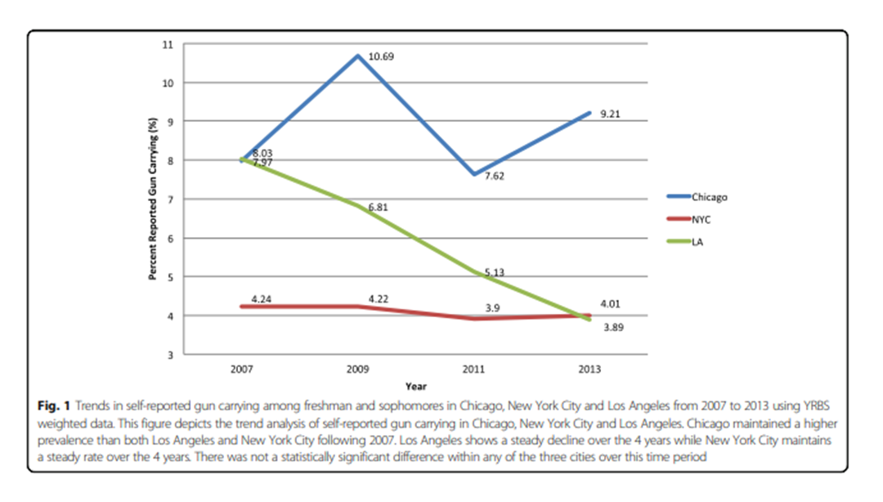

Slide 47
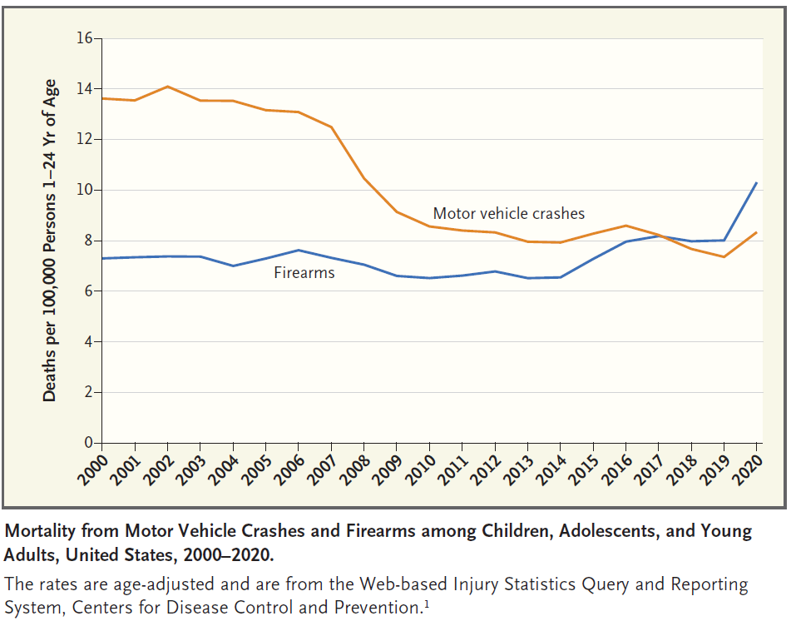
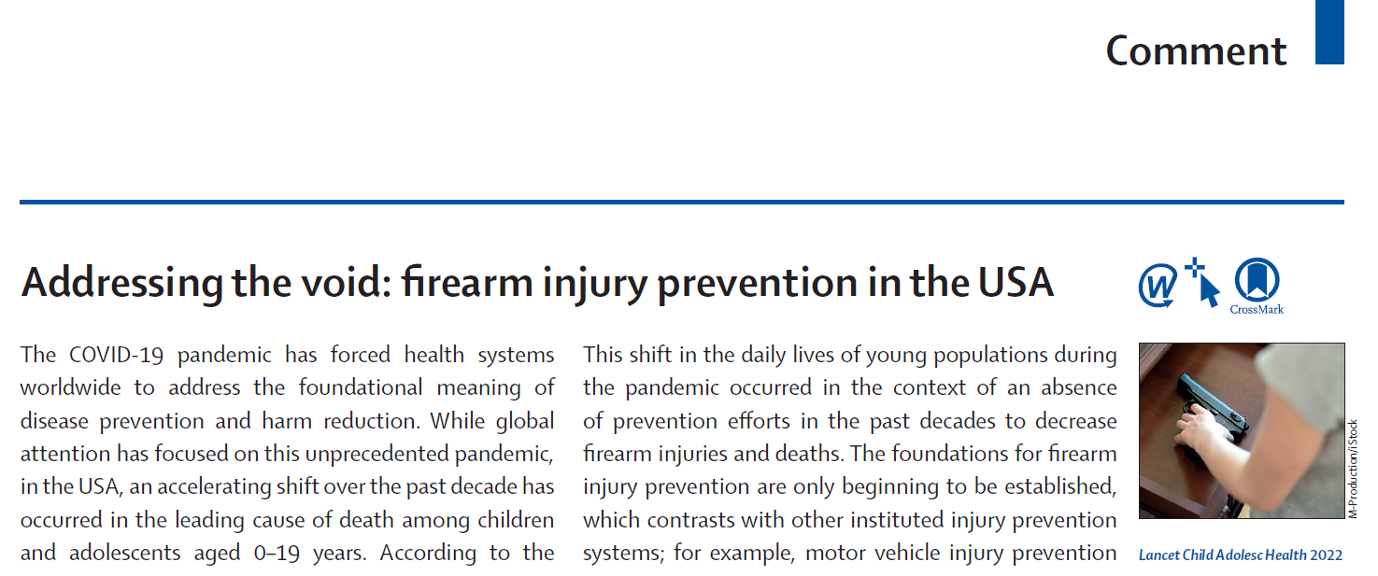

Slide 48
Why is it so important for medical students to be engaged in Firearm Injury Prevention Research?
In 1996, the Dickey Amendment essentially eliminated firearm injury prevention research funding
Not until 2020 was a significant amount of federal research dollars restored ($50 million)
Still a drop in the bucket compared to the relative burden of disease
Restriction led to a loss of a generation or two of firearm injury researchers
If our goal as physicians is to improve the health of populations, we need to focus on firearm injury prevention research and engaging trainees
Secondary database analysis in med school is a great place to start!

Slide 49
How to engage trainees in firearm injury prevention education

Slide 50
“Giving Clinicians the Tools They Need to Prevent Firearm Injury in their Patients”
https://www.bulletpointsproject.org/

Slide 51
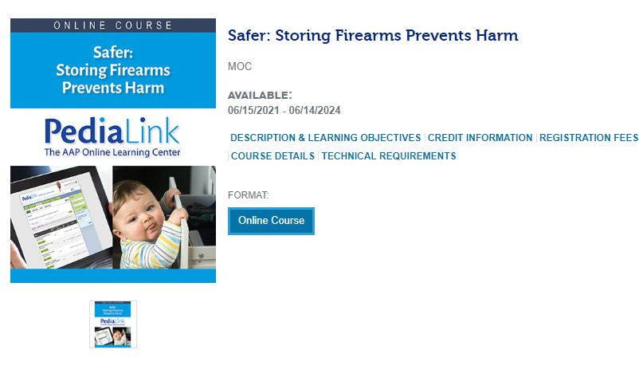
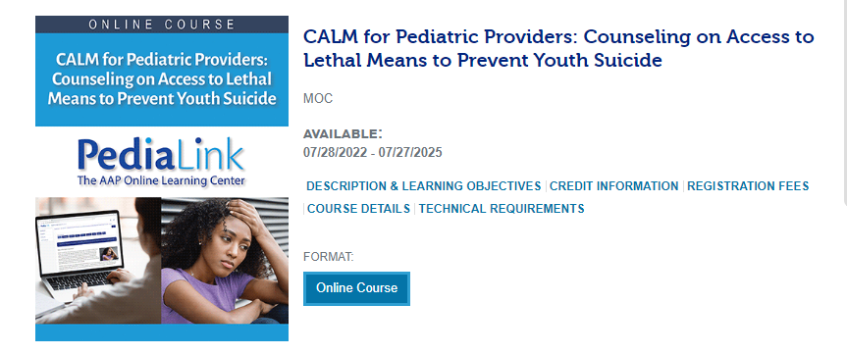
Pediatrics
https://www.aap.org/en/patient-care/gun-safety-and-injury-prevention/

Slide 52
Psychiatry & Gerontology
https://www.hsph.harvard.edu/means-matter/

Slide 53
Suicide: How
Means Matter
85% of firearm suicide attempts are fatal
Most nonfatal suicide attempts are overdoses, followed by cutting; <1% use a gun
90% of survivors of near lethal suicide attempts do not commit suicide later
Multiple studies have shown a gun in the home increases the risk of suicide
Risk of youth suicide lower in those storing all guns locked or unloaded (Grossman et al, JAMA 2005)
www.meansmatter.org

Slide 54
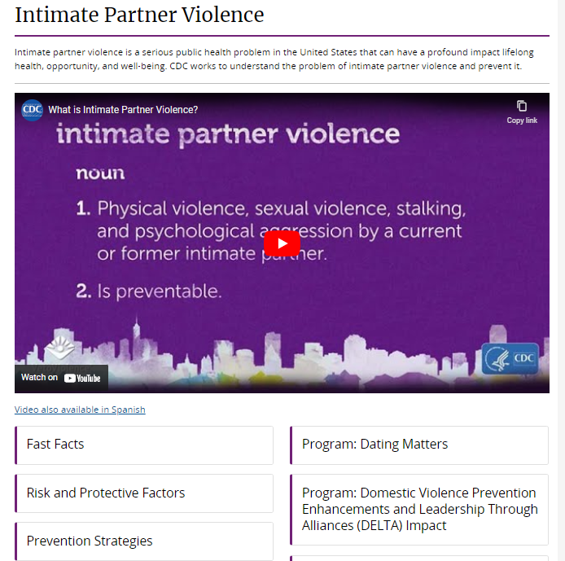
OB, Pediatrics, & Internal Medicine
https://www.cdc.gov/violenceprevention/intimatepartnerviolence/index.html

Slide 55
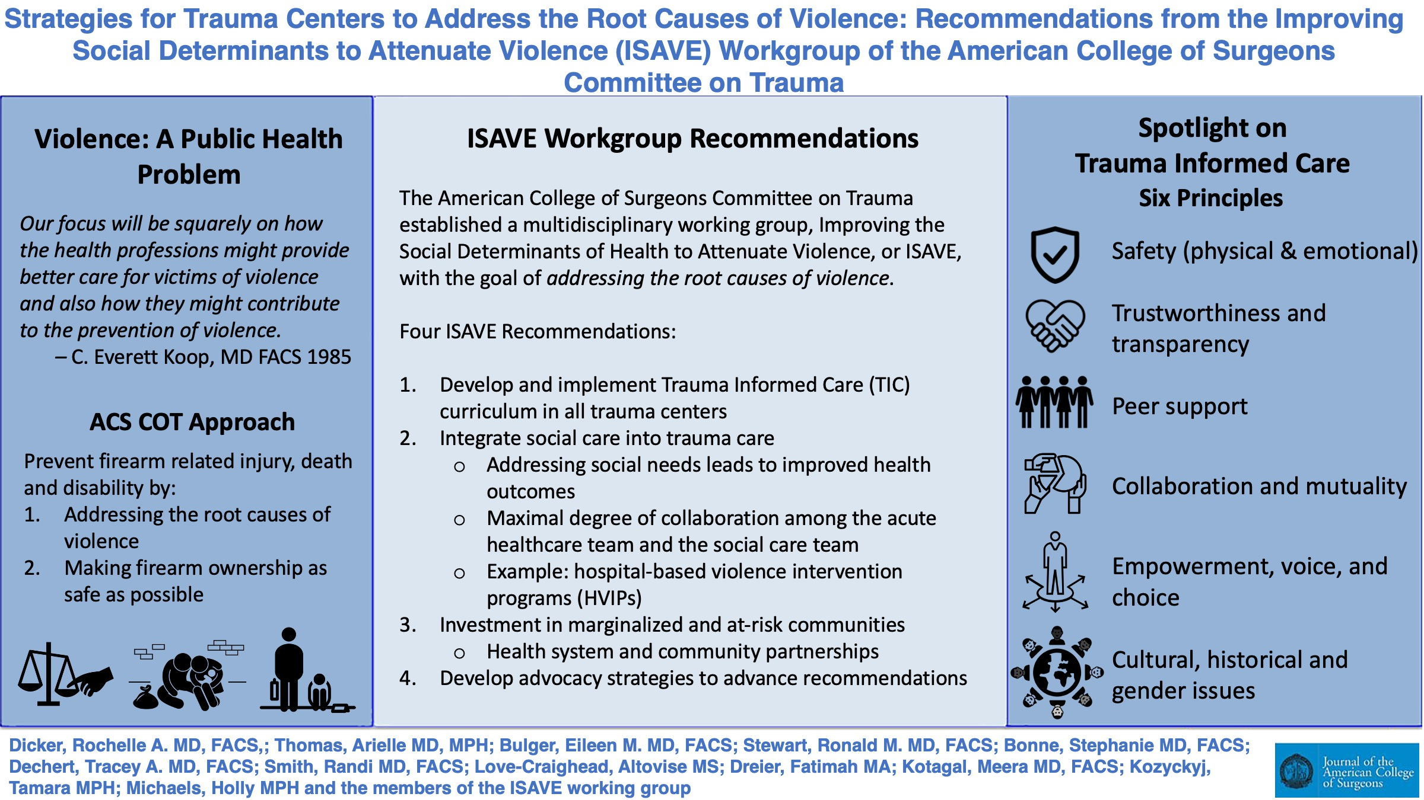
Surgery
Symphony Fletcher &
Dr. Abdullah Pratt; U of C
https://www.stopthebleed.org/training/online-course/

Slide 56
How to engage trainees in firearm injury prevention advocacy

Slide 57
What is Advocacy?
System Changing Action
Uses good information to improve health
Can occur at multiple levels
Works to make a difference in the world

Slide 58
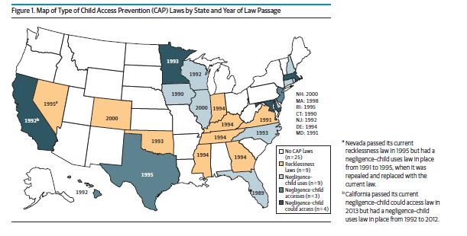
Using student research to inform policy change

Slide 59
Student Action to Prevent Firearm Violence: Blogs & Letters to the Editor

Slide 60
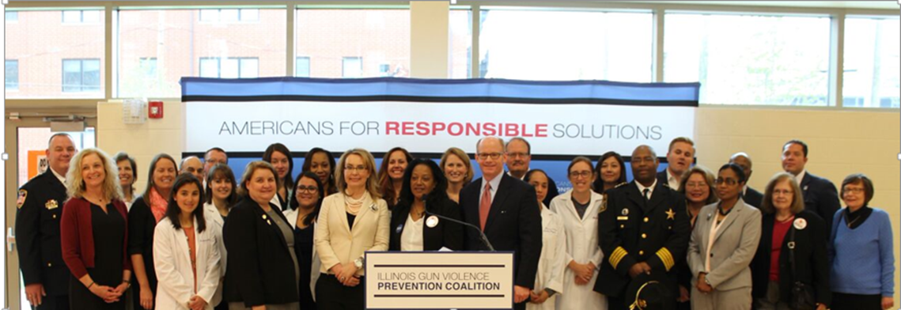
Student Action to Prevent Firearm Violence: Press Conferences

Slide 61
Why we need to teach medical students about firearm injury
Firearm injury is the leading cause of death for young people in the US
It is a health equity issue
Certain groups are disproportionately affected
Nearly every discipline has an interaction with firearm injury and their patient population
69% of 2018 pediatric residency graduates reported treating a gun injury in training.
41% treated five or more children with gun injuries and 18% treated 10 or more injuries.
Including education about firearm injury prevention can be done with minimal disruption to other content
Life expectancy is decreasing in this country and not all of the cause is due to COVID, firearms play a significant role
Firearm injury is preventable—but we need to give our students the tools to address it

Slide 62
Educating Physicians About Firearm Safety and Injury Prevention – AM Rounds (academicmedicineblog.org)
“I want to thank you all for joining the podcast today. And I want to encourage all of our listeners to visit academicmedicine.org to find the articles that we discussed today, as well as the complete collection on firearm injury prevention education. If you or your colleagues have work in this area, consider submitting it to us for peer review and publication.”
On this episode of the Academic Medicine Podcast, guests Katherine Hoops, MD, MPH, Andra Blomkalns, MD, MBA, and Allison Augustus-Wallace, PhD, MS, MNS, join host Toni Gallo to talk about firearm safety and injury prevention education.
Toni Gallo, Staff Editor

Slide 63
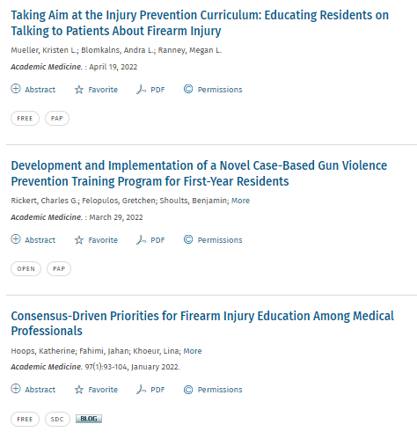
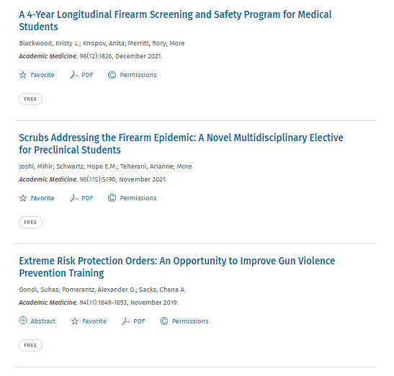
The Complete Collection

Slide 64
The Complete Collection

Slide 65
The Complete Collection

Slide 66
The Complete Collection

Slide 67
Professional Organization Resources
https://www.aap.org/en/patient-care/gun-safety-and-injury-prevention/
https://www.facs.org/quality-programs/trauma/advocacy-and-injury-prevention/firearm-injury-prevention-activities/
https://www.apa.org/topics/gun-violence-crime
https://www.acog.org/clinical-information/policy-and-position-statements/statements-of-policy/2019/gun-violence-and-safety
https://www.aafp.org/advocacy/advocacy-topics/prevention-public-health/injury-violence.html
https://education.psychiatry.org/diweb/catalog

Slide 68
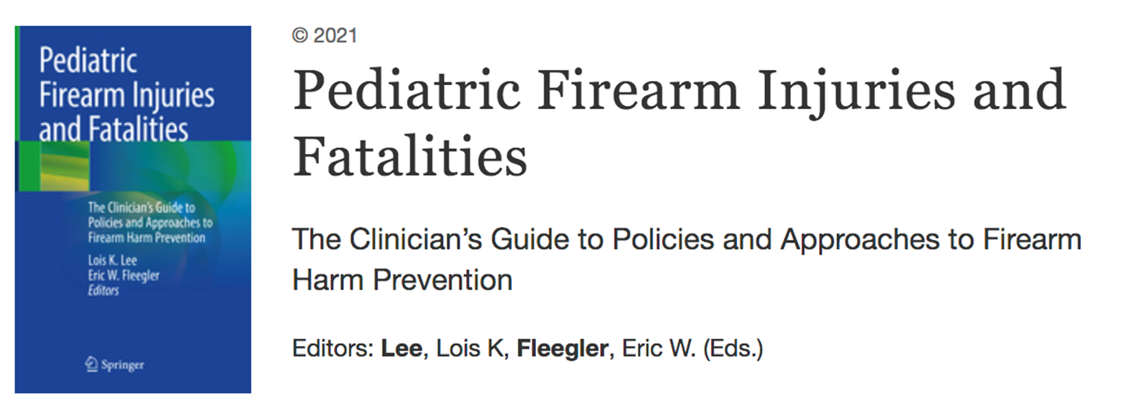

Slide 69
Thank you!
https://sdoheducation.org/

