Slide 1
Interprofessional Student Hotspotting Learning Collaborative: A Pilot Study of Proposed Goals, Achieved Interventions, and Barriers Facing Hotspotting Patient and Teams
LAUREN HERSH md, BROOKE SALZMAN md, TRACEY EARLAND PHD OTR/L, MEGAN HERSHMAN MS

Slide 2
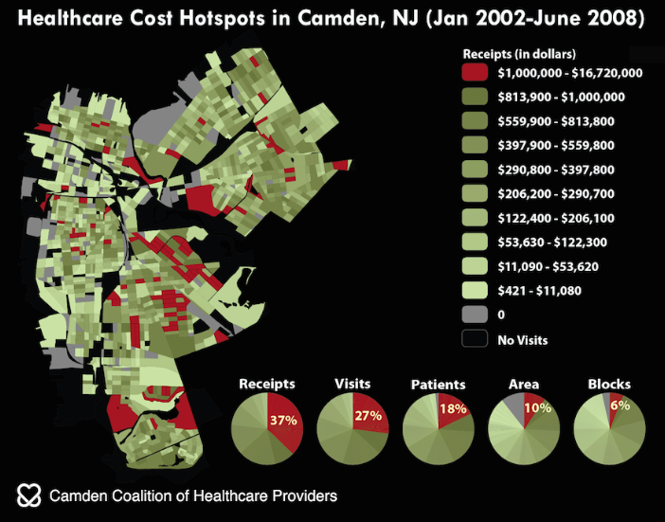
What is Hotspotting?
Hotspotting is the identification and engagement of the highest utilizing, highest cost patients whose unmet complex health and social needs land them repeatedly in emergency departments and hospitals.
Process of engaging individuals in order to better understand barriers to health and address root causes of high utilization.

Slide 3
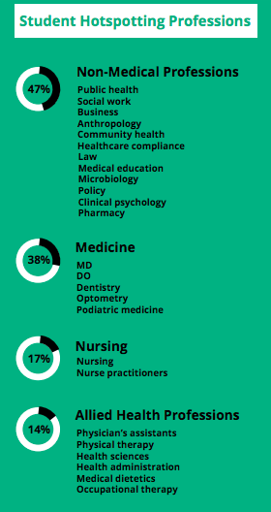
What is Student Hotspotting (SH)
Six-month program that trains interprofessional teams of students to embrace a person-centered approach while working with patients carrying complex medical and social needs.
Curriculum provides education, support, and mentorship to teams as they connect with patients, learn about root causes of high healthcare utilization, support patient-driven pursuits in wellness, and share experiences with their institutions.
Students utilize insight / skill from their professional backgrounds but NOT providing healthcare
Ethics
Roles and responsibilities
Teams / Teamwork
Interprofessional communication

Slide 4
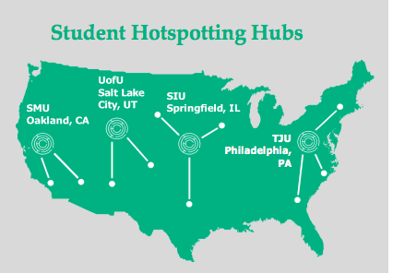
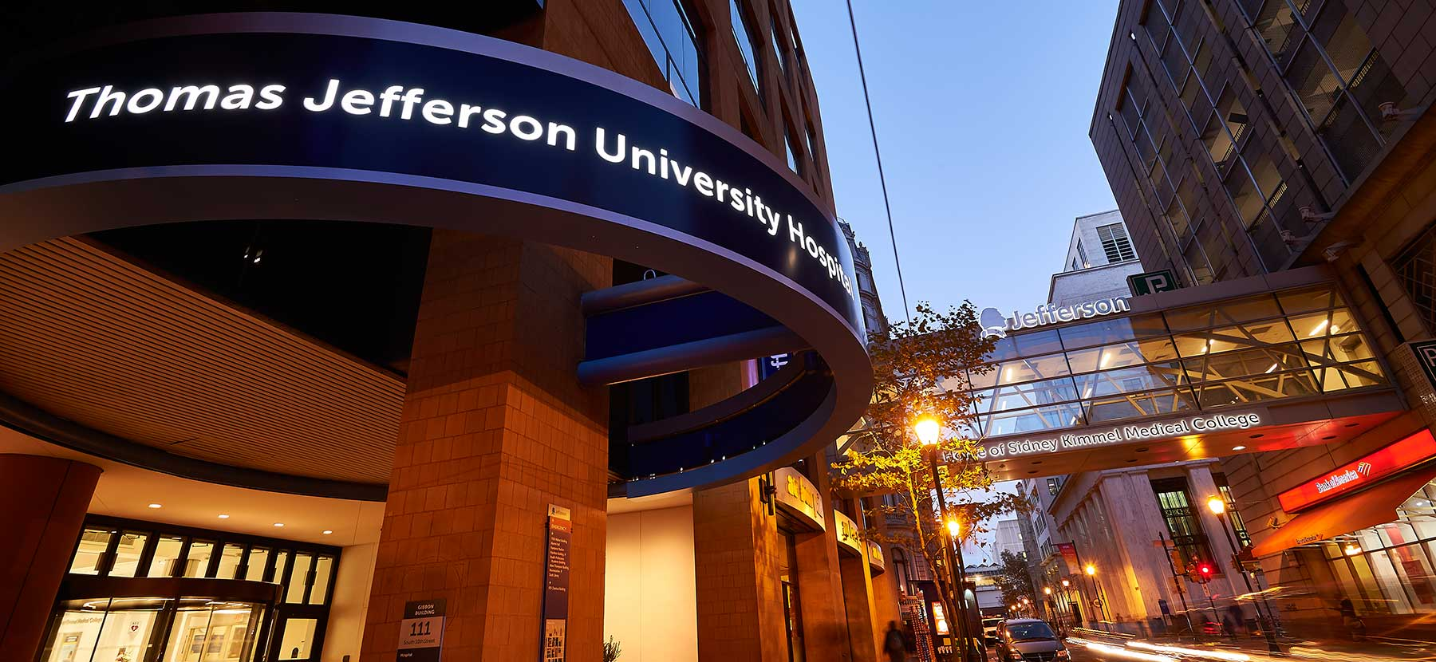
Student Hotspotting at Jefferson
2014: 1 of 10 teams across the nation to participate in the first Student Hotspotting cohort
2017: Recognized as 1 of 4 national “hotspotting hubs”
2020: Reached an annual critical mass of nearly 50 interprofessional healthcare students from seven professions

Slide 5
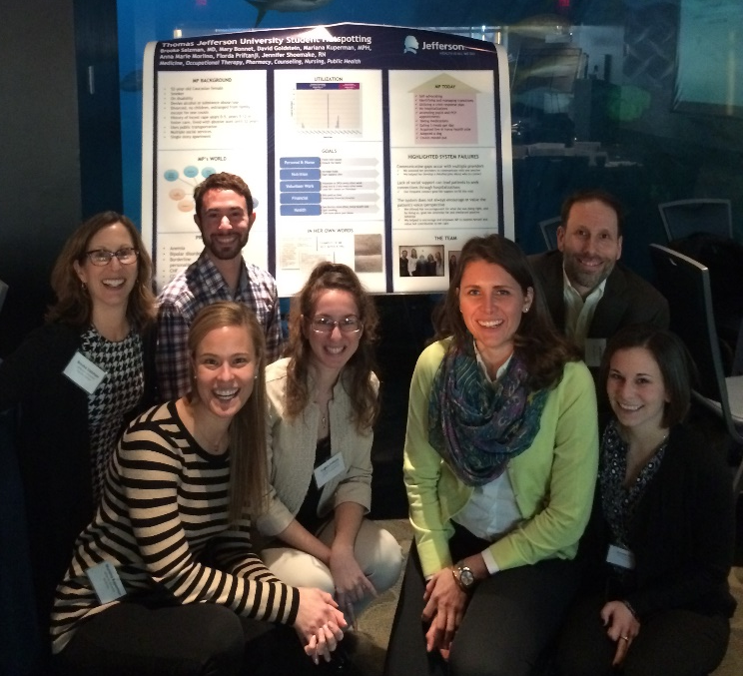
Jefferson Student Hotspotting: Capstone Project
Each student team creates a capstone poster, which highlights their experiences with their patient, navigating through healthcare systems and community resources, as well as the Hotspotting Program.
Through the work of independent reviewers, we reviewed all posters from 2014 - 2020 and identified major themes related to (1) patient goals, (2) team interventions, and (3) barriers to intervention implementation.
This study provides a first glimpse into the work and outcomes associated with a Student Hotspotting Program.

Slide 6
Capstone Project Quantitative Results
N =
31 patients

Slide 7
Prevalence of Common Medical and Mental Health Diagnoses within Study Population

Slide 8
Reported Patient Goals

Slide 9
Hotspotting Team Interventions

Slide 10
Sub-Categorical Breakdown Navigating Healthcare System
NAVIGATING HEALTHCARE SYSTEM | Teams Reporting
Appointment accompaniment | 19%
Improve ability to schedule and keep appointments | 19%
Establish/develop relationship with PCP | 15%
Facilitate communication between healthcare providers | 12%
Connect with referrals in health care system | 12%
Create emergency or crisis plan response | 8%
Patient education regarding accessing appropriate levels of care (ER versus PCP) | 8%
Navigate healthcare system | 4%
Facilitate communication between patient and healthcare providers | 4%

Slide 11
Team-Based Barriers in Achieving Hotspotting Goals

Slide 12
Patient-based Barriers to Achieving Hotspotting Goals

Slide 13
Lessons Learned / Next Steps
Recognition of powerful work and resiliency brought about by Student Hotspotting – both for patients, learners, and teams
Facilitated linkages with community resources and services targeting commonly identified goals and barriers
Reinforced curriculum objectives to ensure that goals are derived from patients in collaboration with the team – but not by the team
Catalyzed refinement of documentation standards to better track patient demographics, patient goals, barriers to care, and interventions

Slide 14
Questions???

