Slide 1
Voting is Healthy: Grady Hospital’s Voter Engagement Campaign
Hannah Marcovitch M2 & Eudora Olsen M2
Emory University School of Medicine

Slide 2
Disclaimers
Neither of us has any actual or potential conflicts of interest in relation to this presentation.

Slide 3
Background: Effect of Policy on Health
Social determinants of health lead to health disparities
Policy interventions aimed at education, urban planning, housing, income, employment, and healthcare improve health outcomes more effectively than interventions limited to the healthcare sector^{1,2}
Despite the direct impact policies have on patients and the community, physicians consistently vote at lower rates than the general population³
1. McCartney G, Hearty W, Arnot J, Popham F, Cumbers A, McMaster R. Impact of Political Economy on Population Health: A Systematic Review of Reviews. Am J Public Health. 2019;109(6):e1-e12. doi:10.2105/AJPH.2019.305001
2. Thornton RL, Glover CM, Cené CW, Glik DC, Henderson JA, Williams DR. Evaluating Strategies For Reducing Health Disparities By Addressing The Social Determinants Of Health. Health Aff (Millwood). 2016;35(8):1416-1423. doi:10.1377/hlthaff.2015.1357
3. Grande D, Asch DA, Armstrong K. Do doctors vote?. J Gen Intern Med. 2007;22(5):585-589. doi:10.1007/s11606-007-0105-8

Slide 4
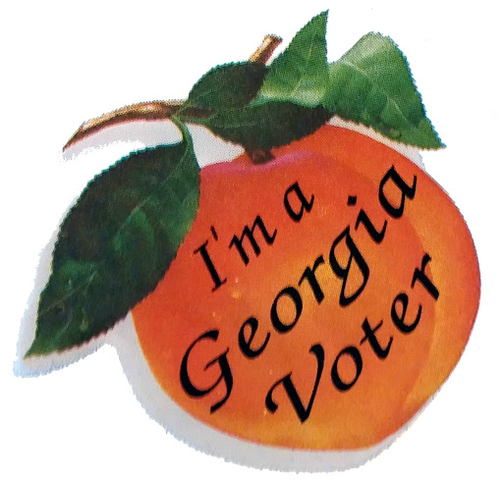
Background: Georgia voting landscape
2010-2018: 1.6 mil voters were purged from voter rolls
2018: >53,000 voter registrations held in “pending” status and >100,000 votes went “missing,” 80% of which were registrations from people of color⁴
These same disenfranchised voters disproportionately suffer health disparities^{1, 5}
4. Why We Fight. Fair Fight website. Accessed August 20, 2020. https://fairfight.com/why-we-fight/.
5. Yagoda N. Addressing Health Disparities Through Voter Engagement. Ann Fam Med. 2019;17(5):459-461. doi:10.1370/afm.2441

Slide 5
Background: Barriers to voting
Voting Rights Act
Required Federal Oversight of Election Changes
Affected 9 states (mostly in the south)
Gutted by 2013 Supreme Court ruling, leading to:
Voter ID Laws
Precinct/Polling Changes
Early Voting/Registration Restrictions
Gerrymandered Districts

Slide 6
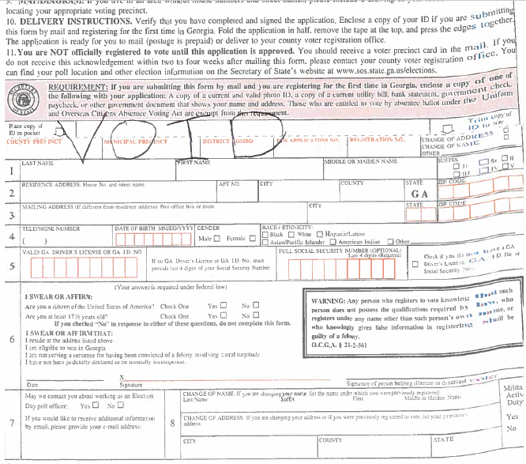
Background: Barriers to voting
Registration Barriers
Institutional Barriers
Personal Barriers

Slide 7
Background: Unique Circumstances of 2020
COVID-19
Economy
Widespread Black Lives Matter protests

Slide 8
Methods
Goal: To increase voter registration among Grady staff and patients
Interdisciplinary, multi-institutional team met weekly and designed a campaign to increase voter registration at Grady
Collaborated with Georgia Equality, a member group of the non-partisan organization Pro Georgia

Slide 9
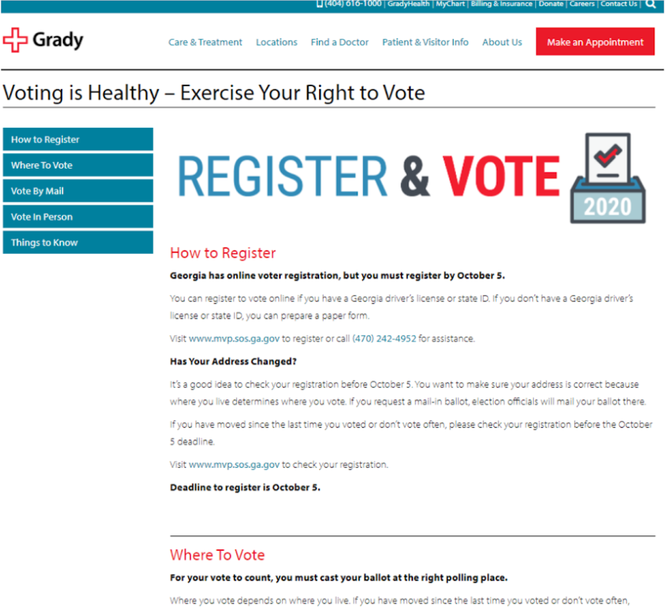
Voter Landing Page

Slide 10
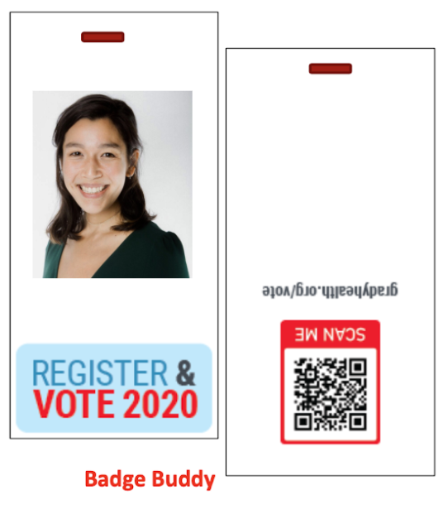
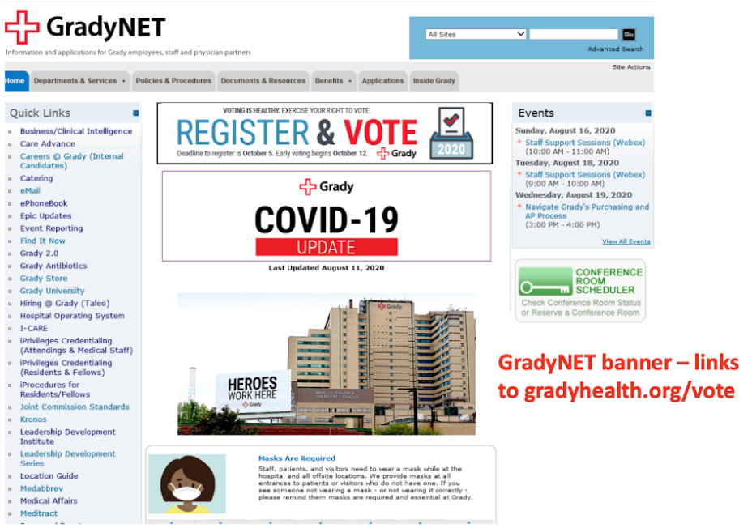
Internal - for Medical Staff and Employees

Slide 11
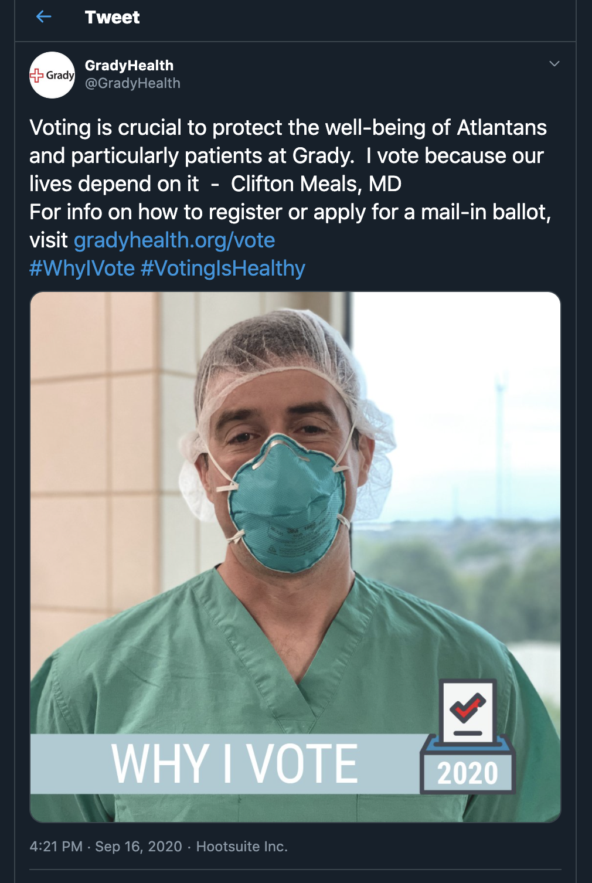
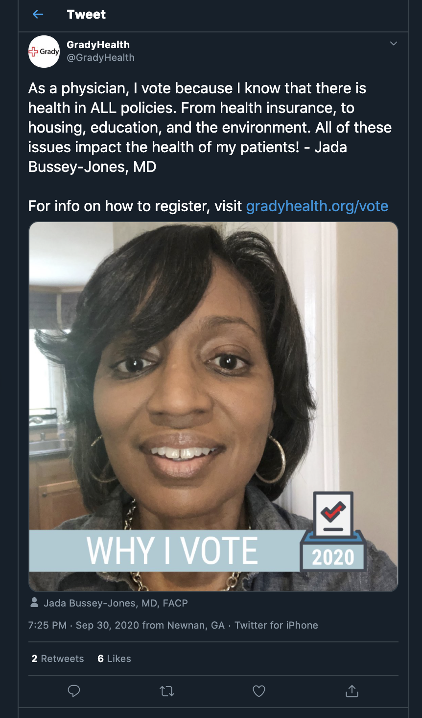
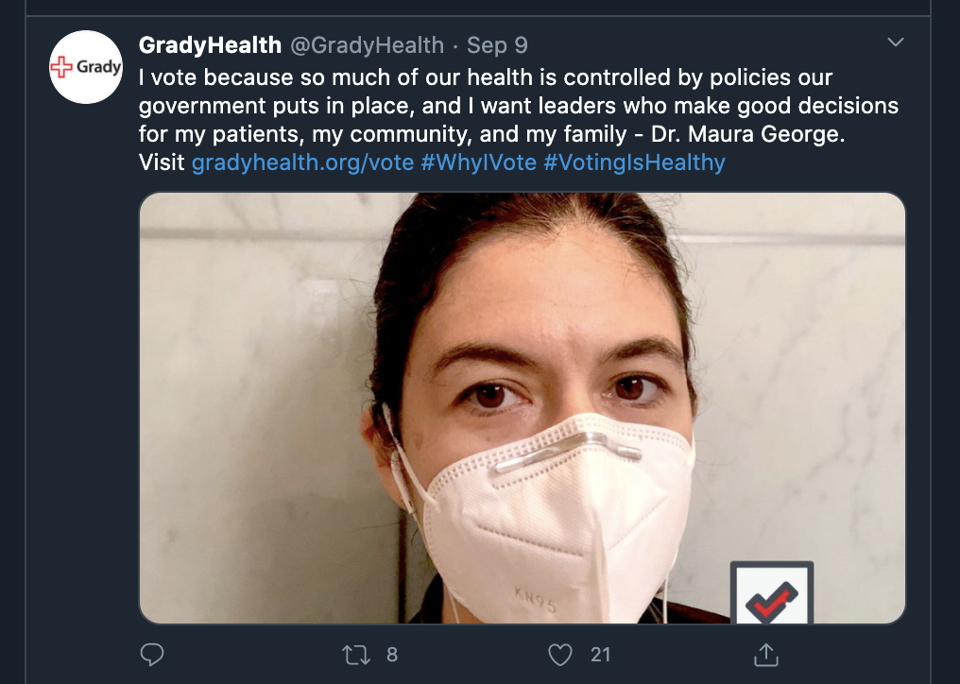
Social Media

Slide 12
Banners & Posters

Slide 13
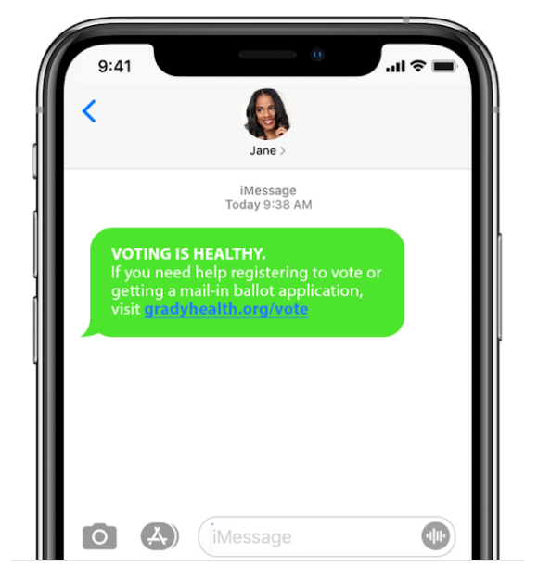
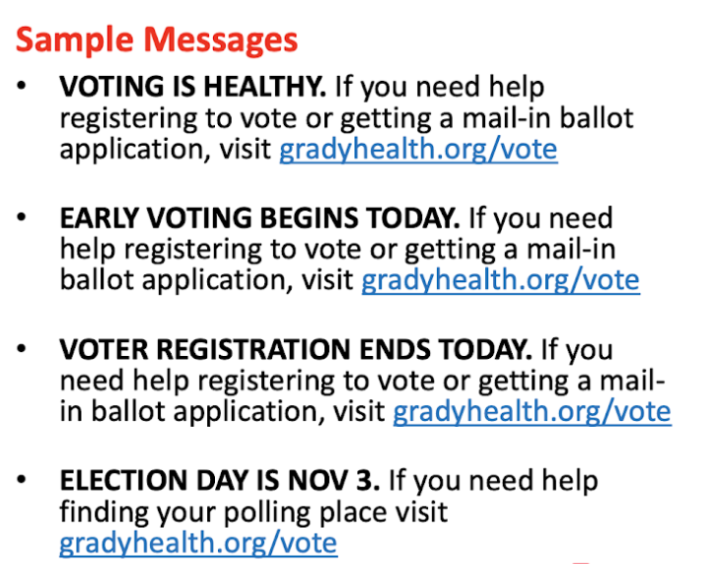
Text Messages

Slide 14
Conclusion
Grady’s Voting is Healthy Campaign mobilized to deliver several effective materials to increase voter support at Grady
We were able to foster interdisciplinary action and advocacy to produce these low-cost and high-yield voter materials
Given the proven association between public policy and population health, this voting campaign should be replicated in future elections to increase voter registration and civic engagement at Grady Hospital and other major urban hospitals

Slide 15
Acknowledgments
Shannon Clawson - Georgia Equality
Lindsay Caulfield, Leigh Reece, Sean O’Connor - Grady Marketing Team
Matt Hicks, Ines Owens - Grady Government Affairs
Onyi Okwandu Ezeike - Sr. Clinical Business Manager
Raha Sadjadi, MD, Aadil Vora, MD, Gwanyalla Nguedab, MD - Residents
Clifton Meals, MD - Team Lead
Maura George, MD - Advisor

Slide 16
Contact Information
Hannah Marcovitch: hannah.marcovitch@emory.edu
Eudora Olsen: eudora.olsen@emory.edu

