Slide 1
Understanding and Applying the Science at the Intersection of Racism, Trauma and Health Disparities NCEAS February 24, 2021
The Center for Collaborative Study of Trauma, Health Equity & Neurobiology
Audrey Stillerman, MD
Patricia Rush, MD MBA
Loren Williams, EdD LCPC – Advisor to THEN
Notes:
Good afternoon and thanks for joining us. We are representing the Center for Collaborative Study of Trauma, Health Equity and Neurobiology (THEN Center) Today we’re going to share an abbreviated core lesson from our curriculum to guide us in applying the science at the intersection of racism, trauma and health disparities.

Slide 2
DISCLOSURE
Speakers have No Commercial Interests and No Conflicts of Interest

Slide 3
Understanding Health Disparity requires confronting Racial Trauma and all discrimination-oppression
Racism and Discrimination are Trauma
Model of Brain-Body Regulation to understand Health Disparity and provide effective solutions
Notes:
Need to make a pitch about how EXCITING and o this new model is
And how it will help us
As patients
- as clinicians
Requires learning new Concepts
But will pay off

Slide 4
Notice of Traumatic Content
Trauma is personal for everyone.
This lecture includes discussion of
Childhood Neglect - Deprivation and Abuse
And the impact of Racial Trauma and Discrimination.
This content may be disturbing.
We invite you to visit www.thencenter.org sections on Secondary Trauma and suggestions for Self Care.
Notes:
If you need to take a break at any point in the presentation, please do.

Slide 5
COVID
Notes:
The number of problems we face can seem overwhelming! Could these seemingly separate problems be connected to each other?
Is part of the PROBLEM our current MODEL of Health?

Slide 6
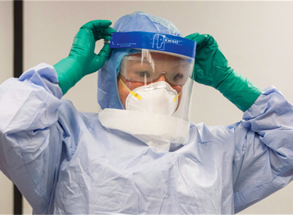
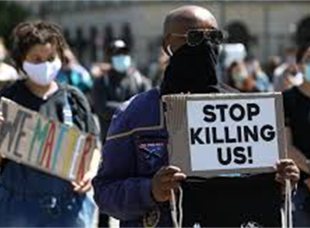
Racial Trauma / Discrimination
The confluence of a global pandemic disproportionately ravaging certain communities and highly visible police brutality
has made it IMPOSSIBLE for us to ignore the realities of centuries of oppression and marginalization of BIPOC

Slide 7
Inequities in Health:
Intensified by Intersectionality
Race
Gender
Immigrant Status
Economic Status
Notes:
Inequities in health are unfairly connected to a person’s race, gender, sexual orientation, immigrant and economic status and more. Race is a social construct rather than a biological or genetic reality.
Racial categories have been used as weak proxies for genetic diversity—a concept too crude to provide meaningful information in any realm.
Many people indentify with social categorizations applying to multiple different groups and are injured by overlapping and interdependent, or intersectional, systems of discrimination or disadvantage
between Africa and Europe, for example, there is not a single absolute genetic difference, meaning no single variant where all Africans have one variant and all Europeans another one, even when recent migration is disregarded," Pääbo told Live Science. "It is all a question of differences in how frequent different variants are on different continents and in different regions.“https://www.scientificamerican.com/article/race-is-a-social-construct-scientists-argue/

Slide 8
Health Inequity
Unequal Treatment (by healthcare system)
Lack of respect and access to diagnosis and treatment
Delay in assessment and care
AND
2. Traumatic Life Experience
Severe adversity, poverty, neglect
Trauma/abuse, loss of parent, incarceration
Discrimination = Toxic Experience >> Disrupts Regulation
Notes:
There is growing awareness that Health Inequity is not only the result of unequal treatment by the health care system as a result of lack of respect, limited access to diagnosis and treatment BUT ALSO the result of the toxic experiences of disrimination, trauma and neglect which dysregulate the brain-body systems

Slide 9
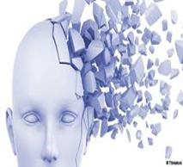
Racial Trauma - Disrupter of Regulation
Trauma
Any event that threatens or harms us or people we care about or events we witness
Demands that Overwhelm Our Resources
Impairment of multiple dimensions of our being over time
Notes:
This definition of allows us to see clearly how racism and all forms of disrimination/oppression are traumatic experiences

Slide 10
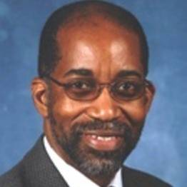
Everyday Discrimination – a Major Trauma David Williams, PhD, MPH - Harvard
Questionnaire re Everyday Discrimination
In your day-to-day life, how often do these things happen to you?
What do you think was the main reason for these experiences?
Treated with less courtesy or respect? Receive poorer service?
You are called names or insulted?
You are threatened or harassed?
People act as if you’re not smart
People act as if they are afraid of you
People act as if you’re not honest or that they are better than you
Notes:
Researchers have developed measurement tools of perceived discrimination and racial traumatic stress. Here is an example of the Everyday Discrimination Questionnaire. Others are developing tools to measure anti-racism and other anti-ism policies, practices and outcomes.

Slide 11
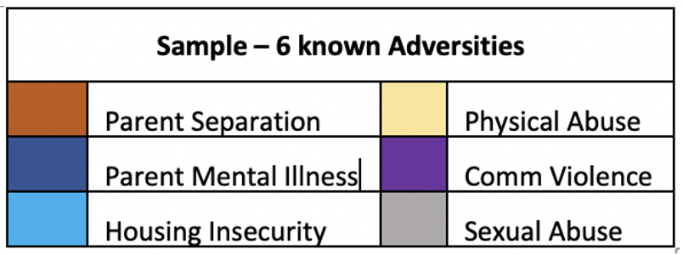
Racial Trauma Impact on Cumulative Adversity
Notes:
Racial trauma adds another layer of injustice and pain to many people’s already full plate of adversity increasing the intensity of suffering.

Slide 12
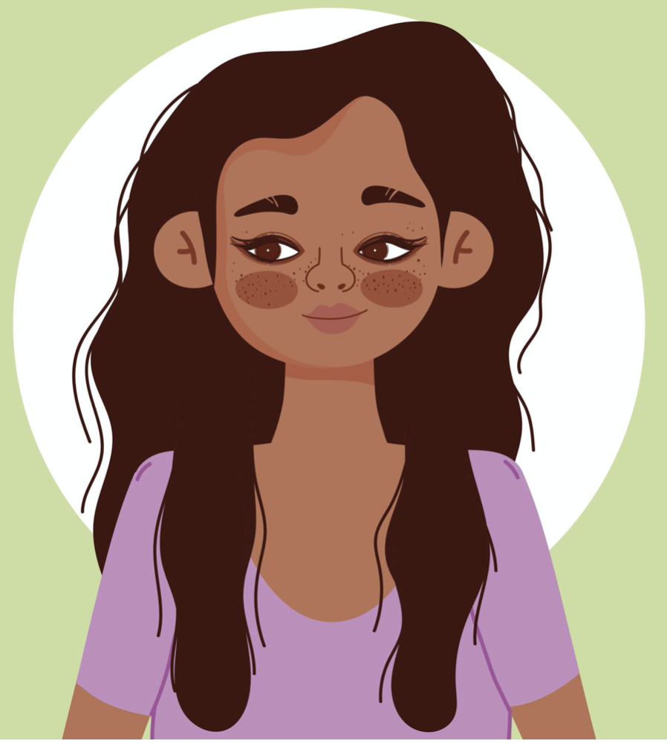
Multiple Studies Demonstrate: Experience of Discrimination
plays Key Role in Pathogenesis
Low Birth Weight
Maternal Death
Cancer
Emotional
PTSD
Depression
Vascular Disease
Stroke
Heart Disease
Kidney Failure
Autoimmune Dz
Sleep problems
Obesity

Slide 13
Complex, Longstanding Problems Require New Ways of Thinking
A comprehensive model based on the rigorous Science of Brain-Body Regulation is key to:
promote health,
prevent & treat disease,
achieve Health Equity
dismantle Systemic Discrimination- Racism
Notes:
Complex, long-standing problems like racism and health inequity require new ways of thinking. Basic science research supports the idea that a comprehensive approach based on the rigorous science of Brain Body Regulation is key to...

Slide 14
THEN Venn Diagram + more intro of us
Notes:
In 2017, we and 2 other healthcare leaders formed THEN
The Center for Collaborative Study of Trauma, Health Equity, and Neurobiology
Our mission is to:
Build a multidisciplinary community of trainees, faculty and activists
Offer FREE science education based on this rigorous research
Inspire the creation of an expanded medical model focused around neurophysiology, human development and Brain-Body regulation

Slide 15
Notes:
Please meet our Advisory Board.
clinicians
researchers
educators
and advocates

Slide 16
Model of
Brain-Body Regulation
to understand
Health Disparity
and provide
effective solutions
Notes:
Let’s explore how we can use a model of Brain Body Regulation to understand...

Slide 17
What is Regulation?
Ability of brain-body to maintain a stable internal environment - despite ordinary and extraordinary challenges.
Brain-body stability requires
Continuous SENSING of internal & external conditions
RESPONDING (adjusting) to keep brain-body in desirable zone
Notes:
We can identify brain-body regulation in daily life in our ability to awaken refreshed, digest and eliminate our food, concentrate remember and learn, have positive relationships with ourselves and others, resolve conflicts and sleep restoratively for 6-8 hours.

Slide 18
Experience and Brain-Body Regulation
Positive - Tolerable
Toxic
Predictable
Moderate
Controlled
Matches abilities
Regulation - Resilience
Unpredictable
Severe or Frequent
Uncontrolled
Overwhelms abilities
Dysregulation - Vulnerability
Notes:
We can characterize experiences to help as understand their impact. Read slide.
All of our experiences, positive, negative and neutral, enter the body-mind through the senses and are sent to the brain for processing, interpretation, and responsive action . In response to Experience, the brain adjusts its signals – throughout the brain & to other systems.
The brain has deep and connections to the Endocrine, Immune and all other body systems.
The coordination and synchronization of these systems is the core of REGULATION
The brain and Autonomic Nervous System send hormonal and other chemical signals to the Endocrine, Immune & other systems and the body systems also send signals back to the Brain.
When the brain-body is exposed to toxic experiences, there is “wear and tear on the body" referred to as allostatic load or weathering,which accumulates over time when positive experiences are insufficient.
Under the burden of toxic stress from experiences like racism and poverty, the Brain is unable to “settle or calm” and continues to send dysregulated signals to the immune and endocrine systems impairing their optimal functioning.
Being stuck in a dysregulated state can result in sleep disruption and eventually the inflammation which drives many diseases, including hypertension, heart disease, cancer, and autoimmune disease.
Lack of brain regulation is also seen as a major factor in Mental Suffering and Behavioral and relational Challenges

Slide 19
Experiences that support Brain-Body Regulation
Inborn Regulation
Regulatory Activities
SLEEP
Daily Routine
Movement-Exercise
Relationships especially Parent-Child
Sports
Expressive Arts
Mindfulness
Yoga
Fun - Play
Notes:
Sufficient resources to meet our physiologic needs like food, housing, safe neighborhoods, etc, support brain-body regulation
There are also many activities that support brain body regulation.
Child Psychiatrist Dr Bruce Perry identifies 6 common characteristics of regulatory activities,
Regulatory activities are rhythmic, repetitive, relational, rewarding, match current development and are respectful of the culture of the individual and their community.
In born regulatory processes and regulatory activities work best when we engage in them often, that is in the right DOSE for us.

Slide 20
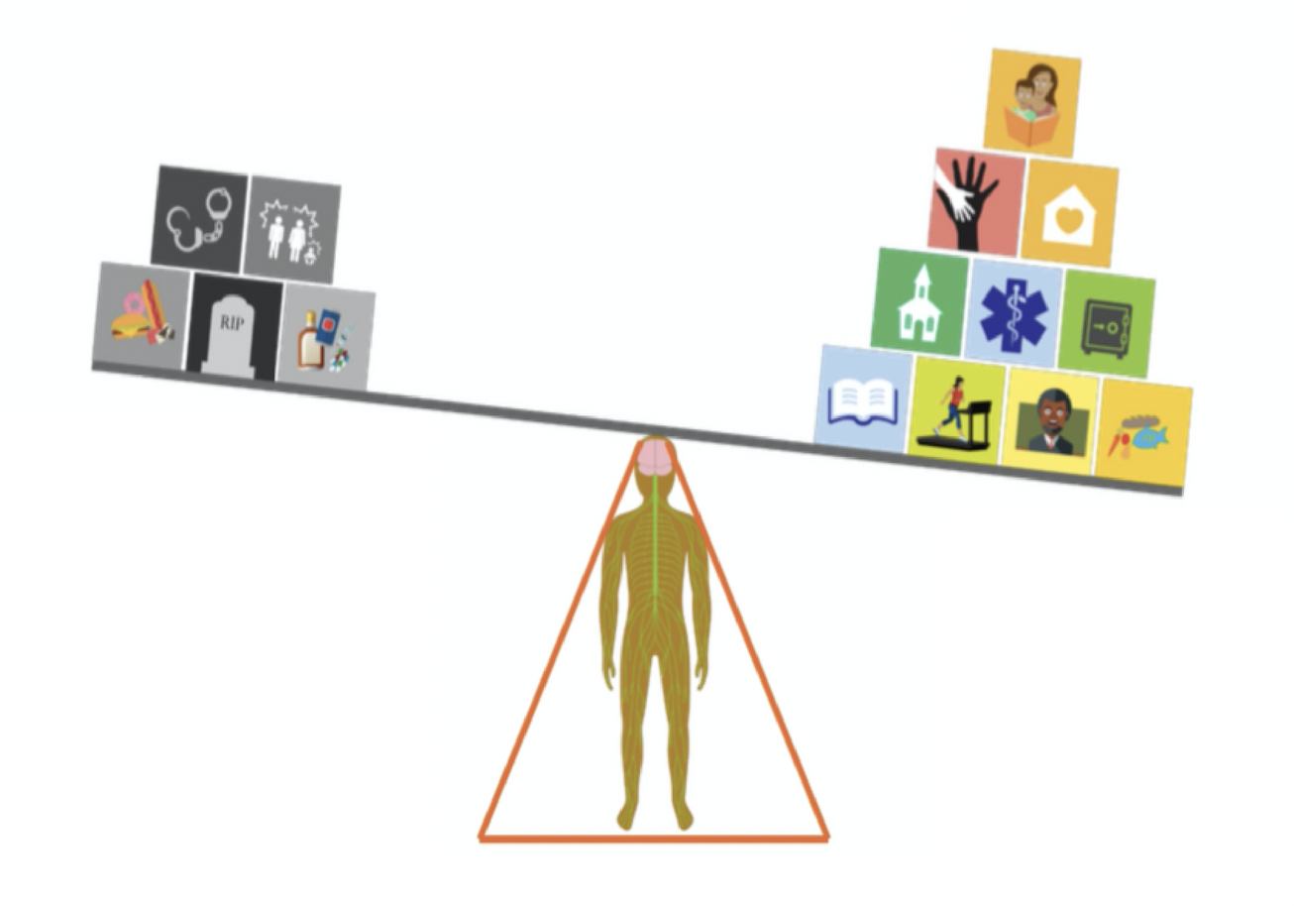
Experience: it all counts!
Stressors: * Lack of safety-security
food, housing, violence
* Racial Trauma, Discrimination
* Childhood Neglect-Abuse with dysregulated Brain Networks
Supports: * Security-safety-justice food, housing, schools, family income * People you can count on
* Healthcare you trust
Notes:
Each person has a complex combination of experiences and they all matter although the ones that have the most impact are those that happen earliest in our lives.
All of our experiences, positive, negative and neutral, enter the body-mind through the senses and are sent to the brain for processing, interpretation, and responsive action . In response to Experience, the brain adjusts its signals – throughout the brain & to other systems.
The brain has deep and connections to the Endocrine, Immune and all other body systems.
The coordination and synchronization of these systems is the core of REGULATION
The brain and Autonomic Nervous System send hormonal and other chemical signals to the Endocrine, Immune & other systems and the body systems also send signals back to the Brain.
When the brain-body is exposed to toxic experiences, there is “wear and tear on the body" referred to as allostatic load or weathering,which accumulates over time when positive experiences are insufficient.
Under the burden of toxic stress from experiences like racism and poverty, the Brain is unable to “settle or calm” and continues to send dysregulated signals to the immune and endocrine systems impairing their optimal functioning.
Being stuck in a dysregulated state can result in sleep disruption and eventually the inflammation which drives many diseases, including hypertension, heart disease, cancer, and autoimmune disease.
Lack of brain regulation is also seen as a major factor in Mental Suffering and Behavioral and relational Challenges
In this example, the Scale is tipping toward the positive, ie, this person has had more positive than adverse experiences.
Although Everybody has a genetic map and is born at a certain time in history-culture
the experiences we have matter most

Slide 21
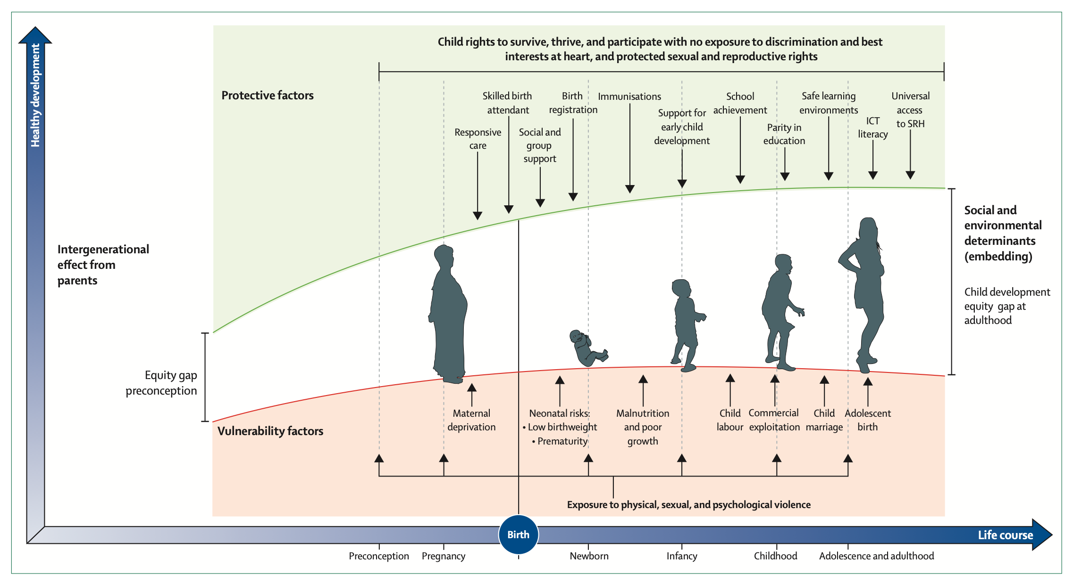
Clark H, et al. (Lancet 2020) A Future for the World’s Children?
Notes:
This slide shows to trajectories of health, one for a person privileged to have their basic needs met and access to health care, education and other social influences of health. It highlights the intergenerational impact of deprivation and trauma beginning with maternal experiences preconception and resulting in increasing disparities across the life span and into the next generation

Slide 22
Notes:
Although all traumatic experience deserves acknowledgement, we want to emphasize again that an important source of TRAUMA remains unrecognized by most of Medical Science
And that is RACIAL TRAUMA and OPPRESSION
All forms of Discrimination are a particularly severe and cruel Trauma
Creating a feeling of inescapable fear and disrupting brain-body regulaton.
What can we do to help HEAL this Trauma?
first we must acknowledge that the Traumatic Experience happened
Next we must support people to positively rewrite their narrative
And work to eliminate all forms of discrimination, racism and oppression
with creation of safety, dignity and respect

Slide 23
It is Time for Courageous Action In Meidicine and Our Communities
PRIMARY PREVENTION is the key!
* Eliminate ROOT causes * Provide REAL support for ALL families
* Offer universal access to healing resources to prevent and treat trauma
* Continued EXCELLENCE for ALL in Medical Care & Human Services
Notes:
Dismantle the structures of racism and every form of discrimination to improve health for all!

Slide 24
Discussion Agenda
Reflective Practice
Q & A
Regulatory Activity
Case
Notes:
We’re going to take you through a mini version of activities we include in our lessons. Please get paper and something to write with and we’ll begin with 3 minutes of reflective practice. Write or draw thoughts, feelings, questions and comments that arose during the presentations and then we’ll reconvene and share. Starting the timer now.
Q and A 5 minutes
Now we’ll do a 2 minute regulatory practice that is easy to do during your day and to teach to patients, clients and family.
Last, let’s discuss a case using our model of brain-body regulation.

Slide 25
SAMPLE CASE: Karen, age 54
Karen brought to ER for shortness of breath Severe Asthma - placed on Ventilator (3rd ICU hospitalization in past year)
Also has HTN (age 30), Heart Disease (age 48), Depression (since her 30’s - untreated)
Lives alone, disabled on Medicaid
Recovers from acute asthma attack and goes home on 12 daily meds
Karen is a real case, name & details changed to protect anonymity
Notes:
Ask: What factors may have contributed to the onset of multiple severe chronic illnesses at a young age?

Slide 26
SAMPLE CASE: Karen - Life Course
What happened here to change Karen’s Brain-Body Regulation?
Notes:
Entering Karen’s problem list into a life course chart prompts us to wonder, What happened prior to the onset of karen’s medical problems to disrupt Karen’s Brain-Body regulation?

Slide 27
CASE: More History
Primary Care Doc and Karen talk about SLEEP - Hasn’t slept well in years, “maybe my whole life” - Neighborhood violence, hears gunshots
When Karen was ready and asthma was stable, discussed her childhood experience - Grew up in inner city - 6+ childhood adversities

Slide 28
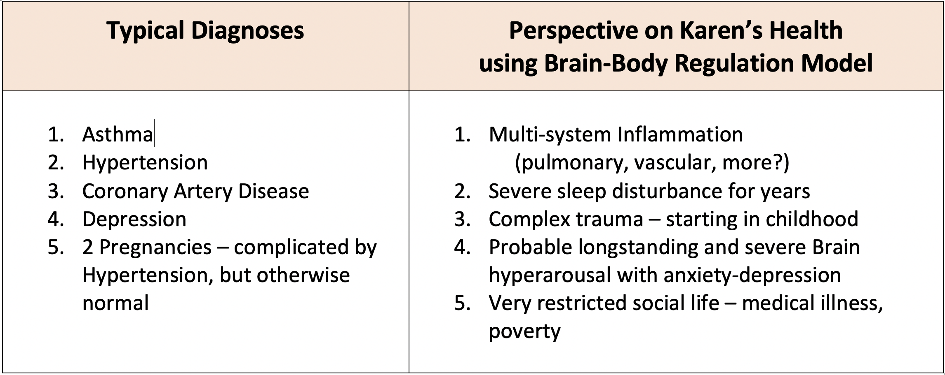
CASE: Karen - Different Look at Diagnoses

Slide 29
Karen - a new Crisis
After being stable for 2+ years, Karen rehospitalized with asthma >> back to ICU
What happened?
Daughter homeless after house fire
DCFS places grandchildren in foster care
Karen very angry - feels DCFS judged wrongly daughter as “unfit mother” because she is Black
Could experience of injustice upset Brain-Body? What is our response?

Slide 30
Thank
You!
Dr Patricia Rush
Dr Audrey Stillerman
Dr Loren Williams
info@thencenter.org
www.thencenter.org

