Slide 1
Accelerating a Social Mission Research Agenda
Clese Erikson, M.P.Aff & Margaret Ziemann, mph
The Fitzhugh mullan institute for health workforce equity the George Washington university

Slide 2
Acknowledgements
This project was supported by the Bureau of Health Workforce (BHW), National Center for Health Workforce Analysis (NCHWA), Health Resources and Services Administration (HRSA) of the U.S. Department of Health and Human Services (HHS) as part of an award totaling $450,000, with zero percent financed with non-governmental sources. The contents are those of the author[s] and do not necessarily represent the official views of, nor an endorsement by HRSA, HHS, or the U.S. Government.
Special thanks to Noah Westfall for his research support

Slide 3
Workshop Agenda
PART I
Introduction to ‘Social Mission’
Overview of the SDoH research landscape in health professions education
Presentation of roadmap for advancing social mission research
PART II
Breakout groups
SDoH research: opportunities & challenges
Stakeholder analysis

Slide 4
Fitzhugh Mullan Institute for Health Workforce Equity
Vision: a world in which a diverse health workforce has the competencies, opportunities, and courage to ensure everyone can achieve their full health potential
WHO ENTERS THE HEALTH WORKFORCE?
HOW THEY ARE TRAINED​?
WHERE DO THEY WORK?
WHOM THEY SERVE?
HOW THEY PRACTICE?
UNDER WHAT WORK CONDITIONS?

Slide 5
What do We Mean by Social Mission?
“The social mission of a health professions school is the contribution of the school in its mission, programs, and the performance of its graduates, faculty and leadership in advancing health equity and addressing the health disparities of the society in which it exists.”
Diverse Workforce | “High need” Practice | Training to address societal needs

Slide 6
Training to Address Societal Needs
“The biomedical model, focused on identifying and treating disease, is the prevailing framework taught in most medical schools. Little emphasis has been placed on the magnitude that environment, background, and resources ultimately has on health. Addressing SDoH begins with educating current and future healthcare professionals on the ways that social factors impact health.” - Advisory Committee on Training in Primary Care Medicine and Dentistry, 2016

Slide 7
Social Mission Research
Research that is focused on health professions training programs' contribution to advancing health equity and addressing health disparities.
Narrative review of peer-reviewed & grey lit in medicine, nursing, dentistry
Included terms to capture SDoH training:
Based on search strings in published reviews
SDoH related concepts included
“Health (in)equity”
“Health disparities”
“Cultural competence”

Slide 8
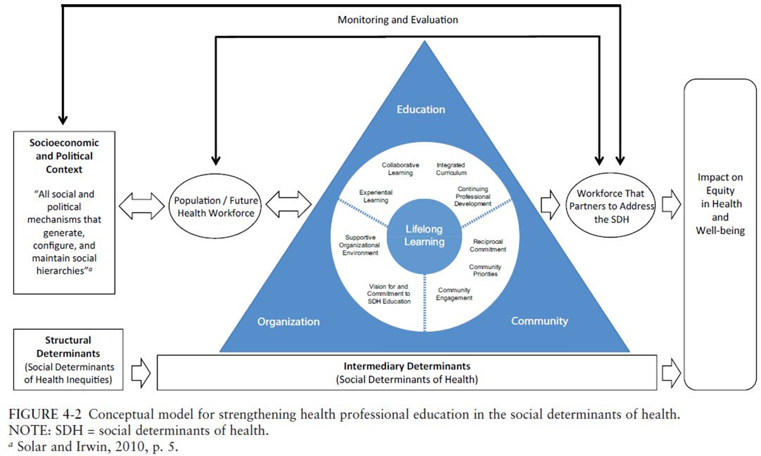
EXISTING EVIDENCE BASE
RESEARCH GAP

Slide 9
Where are the gaps?
What is remarkable about the findings of this review is how varied these programs were and how few of their evaluations looked beyond learning outcomes. In addition, the vast majority of the programs relied on self-reported information from the learners themselves. While interesting, these reported findings do not help determine whether the educational intervention or activity impacted the social determinants of health, improved the health or well-being of the community, or should be considered for diffusion to scale up. Most of the published work in this area is either descriptive or emphasizes learning outcomes of uniprofessional education.
Image credit: Siren, UCSF Key Questions for Improving Social Needs Intervention Research
– The National Academies, Educating Health Professionals to Address the Social Determinants of Health: Appendix A

Slide 10
What’s Driving SDoH Research Gaps?
Ill-Defined scope
Methodological Challenges
Data Limitations
Funding
Time

Slide 11
If Not Now, When??
Health disparities and social inequities exacerbated by COVID
Systemic Racism
Shift to value-based care…
…must prepare future health workforce to address social needs

Slide 12
Roadmap for Advancing SM Research
BUILD A FOUNDATION
STRATEGIC PARTNERSHIPS
STRENGTHEN DATA & METHODS

Slide 13
Build a Foundation
Build and organize research community
Build consensus based theoretical framework
Development of a social mission research agenda

Slide 14
Strengthen Data and Methods
Make more data readily available to researchers
Increase use of National Provider Identifiers (NPIs)
Increase access to validated research instruments
Identify robust set of outcome measures
Advance methods

Slide 15
Data Sharing Example

Slide 16
Engaging Partners
Key Stakeholders
Can contribute
Community-building body
Health professions training programs
Academic research community​
Professional associations​
Health systems​
Government​
Foundations​
Organizational support and focus
Community building
Data
Funding support
Research expertise

Slide 17
Group Discussions
Breakout Room 1
Introductions, information sharing, defining the problem
10 minutes
Break & Debrief
5 minutes
Breakout Room 2
Stakeholder analysis
15 minutes
Report back & Discussion

Slide 18
Breakout Session 1: 10 Minutes
* Assign a reporter *
Are you engaged in SDoH research or program evaluation? What?
What research questions do you wish you had the answer to?
What do you see as the main challenges/barriers to answering those research questions?

Slide 19
Social Mission Research Stakeholders | Key Benefits of Partnering | Key Contributions to Advance Research
Community- building body | Facilitate mission-driven goals; public face of social mission | Champion for social mission research; strategic direction; infrastructure; administrative and operational support
Health professions training programs
Academic research community​
Professional associations​
Health systems​
Government​
Foundations​

Slide 20
Breakout Session 2: Stakeholder Analysis 15 minutes
Are there other stakeholders we aren’t thinking about?
What can each contribute to advance SDoH research?
What does each stakeholder group stand to benefit?
How are we going to get partners excited?
* Assign a reporter *
Community-building body
Health professions training programs
Academic research community​
Professional associations​
Health systems​
Government​
Foundations​

Slide 22
Social Mission Research Stakeholders | Key Benefits of Partnering | Key Contributions to Advance Research
Community- building body | Facilitate mission-driven goals; public face of social mission | Champion for social mission research; strategic direction; infrastructure; administrative and operational support
Health professions training programs | Evidence to guide social mission activities; ability to demonstrate impact | Commitment to program evaluation; data sharing
Academic research community​ | Strengthen education and training​; high impact research opportunities | Research expertise (e.g., develop and share validated instruments, strengthen research designs); publish and disseminate findings
Professional associations​ | Better advocate for members​ | Data sharing; research analytics​; funding; dissemination of findings
Health systems​ | Better prepared workforce​ | Make data available for research​; communicate specific workforce needs to health professions schools
Government​ | Improve accountability​ | Funding; technical assistance; stipulate data requirements​
Foundations​ | Drive change​ | Fund research and community building​ efforts
Notes:
Reference slide only

Slide 23
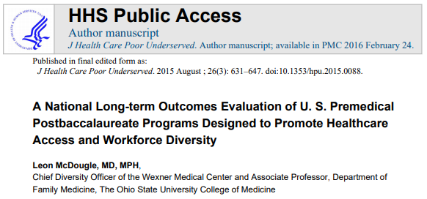
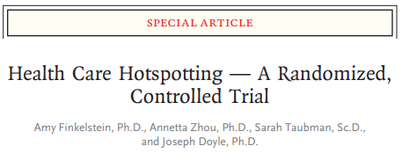
But exceptions in the research exist!
Notes:
Reference slide only

Slide 24
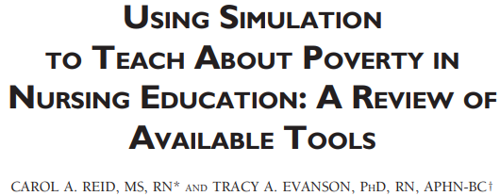
Notes:
Reference slide only

