Slide 1
Cancer Health Justice Lab: Increasing Diversity through Mentorship, Education, Training, and Service
Notes:
MENTORSHIP: Venn Diagram (Humberto)

Slide 2
OBJECTIVES
To provide an overview of developing a research lab that focuses on addressing health inequities.
We invite students, clinicians, and scholars with direct experience in social determinants of health interested in learning about CHJL and how to engage underrepresented groups in intentional decision-making.

Slide 3
AGENDA
NCEAS Conference | 60 Minute Workshop
PRESENTATION
10 | Agenda Overview | -Mission Statement -SDoH, Inequity in Cancer Prevention | Sarah, Luis Pamela | Sarah, Luis Pamela
WORKSHOP
Mins | Activity | Description |  | Person
5 | Polls | -Poll: Getting to know you |  | Sarah, Noah
3-5 | Break | -Guided meditation |  | Juan
10 | Didactic Experience | -Didactic; technical tools -How the lab has adapted to COVID-19 |  | Pamela, Humberto, Vivian, Luis
3-5 | Break | -Guided stretching |  | Juan
20 | Student Led Experiential Experience | -Experiential; training process [Covid-19] -Replicate a task (auto complete) -Showcase capstone poster on PPT] -COVID-19 video |  | Asia, Lashida, Nadia, David
~ | Involvement | -Website showcase |  | All
5 | Panel Reflection and Q&A |  |  | All

Slide 4
MISSION STATEMENT
The Cancer Health Justice Lab (CHJL) is a multidisciplinary research group of public health, social work, nutrition, medicine, nursing, and criminal justice professionals / researchers and students that have come together to address social determinants of health and inequity in cancer prevention in medically underserved and hidden populations

Slide 5
Social Determinants of Health (SDoH)
“
Non-medical factors that influence health outcomes. They are the conditions in which people are born, grow, work, live, and age, and the wider set of forces and systems shaping the conditions of daily life. These forces and systems include economic policies and systems, development agendas, social norms, social policies and political systems.
“
– WHO

Slide 6
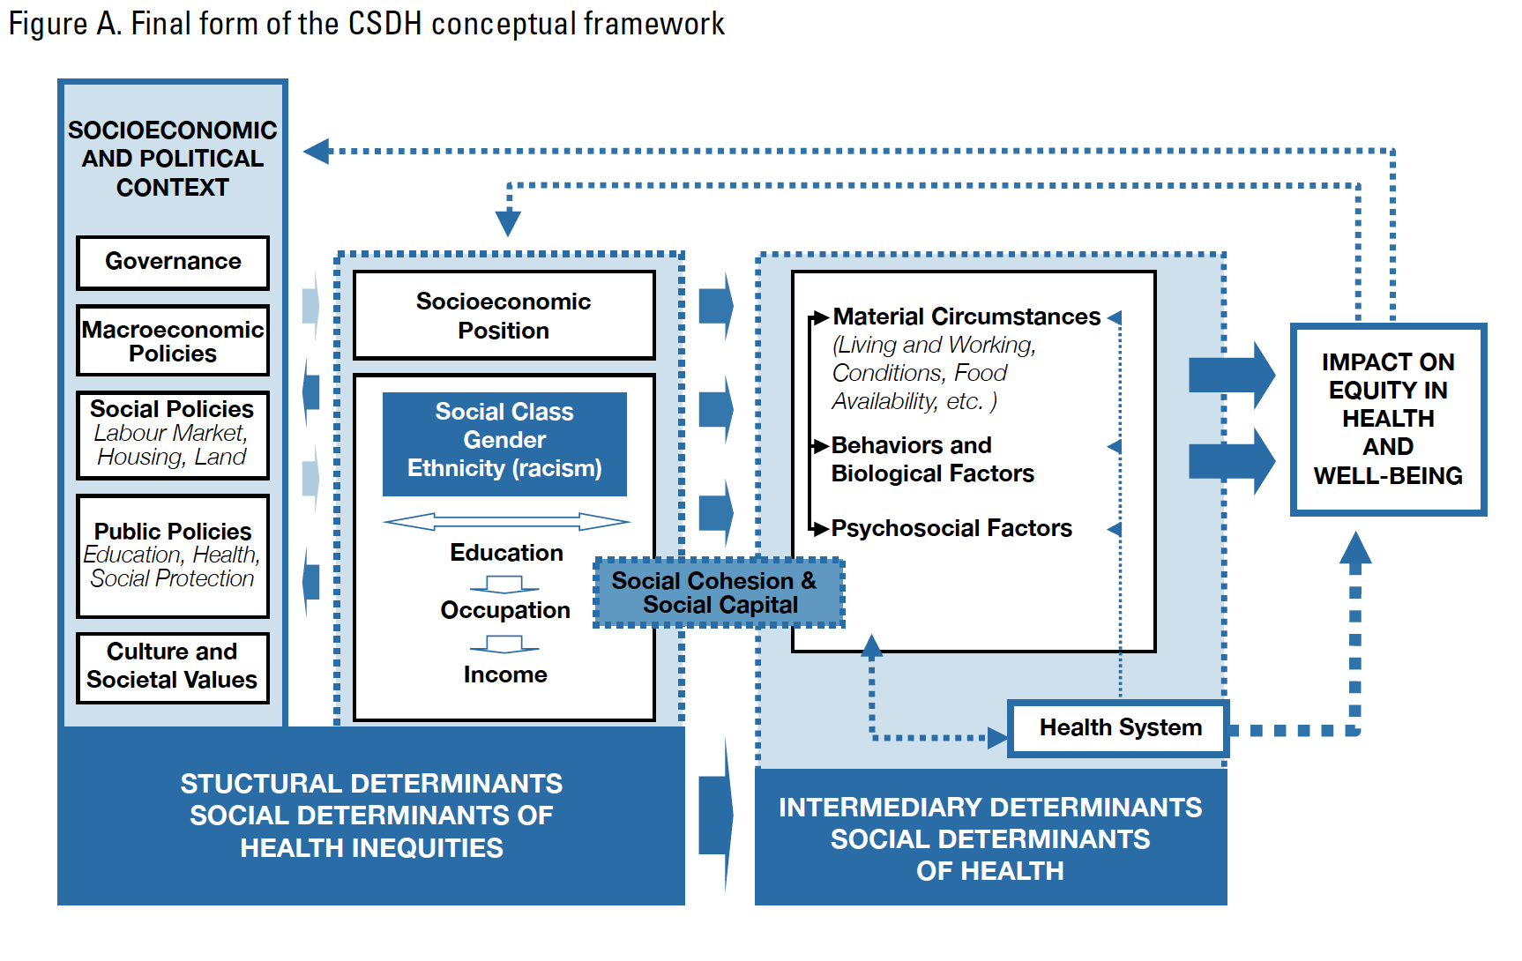

Slide 7
INEQUITY IN CANCER PREVENTION

Slide 8
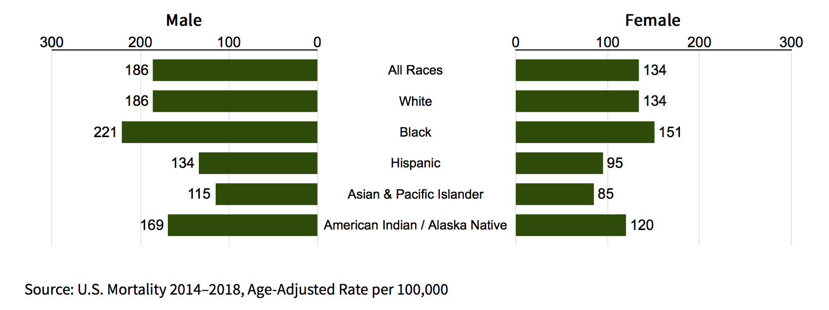
CANCER DISPARITIES IN THE U.S.
Cancer deaths by race/sex
New cancer diagnoses by race/sex
SOURCE:https://seer.cancer.gov/statfacts/html/disparities.html
Notes:
African Americans/Blacks have the highest cancer deaths rates compared to any other race/etnciity group at 177.5 per 100,00 (Cancer.Gov)
Black men have the highest rate of new cancer diagnoses at 515 per 100,00 compared to Asian/Pascific Islander women that have the lowest cancer diagnoses.

Slide 9
UNDERREPRESENTED MINORITIES IN THE HEALTH PROFESSIONS
Using a social determinants health framework, CHJL focuses on mentoring and training students from underrepresented backgrounds to increase participation in medicine, public health, and the biomedical sciences.
5.0%
5.8%
17.1%
56.2%
Association of American Medical Colleges (n.d.). Diversity in Medicine: Facts and Figures 2019. URL: https://www.aamc.org/data-reports/workforce/interactive-data/figure-18-percentage-all-active-physicians-race/ethnicity-2018

Slide 10
POLL TIME!

Slide 11
BREAK #1: MEDITATION
Photo by Tina Nord from Pexels

Slide 12
Group #1: DIDACTIC EXPERIENCE
Cancer health justice lab (chjl)

Slide 13
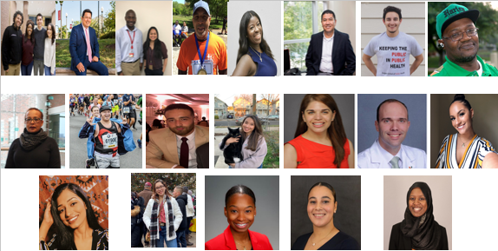
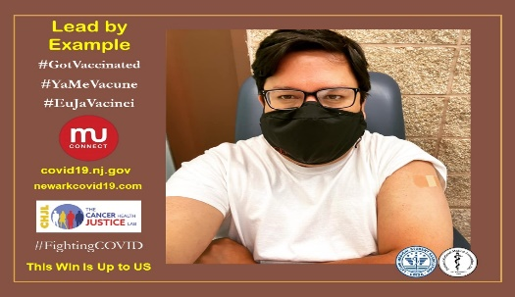
“Dress for the job you want, not the job you have”
“Making education activities visible and valued using a common set of standards, be it for certification, academic promotion, and⁄or improving our educational programs”
Smoking Cessation Treatment
Inequity in Cancer Prevention
Cancer Education and Health
Colorectal cancer Screening
COVID-19 autocomplete
Education
Service
Research
Mentorship
Notes:
Service – Mentoring Chat (Public Health 101): How do we support Service - through our Research and Educational Activities.
Service is a form of giving back and inspiring the next generation of public health advocates or health care professionals.
We hosted a Mentoring Chat with High School Students in Spring and Fall 2020 to help them understand the role of public health and maybe foster that imagination for the profession and the sciences. They would be the next Fauci.
We plan to run the COVID-19 Bilingual Education video as a PSA or interviews with the Spanish Media in the Tri-State Area. The goal is to create awareness about COVID-19 safety measures and vaccination in their language of choice, Spanish.
Finally, we launched a vaccination campaign to bring awareness about vaccination in English, Spanish and Portuguese from community members who already got the vaccine.
I am going to leave you all with a quote, Service is a small act when multiplied by millions of people, can transform the world.” Howard Zinn
What we are doing is a small act; hoping to transform our local footprint into a global impact. This is what CHJL is all about.
Education – (slides 14 and 15)
Research – add colorectal cancer screening; add covid-19 autocomplete

Slide 14
BREAK #2: MEDITATION
Photo by Tina Nord from Pexels

Slide 15
Group #2: EXPERIENTIAL LEARNING
Cancer health justice lab (chjl)

Slide 16
WELCOME!
COVID-19 Autocompletes Study
Training Process
Simulation
COVID-19 Capstone Project
Overview
Findings
Spanish COVID-19 Video
Notes:
Welcome! In this session we’ll be covering the training process for one of our projects here at the lab that is generalizable to everything we work on, simulate one of our activities, and present some of the deliverables produced by members of our team.

Slide 17
COVID-19 AUTOCOMPLETE STUDY
Training & simulation

Slide 18
Presented with a project
Review relevant materials
Engage in practice sessions
Become well-versed in a project
Take the lead on a project
Notes:
Before launching a study, both staff and interns:
May be asked to complete literature analyses
Review the interview / focus group guide
Review the study protocol
Using these resources, staff and interns become versed in the study and engage in practice runs to familiarize themselves with facilitating data collection
During the data collection phase, staff and interns take the lead on facilitating interviews and focus groups while a senior member of the lab is on call for support and to ensure things are operating smoothly
Data analysis is also spearheaded by staff and interns with senior members overseeing the process to ensure tasks (e.g., transcription, creation of codebooks, running statistical analyses) are being completed satisfactorily

Slide 19
AUTOCOMPLETE FROM SPRING 2020

Slide 20
ENGLISH vs. SPANISH AUTOCOMPLETES

Slide 21
Simulation
Complete the following Google search on your own device and share an interesting find in the chat

Slide 22
DELIVERABLES
COVID-19 Capstone project & Spanish covid-19 video

Slide 25
REFLECTION / Q&A
Notes:
{Luis lead}

Slide 26
THANK YOU
Notes:
{Luis lead}

