Slide 1
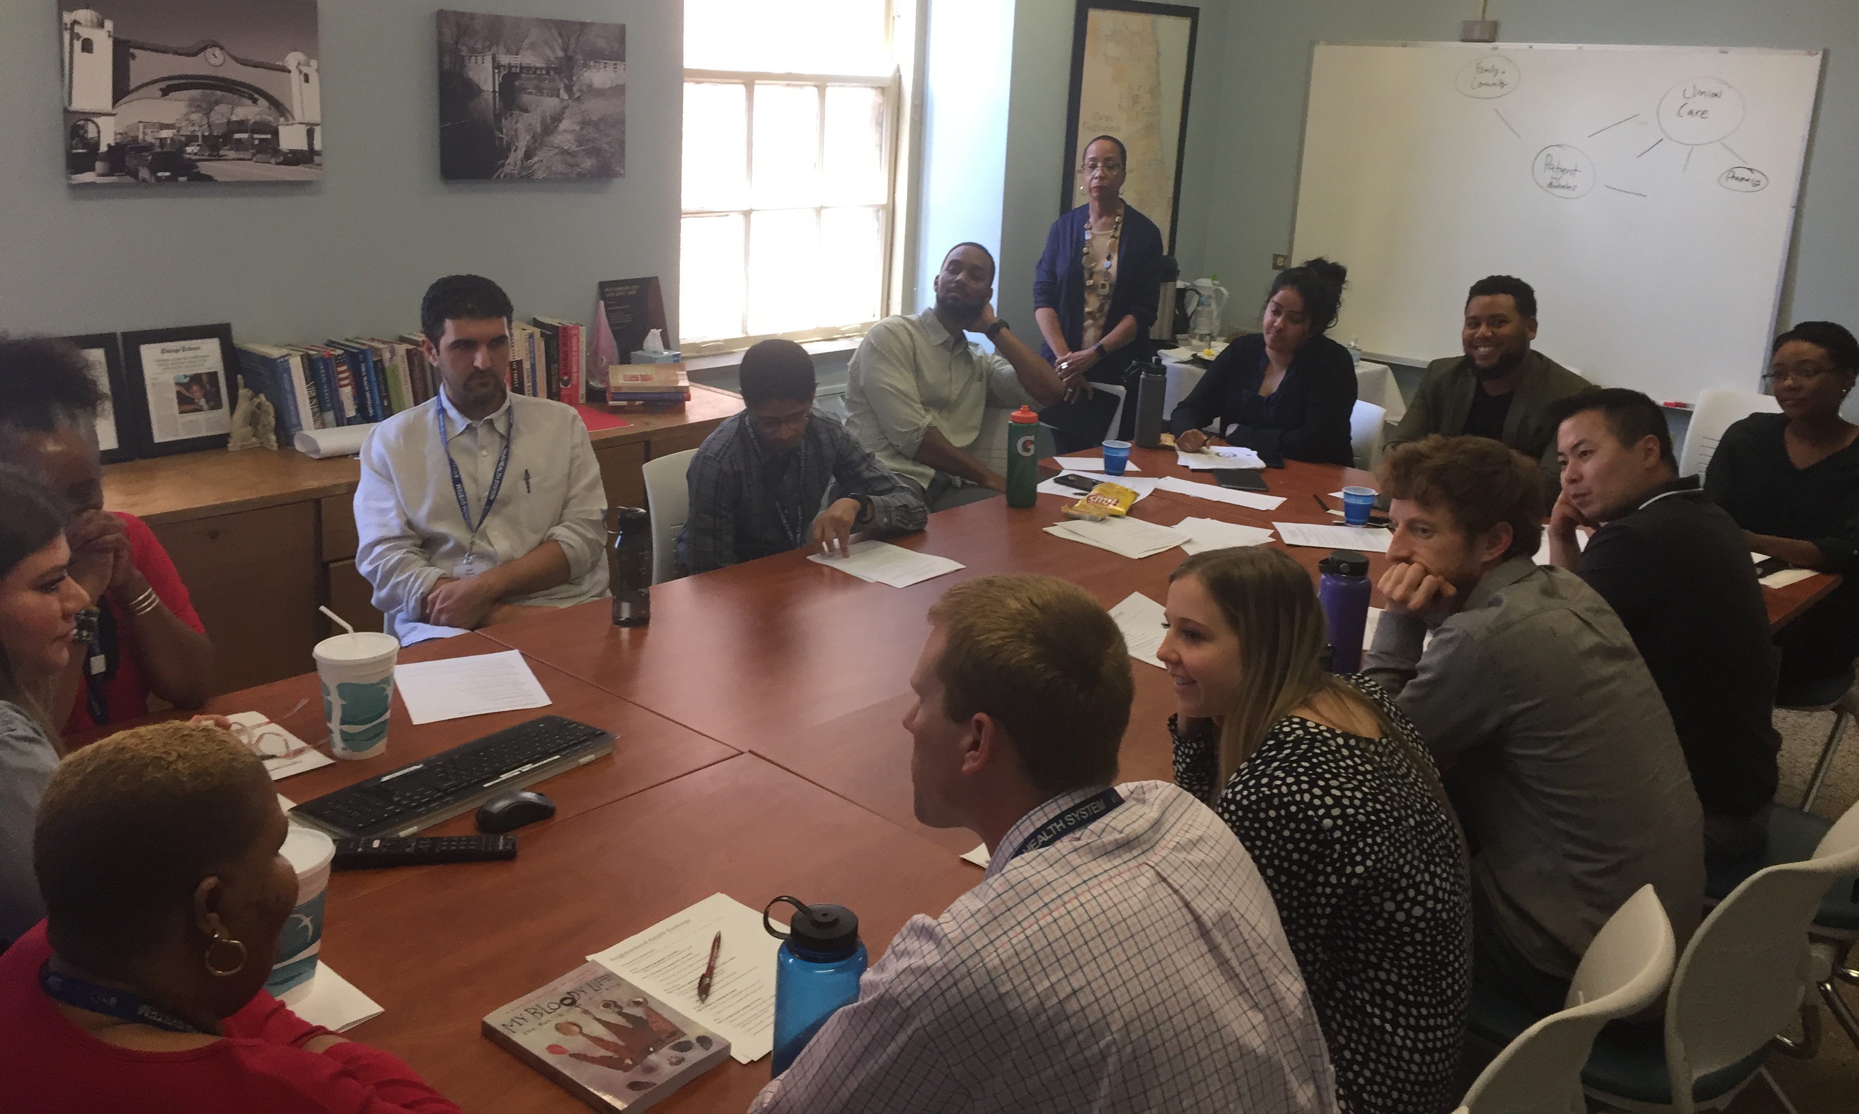
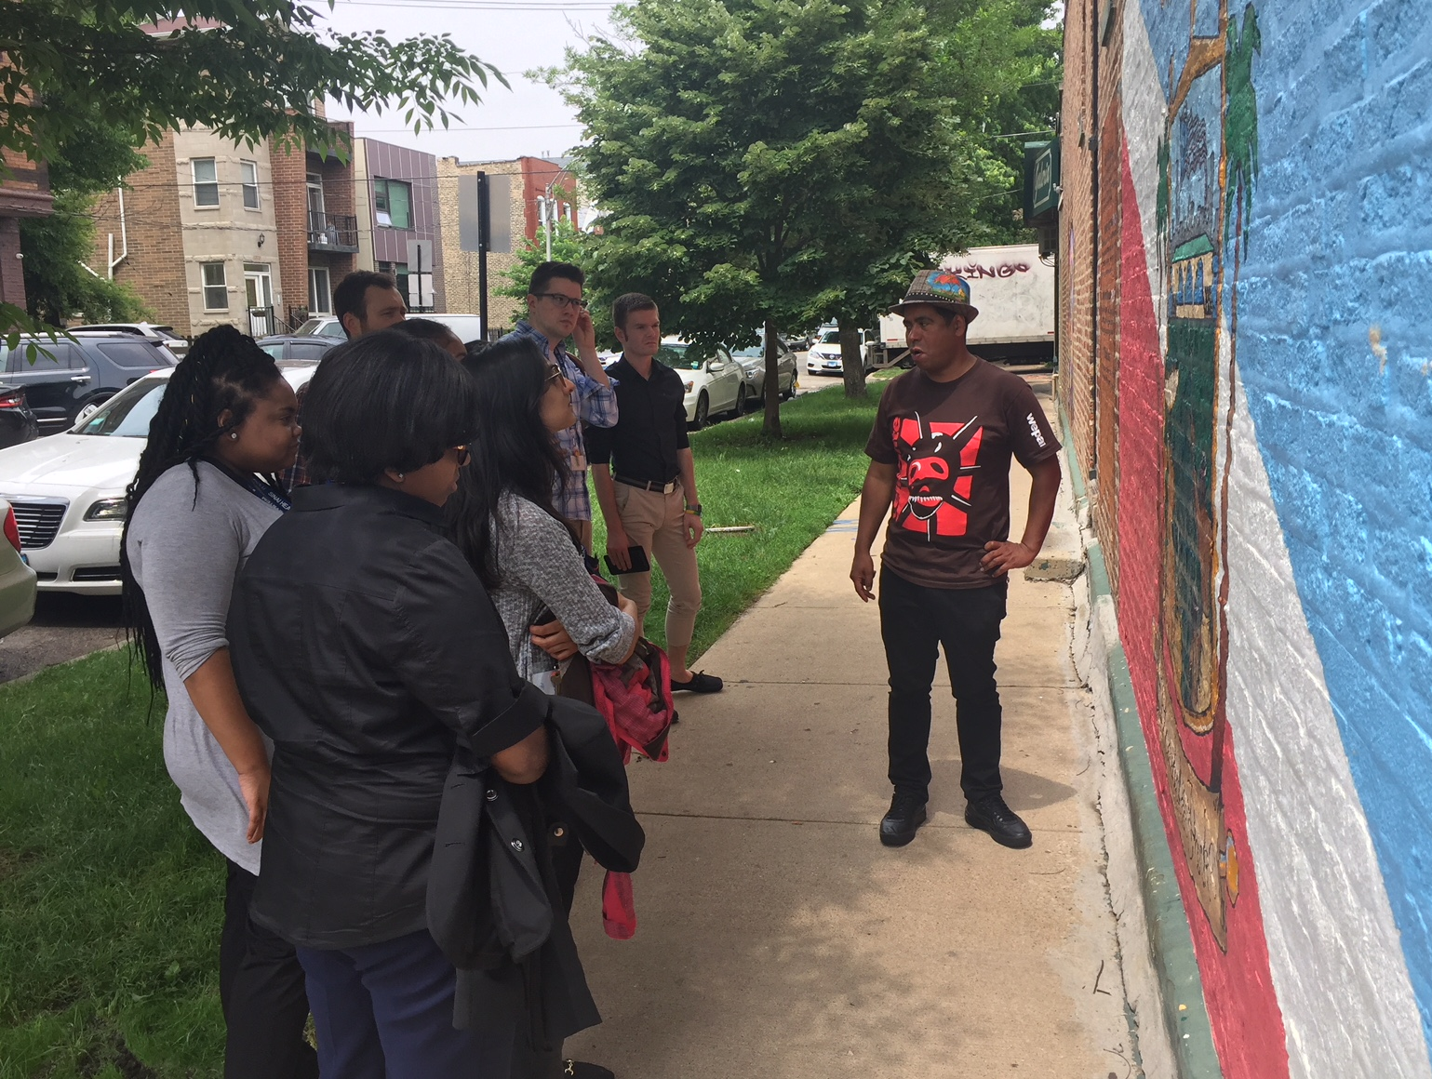
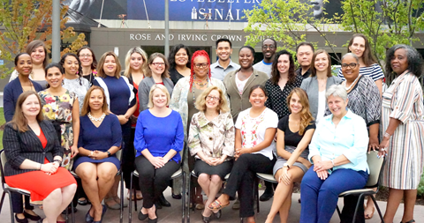
A Week-Long Immersion into Equity, Social Determinants, and
Population Health for Health Professionals
Maureen R. Benjamins, PhD, Senior Research Fellow, Sinai Urban Health Institute (SUHI)
BACKGROUND
Who?
Students pursuing a degree in a health profession field
Public health professionals, health care practitioners, or administrators
What?
One-week intensive institute (virtual in 2020-2021)
Explores population health topics, with a special focus on health equity and social determinants of health
Inter-professional speakers include researchers, public health and healthcare practitioners, and representatives of vulnerable patient populations
Why?
Insufficient training on how to understand and serve diverse patients
Need for increased skills related to evidence-based best practices and research in public health
Need to better appreciate the importance of culture and community engagement within health care
STRUCTURE
Seminars and Skill-Building Workshops
SUHI researchers and partners share their
expertise on a range of topics.
Community Tours
SUHI staff from local neighborhoods lead
participants on tours
that focus on the
history and assets of
the diverse
communities.
Sample Seminar and Workshop Topics
Health inequities
Social determinants of health
Conducting health assessments
Caring for vulnerable populations
Community engagement
Evidence-based public health
Health care policy
Population health management
Structural racism and discrimination
Research methods and statistics
Sharing Our Expertise
Screening for social risk factors in the emergency department
Community health workers as population health solutions: the case for asthma
Addressing infectious diseases in an urban population
PARTICIPANT FEEDBACK
● “I cannot tell you how impactful that experience was to me.”
● The institute “changed my life and opened my eyes on how to be a change leader in medicine and community health…”
● “You all are on the academic front of social justice and medicine.”
● “I realized how important it is to be an advocate that can enact change, and how this in the long run is just as if not more important than being a good clinician.”
● “I have also developed skills in more effective communication with patients, especially those who have lower literacy levels. ”
● “What I saw and experienced on our neighborhood tours has changed my perception of poor neighborhoods and the people that live there.”
● “I feel much more prepared to work with a patient population and take into account their cultures, communities, and experiences.”
● “There is no other experience like this one.”
Sinai Urban Health Institute (SUHI)
SUHI is a research center located within Sinai Chicago, the largest private safety-net health care system in Illinois.
SUHI’s mission: Identifying health inequities, addressing these inequities with innovative solutions, and rigorously evaluating our work to ensure effectiveness.
Team: Diverse staff of 40+ epidemiologists, project managers, research specialists, and community health workers.
Educational and Training Opportunities: SUHI staff regularly share their expertise through teaching, mentoring, internships, and a health equity faculty fellowship program. In addition, through CROWD, we provide training and consultation related to hiring, training, and evaluating community health workers.
Focus of the Institute: Moving beyond awareness of inequities
Questions? Please contact pophealthtraining@sinai.org
1500 South Fairfield Avenue
Chicago, IL 60608
suhi@sinai.org
suhichicago.org

