Slide 1
Expanding the DEI Mission at Your Institution
Andrea Berry MPA
Olga Karasik MD
Tracy MacIntosh MD MPH
Anuja Mehta MD
Barbara Thompson

Slide 2
Disclosures
None of the members of our team have any financial disclosures
This research was supported (in whole or in part) by HCA Healthcare and/or an HCA Healthcare affiliated entity. The views expressed in this publication represent those of the author(s) and do not necessarily represent the official views of HCA Healthcare or any of its affiliated entities.

Slide 3
Notes:
We all wish we could spend our careers doing the work of identifying and eliminating health disparities. That this was seen as the true healthcare emergency that it is. That we would have all the resources and commitment from the top of our institution, permeating to all levels of our institutions. That we would all speak the same language, apologize for the unintentional harms from our words and actions and focus on creating health equity and training the next generation to do better.

Slide 4
Notes:
Instead, we often find ourselves still needing a megaphone to advocate for social and racial justice for ourselves, our patients and our team members. We find ourselves up against some significant bariers to change.

Slide 5
Goals for Workshop
How to get Buy-in from people who actually don’t care
Addressing and meeting Specific Requirements, Mandates & Metrics
How to create systems of support

Slide 6
1) Getting Buy-In
What are the benefits?
To the institution
To the individual
To the program
To the community
To the bottom line

Slide 7
Institutional Surveillance
Getting Buy-in
Conduct a survey to assess the workplace and learning environment
Develop focus groups to understand the culture

Slide 8
Faculty Coaching
Getting Buy-in
Support all faculty in contributing to the education of learners
Draw on their expertise in their individual specialty
Include, but do not expect them to facilitate or moderate workshops
Notes:
Create interdisciplinary panels

Slide 9
2) Meeting your Goals
What are the benefits?
To the institution
To the individual
To the program
To the community
To the bottom line

Slide 10
ACGME on Diversity, Equity & Inclusion
Common Program Requirements
Recruitment and retention of a diverse and inclusive workforce
PDs to cultivate an environment in which residents and fellows can raise concerns and provide feedback without fear of intimidation or retaliation

Slide 11
ACGME on Diversity, Equity & Inclusion
Common Program Requirements (continued)
Programs are asked to collect data on ultimate board certification rates of its graduates (intent to decrease reliance on first time pass rates)
Programs must provide a professional, and respectful environment free from discrimination, harassment, mistreatment, abuse or coercion
Programs to provide education on health disparities

Slide 12
Psychiatry Objective Assessments

Slide 15
USMLE DEI Content Area

Slide 16
Inventory & Checklist
Notes:
Take an inventory of your program requirements and ensure you have strategies to meet all of them: acgme, LCME, tests and board certification requirments

Slide 17
3) Systems of Support
How can we strengthen and support all team members?
Workshops
Movie Screenings
Book Clubs
Panels
Process Groups
Notes:
These need to be required parts of our curriculum
We have to attach value to these and honor the time and effort that people dedicate to them

Slide 18
Process Groups

Slide 19
Coaching
Reporting & Accountability
Simple, transparent reporting process
Consistent follow-up and education & remediation

Slide 20
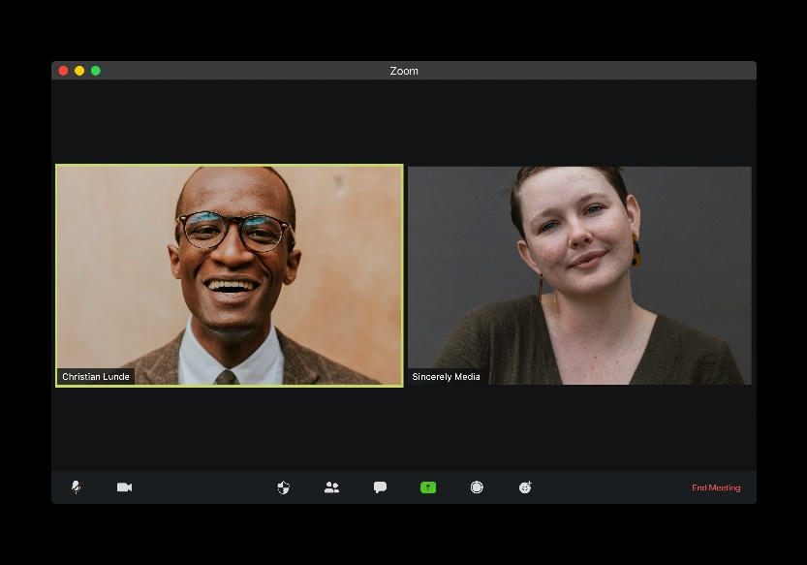
Goals for Break-Outs
25 Minutes, Facilitated Workshop
Outline the value of the DEI programs at your institution
Identify barriers – human or other
Identify strategies to overcome
Identify metrics applicable to your group
Select immediate, actionable next steps and allies

