Slide 1
Improving Women’s Preventative Care Through Culturally-Attuned Health Education and Provider Trainings in an Uninsured, Spanish-Speaking Free Clinic Population
Ella Satish, Katherine Barry, Annie De Groot MD
Clínica Esperanza/Hope Clinic, Providence RI

Slide 2
Introduction
Clínica Esperanza/Hope Clinic (CEHC) is a free healthcare clinic in Providence, RI
Established in 2007 and run by a group of passionate volunteers
We provide health care and education services to thousands of uninsured, Spanish-speaking immigrants per year

Slide 3
Patient Population
CEHC serves over of patients per year in primary care and specialty visits
Our patients are all uninsured
More than 80% speak Spanish as their primary or only language
Over 75% report household incomes of under $15K per year
They face numerous barriers to health, including low literacy and low health literacy

Slide 4
‘Navegantes’ and Peer Education
The Navegante role was established to provide more support to patients as they made their way through the healthcare system
These bilingual, bicultural staff members are highly-trained and certified community health workers who provide healthcare and social service navigation and interpreting services
Our health education programs like Vida Sana are developed and run by Navegantes, and they train other community members to become CHWs through the Advanced Navegante Training Program

Slide 5
Women’s Care and Education at CEHC
Women’s healthcare at the clinic is provided twice per month by a team of Brown University medical students and their volunteer physician preceptors
Patients can receive preventative services and cancer screenings and can also be evaluated for any gynecologic needs they may have
Unfortunately, there has not been a dedicated educational program to partner Women’s Clinic patients in their care and teach them about topics like cancer prevention, menstruation, and fertility

Slide 6
Motivations
Since patient empowerment through culturally-appropriate health education is a key component of the clinic’s mission, staff and volunteers saw an opportunity to improve gynecologic wellness
This was the motivation for creating a framework for educating our low health literacy Spanish-speaking patients about important topics relating to sexual and reproductive health

Slide 7
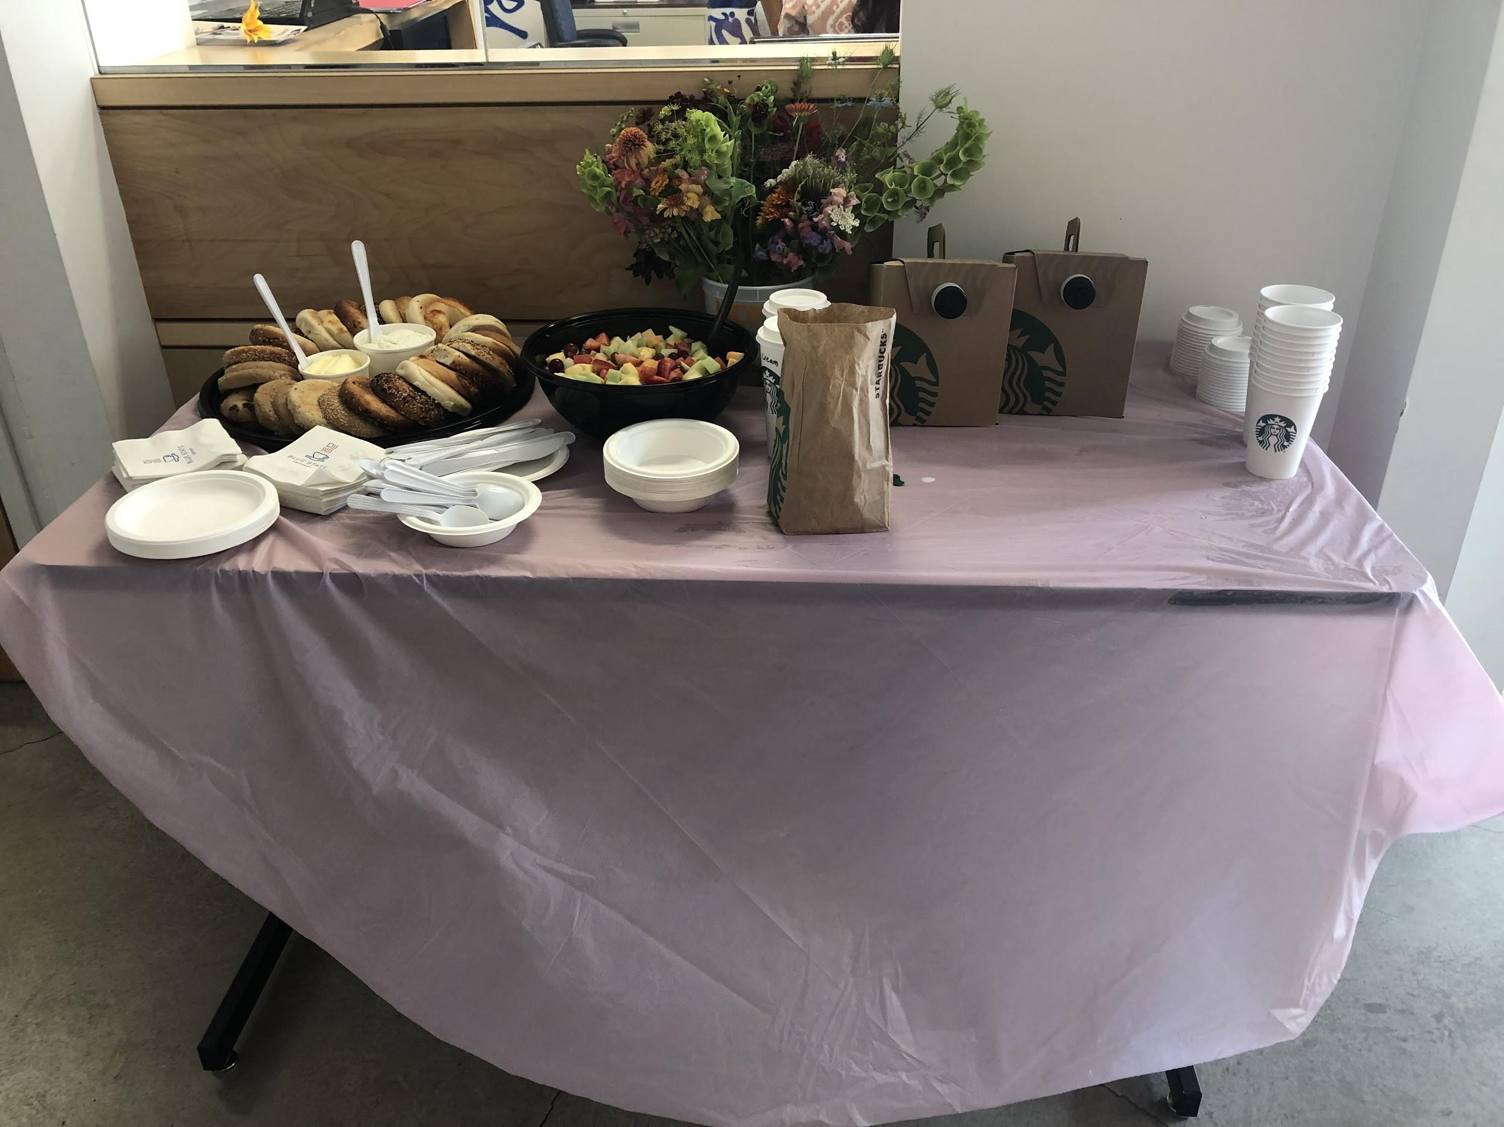
Background
Program began as “Entre Mujeres” in Spring of 2019
We originally focused on cervical cancer and HPV education, focusing on 3 methods of prevention:
Gardasil vaccination
Pap smears
Knowledge of one’s own body

Slide 8
Background
Event was in person on Saturday mornings and Wednesday evenings and included coffee and snacks donated by various local businesses
Posted flyers in community centers, laundromats, grocery stores and other areas around the city to advertise, and called current and former patients of Women’s Clinic
We called it: ‘Entre Mujeres: un evento para las mujeres de nuestra comunidad’

Slide 9
The Origin of ‘Entre Mujeres”
Entre Mujeres was developed by a group of pre-med and medical student volunteers
Collective goal of creating a welcoming space for women willing to dedicate their time to learn more about wellness and their own bodies
The intention was to provide culturally-attuned education sessions tailored to the needs of CEHC’s patient population

Slide 10
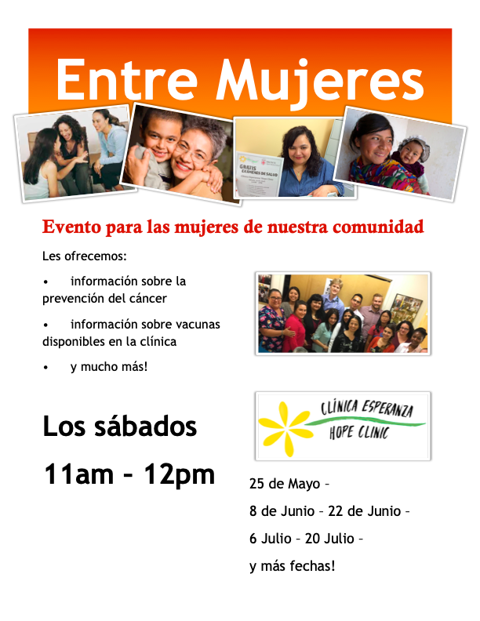
Entre Mujeres: un evento para las mujeres de nuestra comunidad.

Slide 11
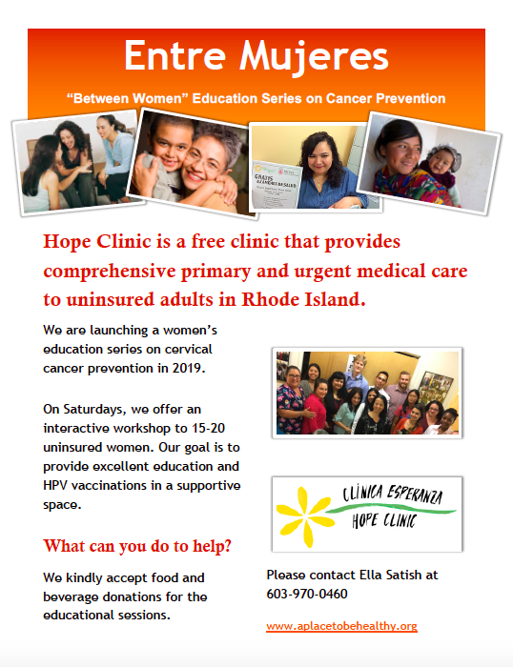
Flyer for community donation requests

Slide 12
Resources for Each Topic
Slides and/or teacher training guide with important talking points
Frequently asked questions and answers
One-page infographic for participants to keep
Equipment to demonstrate procedures or explain concepts

Slide 13
We developed a set of slides with talking points, photos, and diagrams for patients to reference

Slide 14
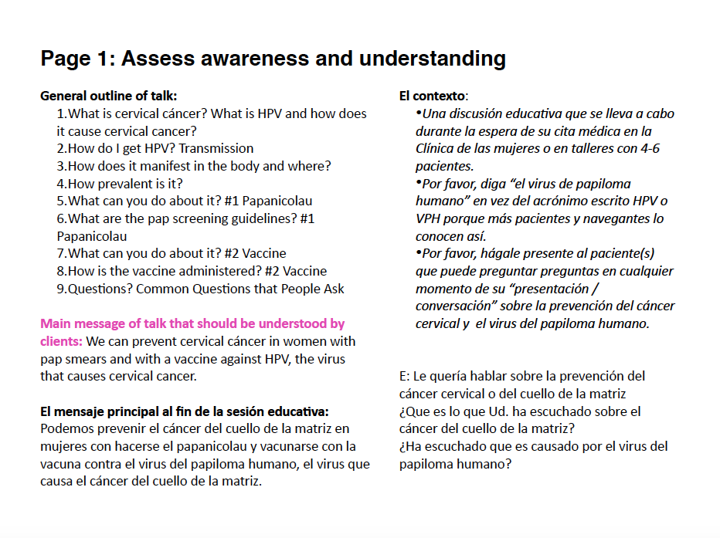
Outline and Objectives

Slide 15
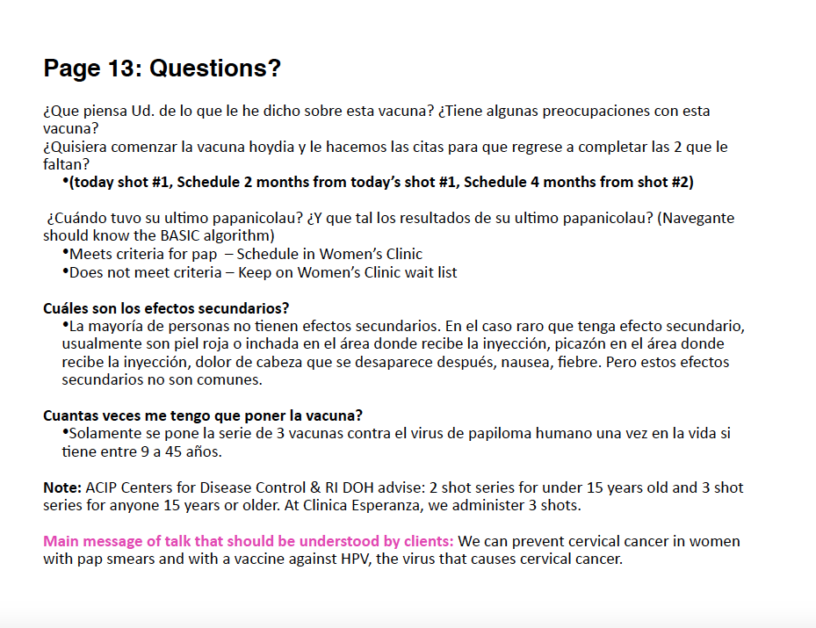
FAQs

Slide 16
Since COVID…
We’ve moved to an online Zoom platform for group education
More of a focus on one-on-one patient conversations during clinic visits
As the weather improves, we are looking to add socially distanced, outdoor sessions as the online platform can be a barrier to participation for many of our patients

Slide 17
One-on-one Education
Shifted our focus to one-on-one education as a result of the pandemic
We offer education after learning about the patient’s questions and interests during their intake session
Counseling typically occurs by our educators after the initial intake while the patient waits to be seen by the physician or after the clinical visit is complete
Most frequent topics: pap smears, contraception, non-STI infections and treatment

Slide 18
Expansion of Topics
We are working to create group sessions based on our one-on-one patient education series on the following topics:
Mammograms
Contraception
Menstrual Cycle
Fertility
Infections (Non-STI)
STIs/Testing
General Women's Wellness
Breastfeeding
Mental Health

Slide 19
Patient Experiences
The majority of vaccine-eligible women and participants opted to get vaccinated after each session
Participants, particularly older women, were excited to share the information they learned with their friends and family
Participants always tapped into our frequently asked questions and feel comfortable bringing up any other concerns
During one-on-one sessions, patients feel empowered with the knowledge to make informed decisions about their health and wellness

Slide 20
Our Takeaways
Feedback on our sessions is overwhelmingly positive, not only from the patients but also from the volunteer clinicians and the medical students
Patients leave our sessions visibly more confident and comfortable with the outcome of their visits
We look forward to compiling more group education topics and helping more women get the most out of their gynecologic care and improve their overall wellness

Slide 21
Thank You!

