Slide 1
Teaching Health Disparities using Case Narratives
February 24, 2021
Bode Adebambo, MD
Associate Professor
Department of Family Medicine
Adam T. Perzynski, PhD
Associate Professor of Medicine and Sociology
Department of Medicine
The MetroHealth System/CWRU

Slide 2
Health Disparity
The original work was supported in part by a Bureau of Health Professions Grant, “Faculty Development for Primary Care” (James Campbell MD, Principal Investigator) 2011 - 2016 HRSA: D55HP23193

Slide 3
I disclose I have the following financial relationship: B Adebambo
I have a royalty agreement with Springer Publishing for a book on Health Disparities.

Slide 4
I disclose the following financial relationships: A Perzynski
I am co-founder and Chief Science and Strategy Officer of Global Health Metrics, LLC, a Cleveland-based startup software company.
I have a royalty agreement with Springer Publishing for a book on Health Disparities.
I have a royalty agreement with Taylor Francis for a book about Structural Equation Modeling.

Slide 5
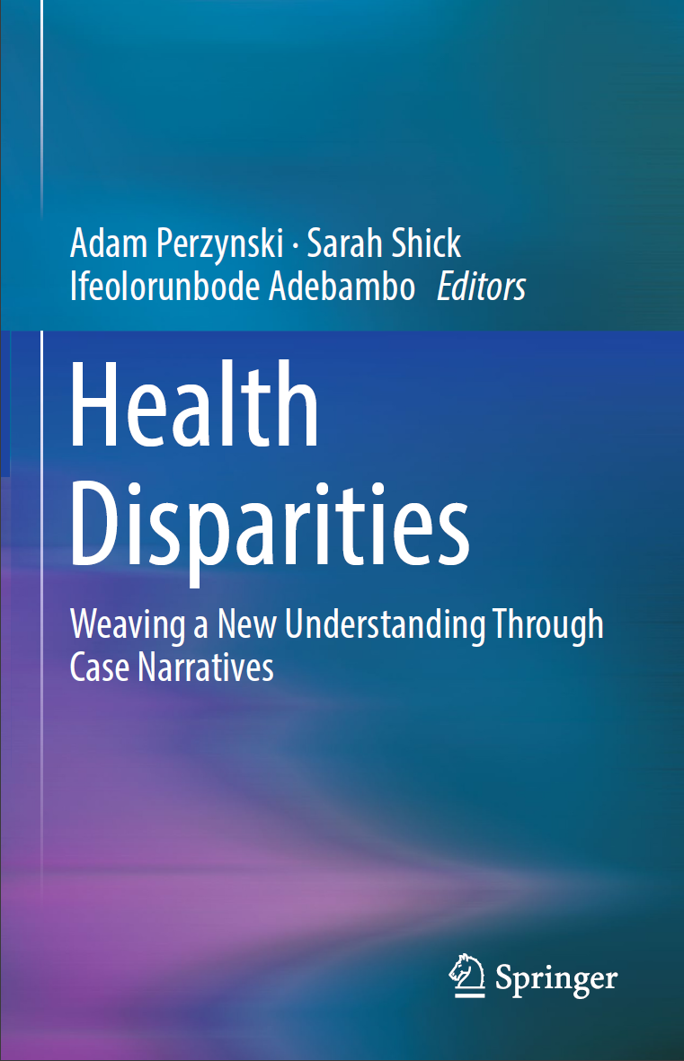

Slide 6
Learning Objectives
1. The learner will identify the health disparities represented in the case narrative.
2. The learner will understand how the health disparities represented in this case affect those seeking and providing health care.
3. The learner will identify their own attitudes towards health disparities using a self-reflection tool.

Slide 7
Health Disparity
“A particular type of health difference that is linked with social, economic or environmental disadvantage………”
Healthy people 2020

Slide 8
Health Disparity vs Health Care Disparity
Health disparity” refers to a higher burden of illness, injury, disability, or mortality experienced by one population group relative to another.
A “health care disparity” typically refers to differences between groups in health insurance coverage, access to and use of care, and quality of care

Slide 9
Conceptual Framework: Disparities, Differences, and Discrimination
A difference in health care is the simple unadjusted difference in means or rates between racial/ethnic groups.
E.g: Health status differences between the groups may explain some of the difference in health care use.
Latino patients may have fewer health problems, perhaps because they are younger, and require fewer visits or worse health among the elderly compared with young adults.
Differences in use because of health status are not considered part of a disparity, nor are those because of different preferences for health care treatment
Discrimination – treating a group of people different from another
IOM – Unequal treatment

Slide 10
Health Disparities
Adversely affects groups of people
Health care disparities occur in the context of broader inequality.
Avoidable differences (WHO)
Mostly related to social determinants of health (WHO)
There are many sources across health systems, providers, patients and managers that contribute to disparities.
Bias, stereotyping, prejudice and clinical uncertainty contribute to disparities.

Slide 11
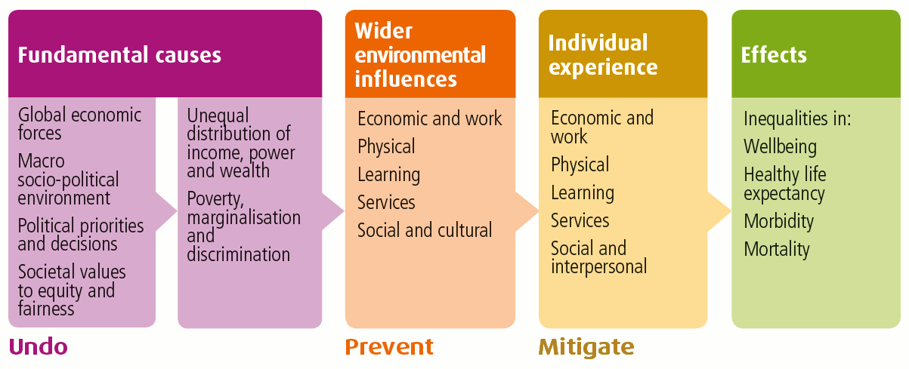
Health Inequality
MOST CURRENT SDOH EFFORTS IN US HEALTHCARE ARE FOCUSED HERE!
From National Health Service, Scotland

Slide 12
Health Disparity
Related to Health outcomes – Overall quality of care and population health. (WHO – USA 37)
Social Justice
Increased medical care expenditure
(Centers of political and economic studies b/w 2003 – 2006 saved 229.4 billion)
About 30% direct cost due to health inequities
Indirect premature death and loss of work
Notes:
Why do we care?

Slide 13
Health Equity
Health equity benefits everyone”. Every person who dies young, is avoidably disabled, or is unable to function at their optimal level represents not only a personal and family tragedy but also impoverishes our communities and our country. We are all deprived of the creativity, contributions, and participation that result from disparities in health status.
CDC 2013 health disparities/inequality report

Slide 14
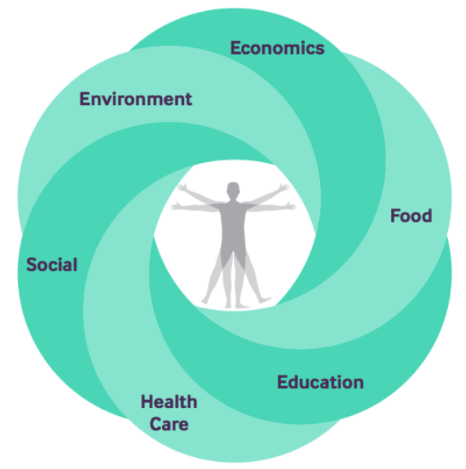
Conceptual Model of Social Determinants of Health
@atperzynski

Slide 15
SDoH
Race/ethnicity Safe and affordable housing
Gender Community Planning
Mental health Religion
Sexual orientation SES
Language/literacy Disability
Education
Healthy food
Transportation

Slide 16
The level of individual social needs is staggering in Northeast Ohio
Data Provided by MetroHealth Institute for HOPE

Slide 17
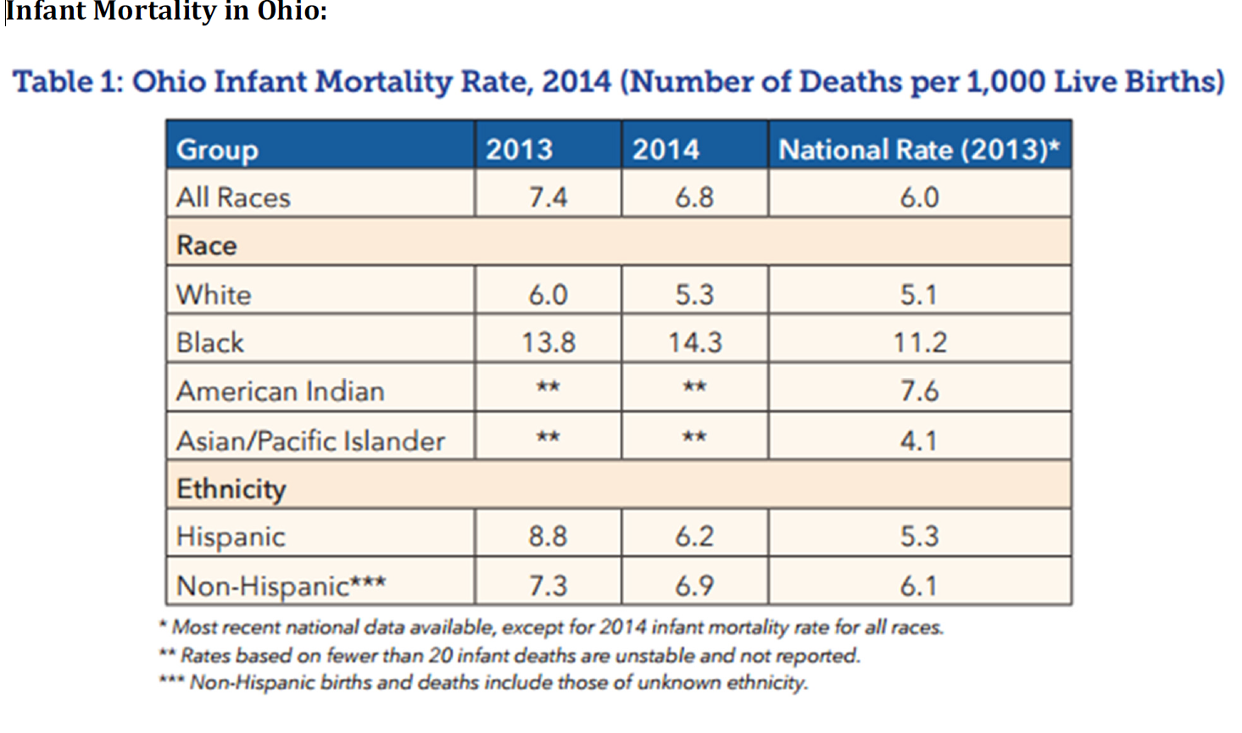
Infant Mortality

Slide 18
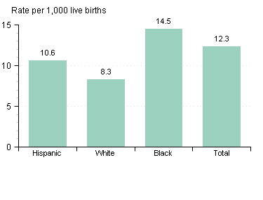
Infant mortality rates by race/ethnicity: Cleveland, 2011-2013 Average

Slide 19
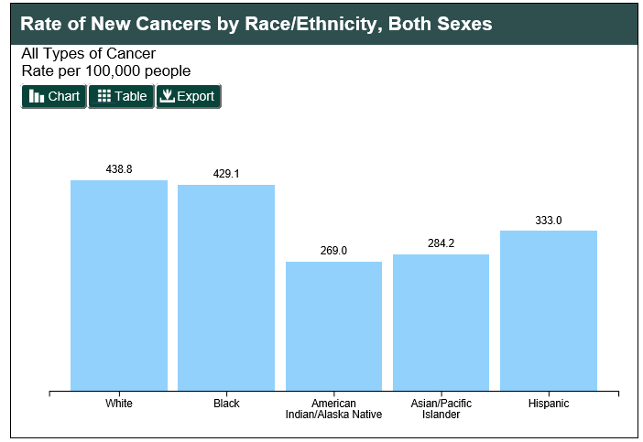
Rate of New Cancers

Slide 20
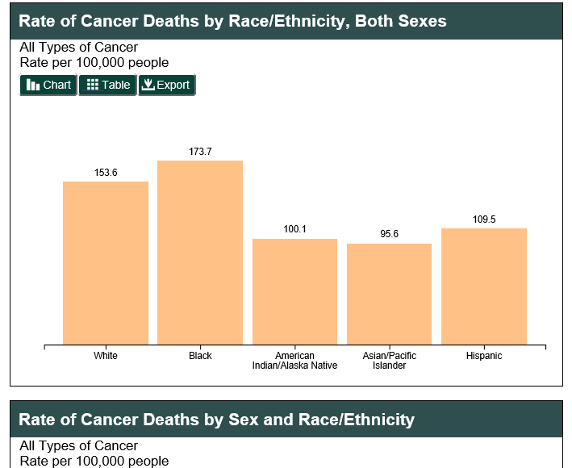
Rate of Cancer Deaths

Slide 21
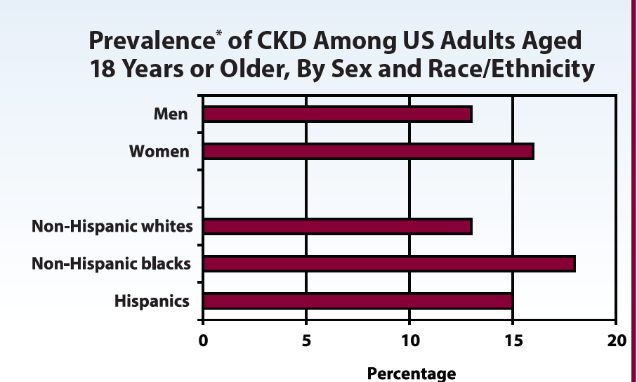
Prevalence of CKD

Slide 22
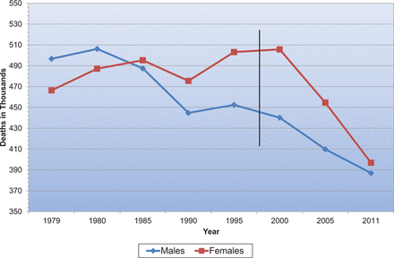
Mortality from CVD

Slide 23
Case Narrative

Slide 24
Reflection tool
How has learning about health disparities today affected the way you will provide health care in the future?
Describe the importance of being sensitive to the needs of diverse patients.
Please write any additional thoughts you have about the narrative(s) or health disparities.

Slide 25
ACGME Milestones
  Family Medicine – PC-3: Partners with the patient, family and community to improve health through disease prevention and health promotion; PROF-3: Demonstrates humanism and cultural proficiency
  Internal Medicine – PROF-3: Responds to each patient’s unique characteristics and needs; ICS-1: Communicates effectively with patients and caregivers

Slide 26
Evaluation Form
 |  | PLEASE CIRCLE YOUR ANSWER
FM Prof–3 Levels | Question / Statement |  | Strongly Disagree | Disagree | Neither Disagree or Agree | Agree | Strongly Agree
1 | Patient narratives evoke strong feelings. | Before | 1 | 2 | 3 | 4 | 5
 |  | After | 1 | 2 | 3 | 4 | 5
2 | Health disparities occur more frequently than health care providers think about. | Before | 1 | 2 | 3 | 4 | 5
 |  | After | 1 | 2 | 3 | 4 | 5
3 | Patient narratives are important for learning about health disparities. | Before | 1 | 2 | 3 | 4 | 5
 |  | After | 1 | 2 | 3 | 4 | 5
3 | Some patients might feel the health care system is indifferent to their needs. | Before | 1 | 2 | 3 | 4 | 5
 |  | After | 1 | 2 | 3 | 4 | 5
3 | Patient narratives help me think about what patients might be going through. | Before | 1 | 2 | 3 | 4 | 5
 |  | After | 1 | 2 | 3 | 4 | 5
4 | I am ready to implement practice changes that reduce disparities. | Before | 1 | 2 | 3 | 4 | 5
 |  | After | 1 | 2 | 3 | 4 | 5
4 | I am confident in my ability to care for people from diverse backgrounds. | Before | 1 | 2 | 3 | 4 | 5
 |  | After | 1 | 2 | 3 | 4 | 5
5 | I am confident in my abilities to lead an effort to address disparities at my institution. | Before | 1 | 2 | 3 | 4 | 5
 |  | After | 1 | 2 | 3 | 4 | 5

Slide 27
Conclusion
Health providers are in a position to affect positive change and reduce health disparities.
It is important we not only provide information and awareness but also challenge reflective and critical thinking in the individual learners.
The use of case narratives is an effective mechanism to improve provider confidence and encourage active action to reduce disparities.

Slide 28
References
IOM Unequal Treatment: Confronting Racial and Ethnic Disparities in Health Care
U.S. Department of Health and Human Services. The Secretary’s Advisory Committee on National Health Promotion and Disease Prevention Objectives for 2020. Phase I report: Recommendations for the framework and format of Healthy People 2020. Section IV. Advisory Committee findings and recommendations. Available at: http://www.healthypeople.gov/hp2020/advisory/PhaseI/sec4.htm#_Toc211942917. Accessed 1/6/10.
CDC Health Disparities & Inequalities Report – United States, 2013, Morbidity & Mortality Weekly Report (MMWR) Supplement, November 22, 2013, Vol.62, Supplement No. 3, pg.1-187
2012 National Healthcare Disparities Report, U.S. Department of Health and Human Services, Agency for Healthcare Research and Quality, AHRQ Publication No. 13-0003 May 2013, http://www.ahrq.gov/research/findings/nhqrdr/index.html

Slide 29
References, cont.
The effect of race and sex on physicians recommendations for cardiac catheterization. Schulman, k. et al NEJM Feb 25, 1999 pg 618-626
A quality Improvement Framework for Equity in Cardiovascular Care: Results of a National Collaborative Journal of Healthcare Quality. Siegal et al Vol.34, No 2, pp.32-43
Centers for Disease Control and Prevention. CDC health disparities and inequalities report— United States, 2011. MMWR 60(Suppl):1–116. 2011.

Slide 30
References
Implicit Bias in health care professionals: a systemic review. Fitzgerald and Hurst. BMC Medical Ethics (2017) 18:19
Racism and Health: Pathways and Scientific evidence. David Williams and Selena Mohammed Am Beh Scientist 2013, 57(8) 1152-1173
Helping Medical Learners recognize and Manage unconscious bias toward certain patient groups. Teal CR, Coll AC Med Educa 2012 Jan; 46(1): 80

Slide 31
References Continued
CDC Health Disparities and Inequalities Report – United States 2011 www.cdc.gov/mmwr/pdf/other/su6001.pdf
Journal of Health Care for the poor and Underserved . Vol. 9, No. 2 1998. Tervalon, Melanie and Murray-Garcia Jann
Stories lives tell: narrative and dialogue in education. Witherel, C., Nodding, N. (Eds) New York. Teacher's College Press. 1991.
Narrative Analysis; qualitative research methods. Riessman, Catherine Kohler, Sage Publication. 1993.
Use of retrospective pre/post assessments in faculty development. McLeod, P. J., Steinert, Y., & Snell, L. (2008). Medical education, 42(5), 543-543.

