Slide 1
Anti-Racist
Pedagogy & Praxis
Danica Sumpter, PhD, RN
The University of Texas at Austin School of Nursing
danica.sumpter@utexas.edu
February 24, 2021

Slide 2
Conflict of interest disclosure
I have no relevant financial relationships with a commercial interest pertaining to the content of this presentation

Slide 3
Where we’re going…
What’s your ‘why’
Vocabulary
Anti-racist pedagogy…what it is and isn’t
Anti-racist praxis…”dogfooding”

Slide 4
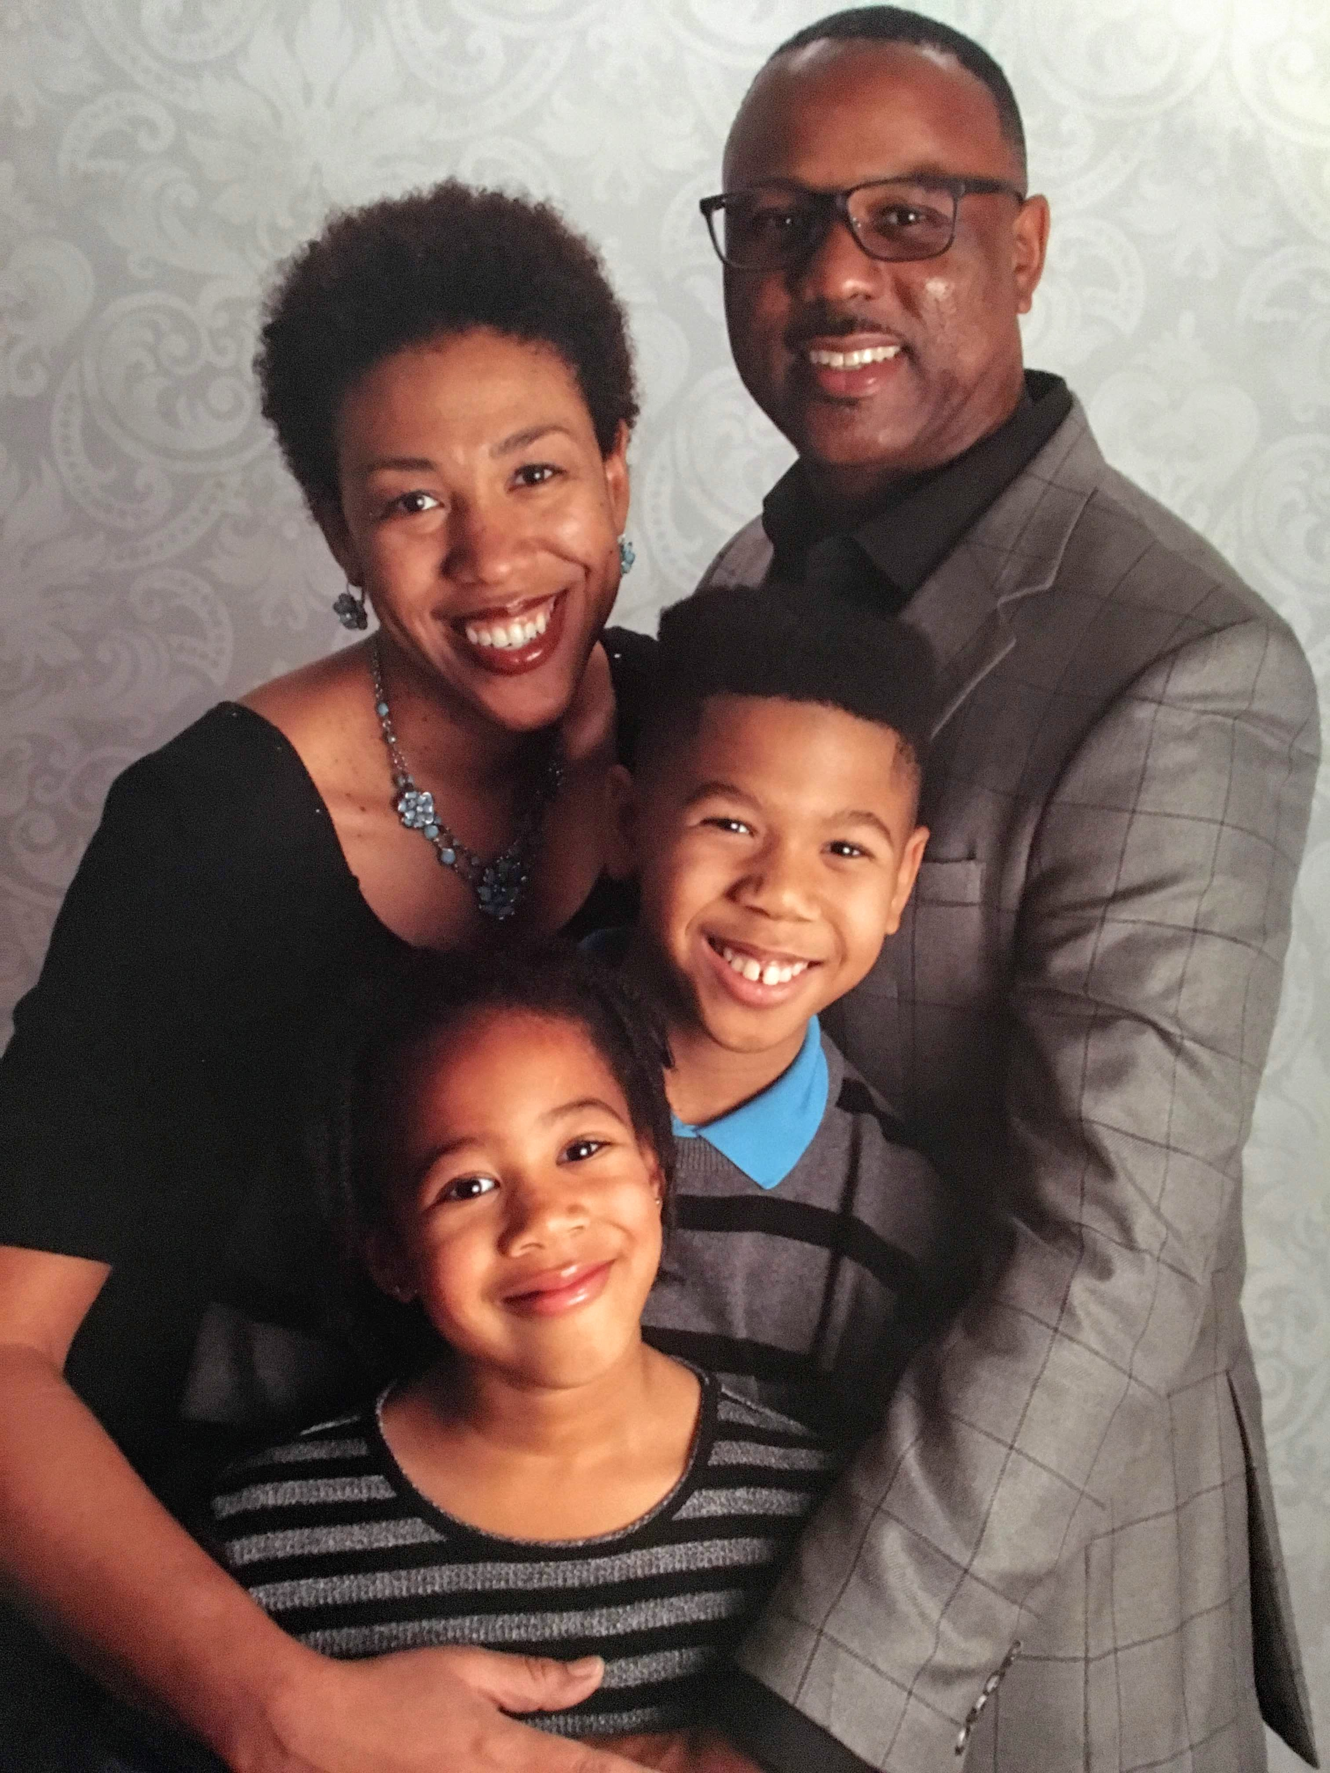
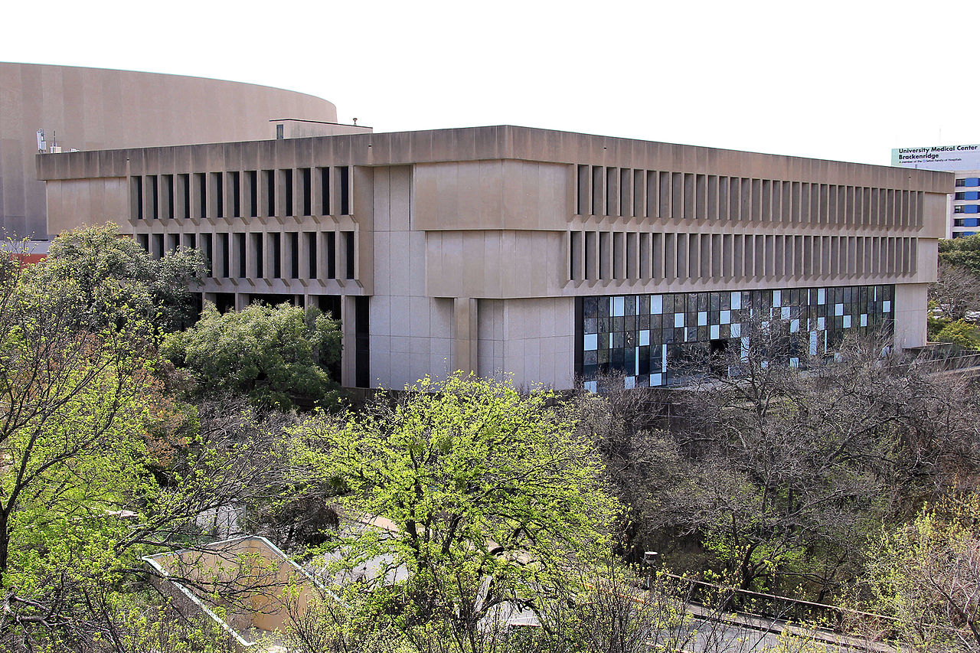
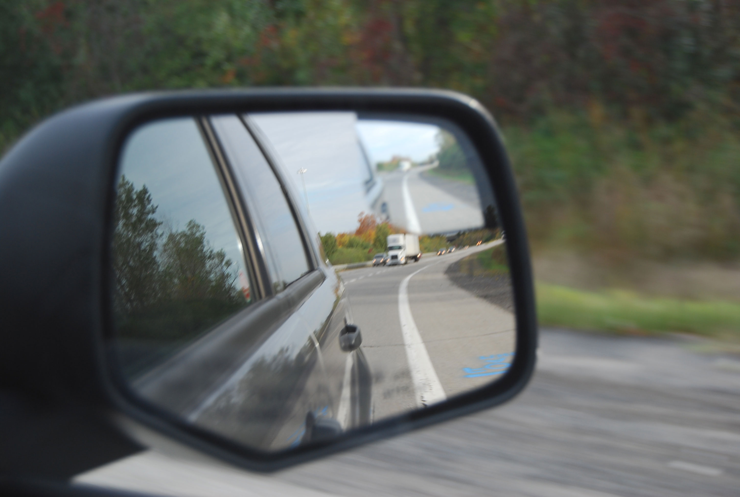
Who am I?
This Photo by Unknown Author is licensed under CC BY-NC
This Photo by Unknown Author is licensed under CC BY-NC-ND
This Photo by Unknown Author is licensed under CC BY-SA
This Photo by Unknown Author is licensed under CC BY-NC-ND
Notes:
Who am I?
Black cis gender female
Christian who lives in a red county and works in a blue one in Texas
Nurse (NICU and pedi) and nurse faculty
Wife and mom of two
Able bodied
All of these identities shape how I perceive the world, they inform my lens
Blindspots...ableist language...blind does not = ignorant or lack of knowledge

Slide 5
Mirror and window work (Emily Style, National SEED Project)
Notes:
Emily Style (founding co-director of National SEED Project (Seeking Educational Equity & Diversity) talks about the curriculum as mirror and window, but I like to think about it in terms of personal development
We look into the mirror to see how our experiences have shaped our beliefs, assumptions and biases about ourselves and others
With new knowledge of self, we look out the window to see how racism, classism, sexism, and other forms of systemic oppression operate to create advantage for some and disadvantage for others
Gaining insight enhances our eyesight

Slide 6
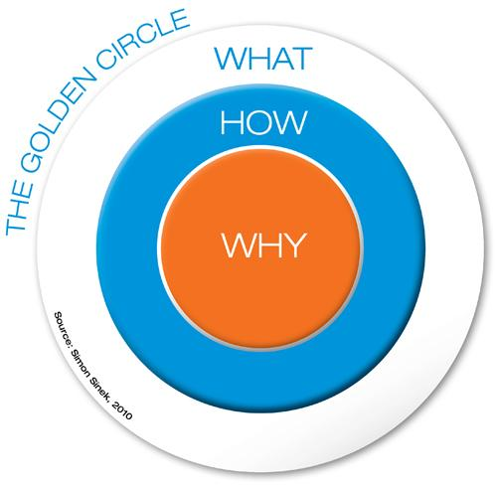
Your ‘why’
My assumption
Notes:
Simon Sinek-ex advertising executive and author
Golden circle...why= what’s your cause, purpose, belief...communication from outside in vs. inside out...people don’t buy what you do, they buy why you do it
I assume you’re here because you want to become or become a better anti-racist teacher/practitioner…stop and think for a moment about your impetus…what’s your “why”?

Slide 7
My “Why”
This Photo by Unknown Author is licensed under CC BY-SA
https://blackmamasatx.com/
Notes:
Feb 2018- convergence of events
Local NPR station with series on Black maternal mortality...faculty meeting
Mother cited racism as what led to her daughter’s death
As an educator of future nurses, I have a role to play
My influence is like ripples in a pond

Slide 8
Vocabulary
Racism- a system of advantage based on race (Tatum, 1997)
Anti-racism- active resistance against racism
Not the same as “not racist”
Pedagogy- the art, science of teaching
Praxis- practical application of a theory
Notes:
Racism- system of advantage based on race (Tatum- Why are all the Black kids sitting together in the cafeteria? And other conversations about race; cites David Wellman)
Involves cultural messages, institutional policies and practices, as well as beliefs and actions of individuals...every indicator across the lifespan reveals the advantages of being white
POC can not be racist b/c they do not systematically benefit...there is no systematic cultural or institutional support or sanction for the racial bigotry of POC, just like sexism
Not all whites are racist but all whites intentionally or unintentionally benefit from racism...though not eFeb 2018- convergence of events
Local NPR station with series on Black maternal mortality...faculty meeting
Mother cited racism as what led to her daughter’s death
As an educator of future nurses, I have a role to play
My influence is like ripples in a pond
qually so
She uses a metaphor of racism as a moving sidewalk...being neutral still moves you in the direction of upholding the status quo...active vs. passive racism
Anti-racism- actively going against the status quo...not the same as “not racist” (person standing on the moving sidewalk)
Pedagogy- art and science of teaching (andragogy acknowledgement)
Praxis- practical application of theory, evidence-based
We don’t need to reinvent the wheel, humanities and liberal arts have been at this for decades (women and gender studies, ethnic studies)

Slide 9
Anti-Racist Pedagogy
Not only what you teach but how you teach
Begins with faculty awareness and self-reflection of social position
This lens is applied to teaching, research and service (department, institution, community)
Organizing efforts for institutional and social change beyond your classroom or clinic space
Is NOT a ready-made product that can be applied to your course but a PROCESS that begins with us as individual faculty and continues as we apply an anti-racist lens to course content, pedagogy, activities, and interactions
Kishimoto, 2018
Notes:
Begins with faculty awareness and self-reflection on social position
Becomes the lens through which you view the world and spills over beyond the classroom into departmental meetings, research, and community service
Leads to organizing efforts for institutional change
NOT a ready made product that you can just drop into a course but a PROCESS

Slide 10
What’s your 20?
Positionality…not just identity
Intersectionality
Power and privilege profile
Notes:
Not just identity but positionality
Social position includes understanding that identities are not static...we possess both privileged and oppressed identities
I need to understand my identities in broader context of power and privilege
My socialization and the intersection of my identities can have an impact on my teaching, research and service
Positionality statement for research proposals

Slide 11
Anti-Racist Praxis
Challenge assumptions and foster students’ critical analysis skills
Develop students’ awareness of their social positions
De-center authority in the “classroom” and have students take responsibility for their learning process
Empower students to apply theory to practice
Create a sense of community in the ‘classroom’ for collaborative learning
**Focus on the PROCESS of learning and not prescribed outcomes
Notes:
Challenge assumptions and foster students’ critical analysis skills (AR approach disrupts the notions of objectivity, pushes us to question what counts as legitimate knowledge in our field, whose knowledge counts, who has access to the knowledge and who doesn’t)
Develop students’ awareness of their social positions (we can’t ask students to be aware and self-reflect on their positions if we are not willing to do so ourselves)...seeing racism as systemic and institutional can lead to intellectualizing and distancing yourself from it...encourage students to make connections and see themselves as part of the topics being discussed...validate students’ everyday experiences without re-centering whiteness (e.g. faculty avoid talking about white privilege or shut the conversation down when white guilt dominates the discussion...EX Plantation Drive)...uncomfortable moments and important opportunities for growth...process of working through discomfort = more important than the outcome...racial identity formation can help normalize guilt and other feelings that arise
De-center authority in the ‘classroom’ and have students take responsibility for their learning process (power sharing, co-create syllabus, assignments, assessments, learning...may be more difficult for faculty of color b/c our authority is already challenged; decentering authority doesn’t mean becoming a neutral facilitator and ignoring social position...rather than providing “the answer”, facilitate challenging discussions, validate various emotions, help students deepen their analysis...sometimes that means placing ourselves in the discussion by sharing our own vulnerabilities...showing that we are together in learning
Empower students to apply theory to practice (problem posing, dialog, developing solutions to improve everyday lives is empowering; if we are active in institutional committees and with community organizations, we can draw from that as examples
Create a sense of community in the ‘classroom’ for collaborative (not competitive) learning...where students are interested in each others’ well being and invested in learning together...where students help each other with concepts and assignments...when the focus is on the learning process, collaboration and dialog helps students understand the importance of allies and support when struggling with difficult projects and concepts
(Kishimoto, 2018)

Slide 12
What does that look like...
Challenge assumptions and foster students’ critical analysis skills
De-center authority in the “classroom” and have students take responsibility for their learning process
Create a sense of community in the ‘classroom’ for collaborative learning
Develop students’ awareness of their social positions
Empower students to apply theory to practice
Co-created “community agreement” based on hopes and fears (1,2,3)
Reading Arao & Clemens and Leonardo & Porter to critique assumptions of safety and violence using Hypothes.is (1,3,4,5)
Authors of color, counternarratives (1,4,5)
Racial identity development and pedagogy of discomfort to make the invisible visible (1,4,5)

Slide 13
Hypothes.is annotation
As a community building tool

Slide 14
What if my course isn’t about race?
What is the political, historical, economical context surrounding the development of your discipline?
What was the context of the US/world when your discipline was developed?
Which theories, research methods, and paradigms became legitimized...which did not?
Who was involved in the creation and perpetuation of the discipline? Who had access to the discipline and its knowledge? Who was excluded and why? What is the consequence?
Counter the assumption that knowledge and its construction is apolitical, ahistorical and neutral.
Race as a social construct...racism is more than individual acts, a system of advantage
Deconstruct myth of meritocracy and shift from ‘victim blaming’

Slide 15
Let’s do the work
Notes:
Google Slide presentation- racial identity development
https://docs.google.com/presentation/d/1ys7OOl5PHwxf9i2dKx69sAI-iUTwhwdBPg0eCs9SShU/edit?usp=sharing

Slide 16
References and Resources
Instead of these ableist words, use inclusive language at work
Emily Style, Curriculum as window and mirror, (https://www.nationalseedproject.org/Key-SEED-Texts/curriculum-as-window-and-mirror)
Start with ‘Why’-How great leaders inspire action, Simon Sinek TED Talk
Tatum, B.D. (1997). Why are all the Black kids sitting together in the cafeteria? And other conversations about race
Black Mamas ATX, https://blackmamasatx.com/

Slide 17
References and Resources
Kishimoto, K. (2018). Anti-racist pedagogy: from faculty’s self-reflection to organizing within and beyond the classroom
Arao, B. & Clemens, K. (2013). From safe spaces to brave places: A new way to frame dialogue around diversity and social justice
Leonardo, Z. & Porter, R.K. (2010). Pedagogy of fear: Towards a Fanonian theory of ‘safety’ in race dialogue
Boler, M. (1999). Feeling Power:Emotions and education

Slide 18
References and Resources
Metzl, J.M., Petty, J. & Olowojoba, O.V. (2018). Using a structural competency framework to teach structural racism in pre-health education
Rozas, J.W. & Miller, J. (2009). Discourses for social justice: The web of racism and the web of resistance
Brookfield, S.D. et al. (2019). Teaching Race: How to help students unmask and challenge racism
Singh, A.A. (2019). The Racial Healing Handbook: Practical activities to help you challenge privilege, confront systemic racism & engage in collective healing

