Slide 1
Utilizing Online Clinical Training to Address Anxiety among Black patients living with Cancer
Brittany Chambers, MPH, MCHES
February 22, 2021
Notes:
Description
Research studies show that Black patients receive less information and communication from their clinicians compared to White patients. To improve clinician-patient communication, this session will describe an interactive, case-based, self-study course that was developed to train clinicians in using evidence-based strategies to treat anxiety. In the session, the presenter will share the impetus behind this education initiative and lessons learned in creating self-study courses for health professionals. The presenter will also share data on the number of clinicians trained to date, reported impact on their clinical practice and tips for ways to engage the targeted audience.

Slide 2
Poll: Who’s in the “room”?
Community member
Staff
Trainee
Student
Health care professional

Slide 3
What is Palliative Care?
Palliative care is specialized health care for people living with a serious illness.
Focused on providing relief from the symptoms (like anxiety) and stress of an illness, and it is based on need, not prognosis.
Goal is to improve quality of life for both the patient and the family.
Provided by a specially-trained team of physicians, nurses, and other specialists who work together with a patient’s other doctors to provide an extra layer of support.
Appropriate at any age and at any stage in a serious illness, and it can be provided along with curative treatment.

Slide 4
Clinical Training Highlights
50 online courses available to CAPC members
580,000 total course completions
70,000 clinicians
1,700 organizations

Slide 5
Communication Inequities
Black patients and caregivers report less satisfaction with quality of communication
How providers listen and share information
Racially discordant patient-provider relationships

Slide 6
Promising Model
Communication skills training programs can help build trust among Black patients
Palliative care principles - focuses on discussion of treatment preferences and alleviating symptom burden

Slide 7
Intervention
Interactive, case-based, self-study course
Using evidence-based strategies to treat anxiety
Empowers clinicians with skills and confidence

Slide 8
Patient Story
“Hello, my name is Anne. I am 35 years old, and I have breast cancer. How is this possible? Well, really I “had breast cancer.” I went through a mastectomy of my right breast with chemotherapy and radiation afterward. The surgeon told me they “got it all.” I have been “clean” since the surgery. No cancer. They did say I will need to be closely monitored for recurrence because I am “triple negative,” whatever that means. I felt great, but lately I have this throbbing, burning sensation that starts in my armpit and travels right down to my fingers. I am tired lately, and the household chores I used to enjoy doing seem overwhelming to me. I can’t get through a spin class anymore. I am so scared because I worry this means the cancer is back.”

Slide 9
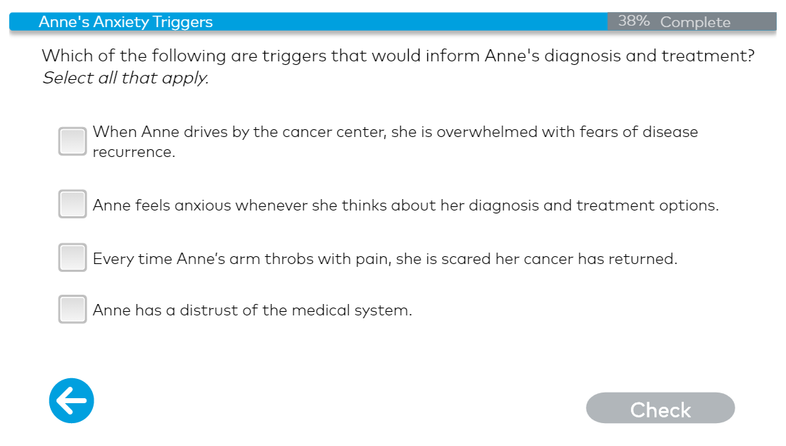
Audience Participation: Active Listening
Notes:
Rationale: All of he above. By identifying Anne’s triggers, you can work with her on desensitization strategies. In addition to the other triggers, clinicians should be aware that 7 in 10 Black patients report being treated unfairly base on their race.

Slide 10
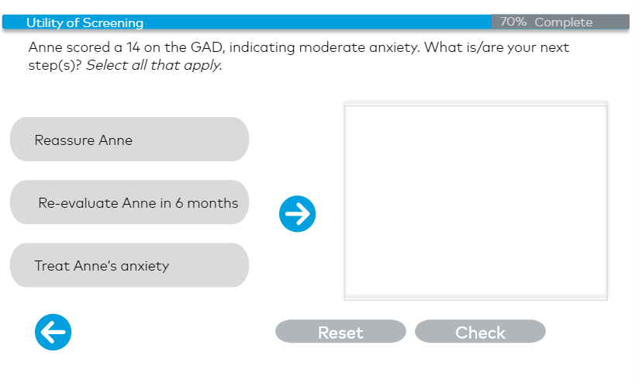
Audience Participation: Clinician Responsibility
Notes:
Answer: reassure and treat
Acknowledge that she is suffering and there are things you can do to help
Many patients with serious illness have clinically significant anxiety symptoms impacting their daily function

Slide 11
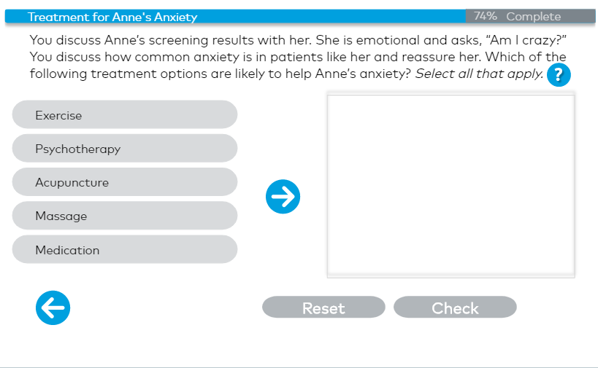
Audience Participation: Reassurance/Treatment Options
Notes:
All of the above

Slide 12
Outcomes
9,000 course completions (19’-21’)
87% report implement practice changes
92% report tech format was easy
Notes:
7965/9097 =87%

Slide 13
Very good course, recommending to coworkers
It will be helpful as I think there are a lot of patients with undiagnosed anxiety that would benefit from these therapies
"It has helped me to slow down and really pay attention to what my pts are saying-or not saying but relaying in their voice, actions/reactions, questions,etc."
Format was enjoyable and promoted learning.
Everything was clear and easy to understand.
Great information.
Learned lot.
Having the direct training to deal with emotions directly has allowed for a smoother more genuine conversation with families.
Helped me navigate the serious illness conversation with confidence.
Good information for when people come in that get diagnosed with cancer and are having surgery to make sure they are getting the help they need

Slide 14
Challenges
Technology glitches
Maintenance of CEUs
Lack of real-time engagement

Slide 15
Technology can change health care
Palliative care principles - focused on discussion of treatment preferences and alleviating symptom burden - infused in a low-cost, scalable online training format

Slide 16
Patient-Centered Care
To help address some of the inequities in care for Black patients, this online course emphasizes:
Anxiety is common and distressing and should be routinely screened for– in every encounter
Listening for “trigger words” to identify anxiety
Active listening and validating the feelings of the patient can help build trust

Slide 17
THANKS!
Take the course: https://www.capc.org/training/symptom-management/anxiety/
Using Palliative Care to Support Equitable Care in the Midst of COVID-19 (https://www.capc.org/blog/using-palliative-care-support-equitable-care-midst-covid-19/)
Contact information:
Brittany.Chambers@mssm.edu
Twitter: @BrittanyMonaye

