Slide 1
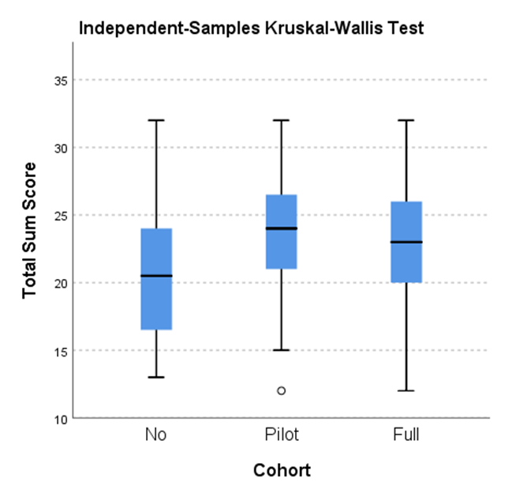

Denizard-Thompson N, Palakshappa D, Vallevand AL, DiGiacobbe G, Damman AM, Miller DP
Wake Forest School of Medicine
Equipping Tomorrow’s Physicians to Care for Underserved Populations through Community Engagement and Instruction on Social Determinants during the Clinical Clerkships
BACKGROUND:
Social determinants of health (SDH), conditions in which people are born, live, and age, lead to significant disparities in health
Physicians often have a limited understanding of the SDH and few medical schools have curricula in how to address these factors
We developed and evaluated a longitudinal curriculum that was integrated into the clinical clerkships to help students better understand the SDH and the unique needs of underserved populations
METHODS:
We implemented the curriculum and conducted a longitudinal cohort study of medical students at one medical school.
We collected data on the first two cohorts that participated in the curricula: MS2019 participated from June 2017-June 2018 and MS2020 participated June 2018-March 2019.
The curriculum consists of a series of ten modules focused on SDH and collaborations with community organizations
Pre- and post- surveys to evaluate the change in students’ knowledge and confidence. Administered the post survey to the MS2018 class who served as a control group
We used non-parametric Mann-Whitney and Wilcoxon Rank Sum tests to evaluate for change in students’ confidence and knowledge after completing the curriculum and to evaluate for end of year differences between the MS2019 and MS2020 (curriculum) and MS2018 (control) classes.
RESULTS:
Table: Linear Mixed Effects Model evaluating change in Total Confidence and Knowledge Score over Time
We found a significant increase in the total score over time for both classes
Significant differences between baseline and end of clerkship (15.7 vs 23.9, p = .001) and baseline and end of school (15.7 vs 23.9, p = .001) mean estimates, but not between the end of clerkship and end of school (23.87 vs 23.93, p = 1.000)
Figure : Difference in End of Year Survey Scores
CONCLUSIONS:
A longitudinal curriculum that combined didactic learning and community engagement in the SDH improved students’ self-reported confidence and knowledge with working with underserved populations
Students who participated in the curriculum reported higher knowledge and confidence than students who did not receive the curriculum
Future research should focus on how the curriculum changes students’ behaviors & developing validated measures to assess students’ understanding of SDH

