Slide 1


Building Awareness and Breaking Down Barriers – a workshop addressing racism and privilege for family medicine residents.
Jennifer Liu MD MPH, Jessica Koran-Scholl PhD, Alberto Marcelin MD, Andrea Jones MD, Melanie Menning MD MPH, Sue Evans MD, Hannah Christiansen MD, Alex Dworak MD, Ryan Hunter MD, Jenenne Geske PhD
Department of Family Medicine, University of Nebraska Medical Center, Omaha, NE 68198
BACKGROUND
METHODS
RESULTS
Eighteen years ago, the IOM released its landmark report, Unequal Treatment, about the bias, prejudice, and stereotyping that contribute to differences in care, yet African Americans and other minorities continue to suffer disproportionately from chronic, treatable conditions.¹ In 2020, we find ourselves witnessing two pandemics: COVID-19 and heightened systemic racism in this country. The pandemic has illuminated existing healthcare disparities, showing that BIPOC (Blacks, Indigenous, and People of Color) have higher cases, hospitalization, and mortality from COVID-19.²
Evidence that these disparities can be perpetuated by healthcare professionals:
Black babies are 3 times more likely to die when cared for by White doctors (vs. Black doctors).³
BIPOC comprise only 10% of the active practicing workforce but continue to report discrimination and exclusion in research, teaching, and providing care.⁴
As medical educators, we must acknowledge systemic racism and its harms and commit to dismantling the structural racism and inequity that still exists in our institutions. This session outlines a multifaceted approach that centers on discussion of social and structural determinants of health in one’s own community.
The session consisted of:
Lectures
Video segments
Reflection
Racial wealth gap simulation that highlighted federal policies that have led to structural harm.
Intern residents participated in the workshop during their orientation month in July 2020. The setting was a mix of small group discussion with some material presented over zoom. Second- and third-year residents participated in a similar workshop in November 2020, but all content was delivered via zoom and done remotely in breakout groups (due to the COVID pandemic).
Surveys were administered to all participating residents before and immediately after the workshop. Surveys consisted of 8 items assessing respondents’ education in and understanding of bias and racism. Responses were not matched from Pre to Post administration.
Seventeen interns attended the workshop and all completed the pre and post surveys. Twenty-one second- and third-year residents attended the workshop. All completed the pre survey and 19 completed the post survey.
Respondents demonstrated statistically significant improvements in all 8 questions concerning their education in and understanding of bias and racism. Many were eager to learn about the next steps in addressing bias and racism along with practical solutions.
However, there were several critical comments regarding the session, some lengthy in response. The following are a few themes that emerged from their comments:
Denial about the existence of systemic racism
Factual misrepresentation
White shaming
Political agenda
Race baiting
RESULTS
Conclusion and Future Directions
CURRICULUM
While there were improvements in knowledge and understanding of racism as a social and structural determinant of health, feedback of the content that was delivered was mixed. Before we engage in the next steps of training residents how to address and respond to racism, we are reassessing our strategies in delivering this important topic. Awareness and acknowledgement of systemic racism must be reckoned with. It will require continued collaboration, commitment, education and crucial conversations to advance health equity and anti-racism in medicine.
Intern orientation provided an opportunity for us to reaffirm the importance of this topic for our new residents. We also assimilated this content to the second- and third-year residents.
GOALS:
Bring awareness to racism as a structural determinant of health.
Increase the capacity to recognize and respond to the ways in which racism contributes to the vulnerability and ill health of the patients and communities we serve.⁵
References
Nelson, A. Unequal treatment: confronting racial and ethnic disparities in health care. J Natl Med Assoc. 2002 Aug; 94(8):666-8
Raifman M.A., Raifman J.R. Disparities in the population at risk of severe illness from COVID-19 by race/ethnicity and income. Am. J. Prev. Med. 2020;59:137–139.
Brad N. Greenwood, Rachel R. Hardeman, Laura Huang, Aaron Sojourner. Physician–patient racial concordance and disparities in birthing mortality for newborns. Proceedings of the National Academy of Sciences Sep 2020, 117 (35) 21194-21200; DOI: 10.1073/pnas.1913405117
Palepu A, Carr PL, Friedman RH, Amos H, Ash AS, Moskowitz MA. Minority faculty and academic rank in medicine. JAMA. 1998;280(9):767-771. doi:10.1001/jama.280.9.76
Metzl JM, Hansen H. Structural competency: theorizing a new medical engagement with stigma and inequality. Soc Sci Med. 2014;103:126-133. doi:10.1016/j.socscimed.2013.06.032
Gaskin DJ, Dinwiddie GY, Chan KS, McCleary RR. Residential segregation and the availability of primary care physicians. Health Serv Res. 2012;47(6):2353-2376. doi:10.1111/j.1475-6773.2012.01417
Fiscella K and Mechelle R. Sanders. Racial and Ethnic Disparities in the Quality of Health Care. Annual Review of Public Health 2016 37:1, 375-394
STEPS:
Acknowledge our own privilege, hierarchy in health care, and unconscious bias.
Examine the historical and structural roots of racism- the root causes of health disparities- including the living and working conditions of our own BIPOC communities in Omaha.
Develop skills needed to address racism across multiple setting and promote health equity in clinical decision making.
Develop concrete plans to promote health equity and demonstrate anti-racist behavior recognizable to the BIPOC community.
* Scored on a 5-point scale where 1=Strongly Disagree, 2=Disagree, 3=Neutral, 4=Agree, and 5=Strongly Agree

Slide 2
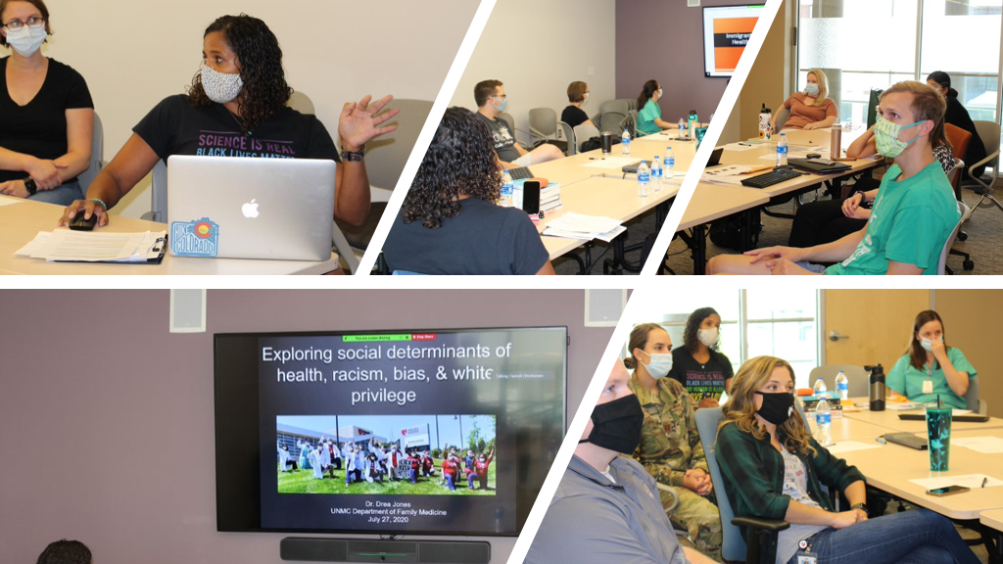

Slide 3
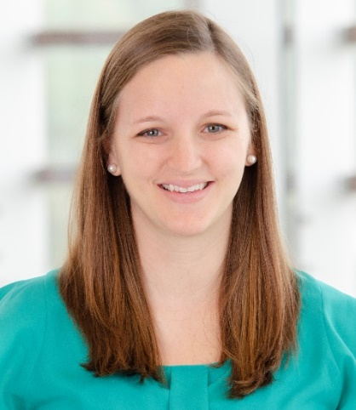
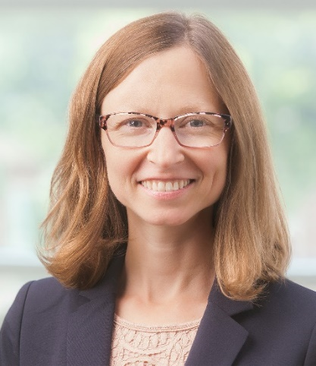
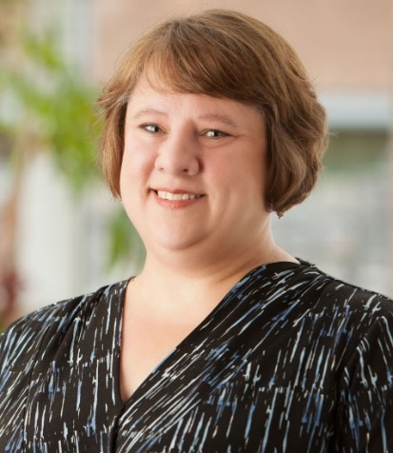
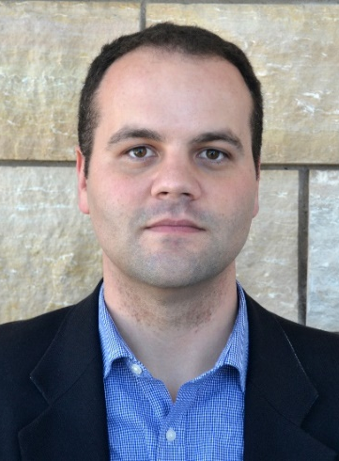
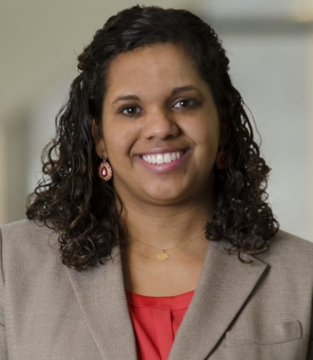
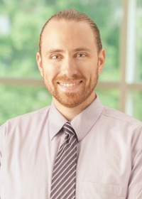
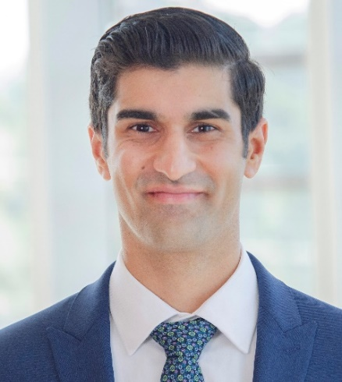
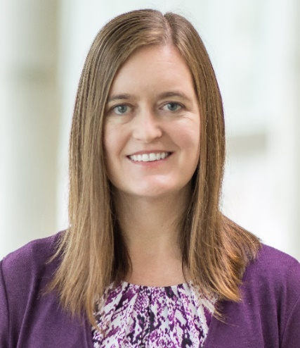
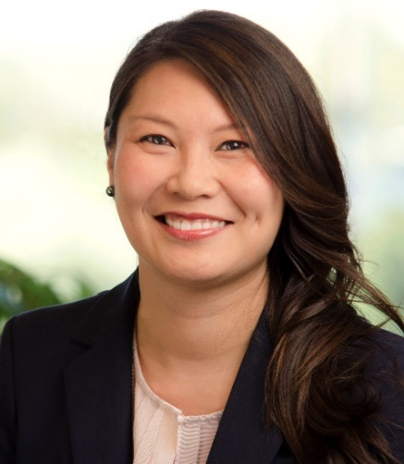
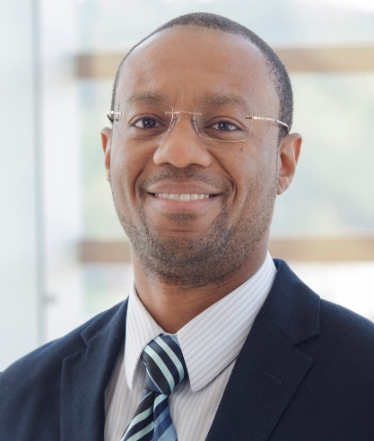
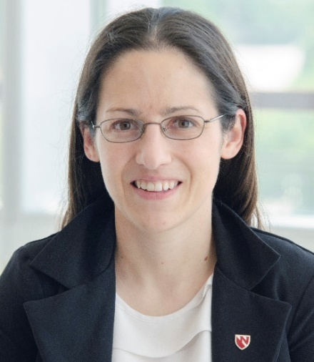
Social Determinants of Health Education Committee
Hannah Christiansen, MD
Susan Evans, MD
Jenenne Geske, PhD
Ryan Hunter, MD
Andrea Jones, MD
Alex Dworak, MD
Neil Kalsi, MD
Jessica Koran, PhD
Jennifer Liu, MD, MPH
Melanie Menning, MD MPH
Alberto Marcelin, MD

