Slide 1
Racism, Linguistics, and
Medical Spanish Education
Opportunities for Caring for Linguistic Minorities with Equity
Glenn Martínez, PhD, MPH
Pilar Ortega, MD
Marco Alemán, MD
Tiffany Shin, MD
Alejandra Zapién-Hidalgo, MD, MPH
Notes:
Each person introduce themselves briefly in order of authors on title page

Slide 2
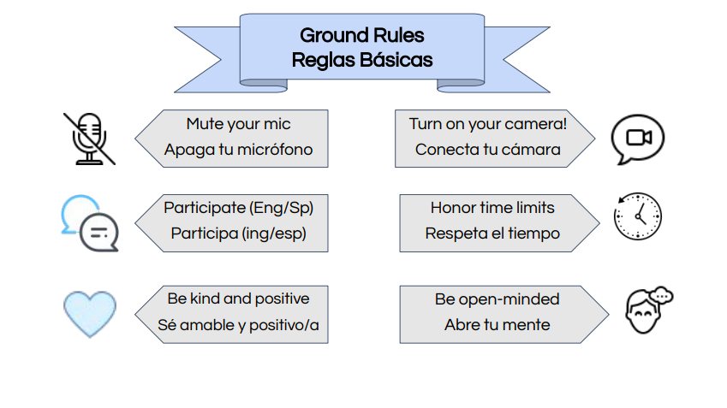
Welcome
Notes:
Ale

Slide 3
Icebreaker
What is your favorite Latinx food?
Notes:
Pilar

Slide 4
Learning Objectives
To understand the raciolinguistic perspective
To apply concepts of language & race to the teaching of communication skills with linguistic minority patients (e.g., medical Spanish courses)
To evaluate curricular materials – dialogues, case-studies, and SP scripts – to identify raciolinguistic hierarchies
To discuss resources that can be useful in creating medical language course materials that appropriately address raciolinguistic hierarchies
Notes:
Glenn

Slide 5
Raciolinguistics and Communication Skills Curricula
Racial logics | Interaction of race, language, ethnicity, national origin | Perception of non-English speakers as health illiterate Perception of Latinos as “white”
Raciolinguistic hierarchies | Microaggressions | Medical student with “Spanish-sounding” name is asked to interpret
Listening subjects | Implicit bias | Cultural health beliefs Varieties of Spanish
Notes:
Glenn/Pilar (10 min)

Slide 6
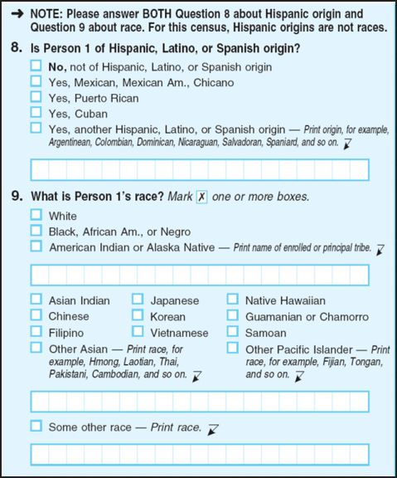
Notes:
Glenn/Pilar (10 min)

Slide 7
Raciolinguistics and Communication Skills Curricula
Racial logics | Interaction of race, language, ethnicity, national origin | Perception of non-English speakers as health illiterate Perception of Latinos as “white”
Raciolinguistic hierarchies | Microaggressions | Medical student with “Spanish-sounding” name is asked to interpret
Listening subjects | Implicit bias | Cultural health beliefs Varieties of Spanish
Notes:
Glenn/Pilar (10 min)

Slide 8
An Encounter
https://www.ahrq.gov/teamstepps/lep/videos/opportunity/index.html
What do you observe in the encounter?
How does the encounter make you feel?
Identify potential ways that the interaction showed raciolinguistic hierarchies.
The nurse's attitude
The interpreter's performance
The patient’s feelings
The doctor’s performance
Propose concrete suggestions for undoing raciolinguistic stereotypes and for improving the teaching of our students.
Notes:
What do you observe in the encounter?
How does the encounter make you feel?
Identify potential ways that the interaction showed raciolinguistic hierarchies.
The nurse's attitude
The interpreter's performance
The patient’s feelings
The doctor’s performance.
Propose concrete suggestions for undoing raciolinguistic stereotypes and for improving the teaching of our students.
Here is the video called a success where they do all correctamente! https://youtu.be/kj-vaBPN34A

Slide 9
Discussion
Discussion

Slide 10
Undoing Raciolinguistic Hierarchies in Medical Spanish Teaching
-Attitudes
-Performance
-Attention to feelings
Notes:
Tiffany:
Take home points about the encounter
-Tone
-Assumptions
Specific tips
-Help students recognize biases
-Help students appreciate the rich and heterogeneous linguistic and cultural practices within communities
-Curricular materials and patient cases should reflect rich practices and be careful that they do not unintentionally reinforce raciolinguistic hierarchies and sterotypes so that learners view Spanish speakers through a biased lens (i.e. myriad of “social problems”-- alcoholism, teen pregnancy, poverty, incarceration

Slide 11
References + Resources
Martínez, GA. Spanish in Health Care: Policy, Practice and Pedagogy in Latino Health. New York: Routledge. 2o20.
Ortega, P; Shin, TM; Pérez-Cordón, C; Martínez, GA. Incorporate Language in Medical Education to Address Structural Barriers to Care During the COVID-19 Pandemic and Beyond. Academic Medicine. Nov 2020 - Published Ahead of Print.
Alim, S; Rickford J; Ball A. Raciolinguistics: How language shapes our ideas about race. Oxford: Oxford University Press. 2016.
Perez D; Sribney W; Rodriguez M. Perceived discrimination and self-reported quality of care among Latinos in the United States. Journal of General Internal Medicine. 24 (Suppl 3): 548-54. 2009.
Connors K. Barriers Latino patients face in the pediatric emergency department. Pediatric Nursing 45: 37-41. 2019.
Rosa, J. Looking like a language, sounding like a race: Raciolinguistic ideologies and the learning of latinidad. Oxford: Oxford University Press. 2019.
Video Resource: https://www.ahrq.gov/teamstepps/lep/videos/opportunity/index.html
National Association of Medical Spanish: https://NAMSpanish.weebly.com

