Slide 1
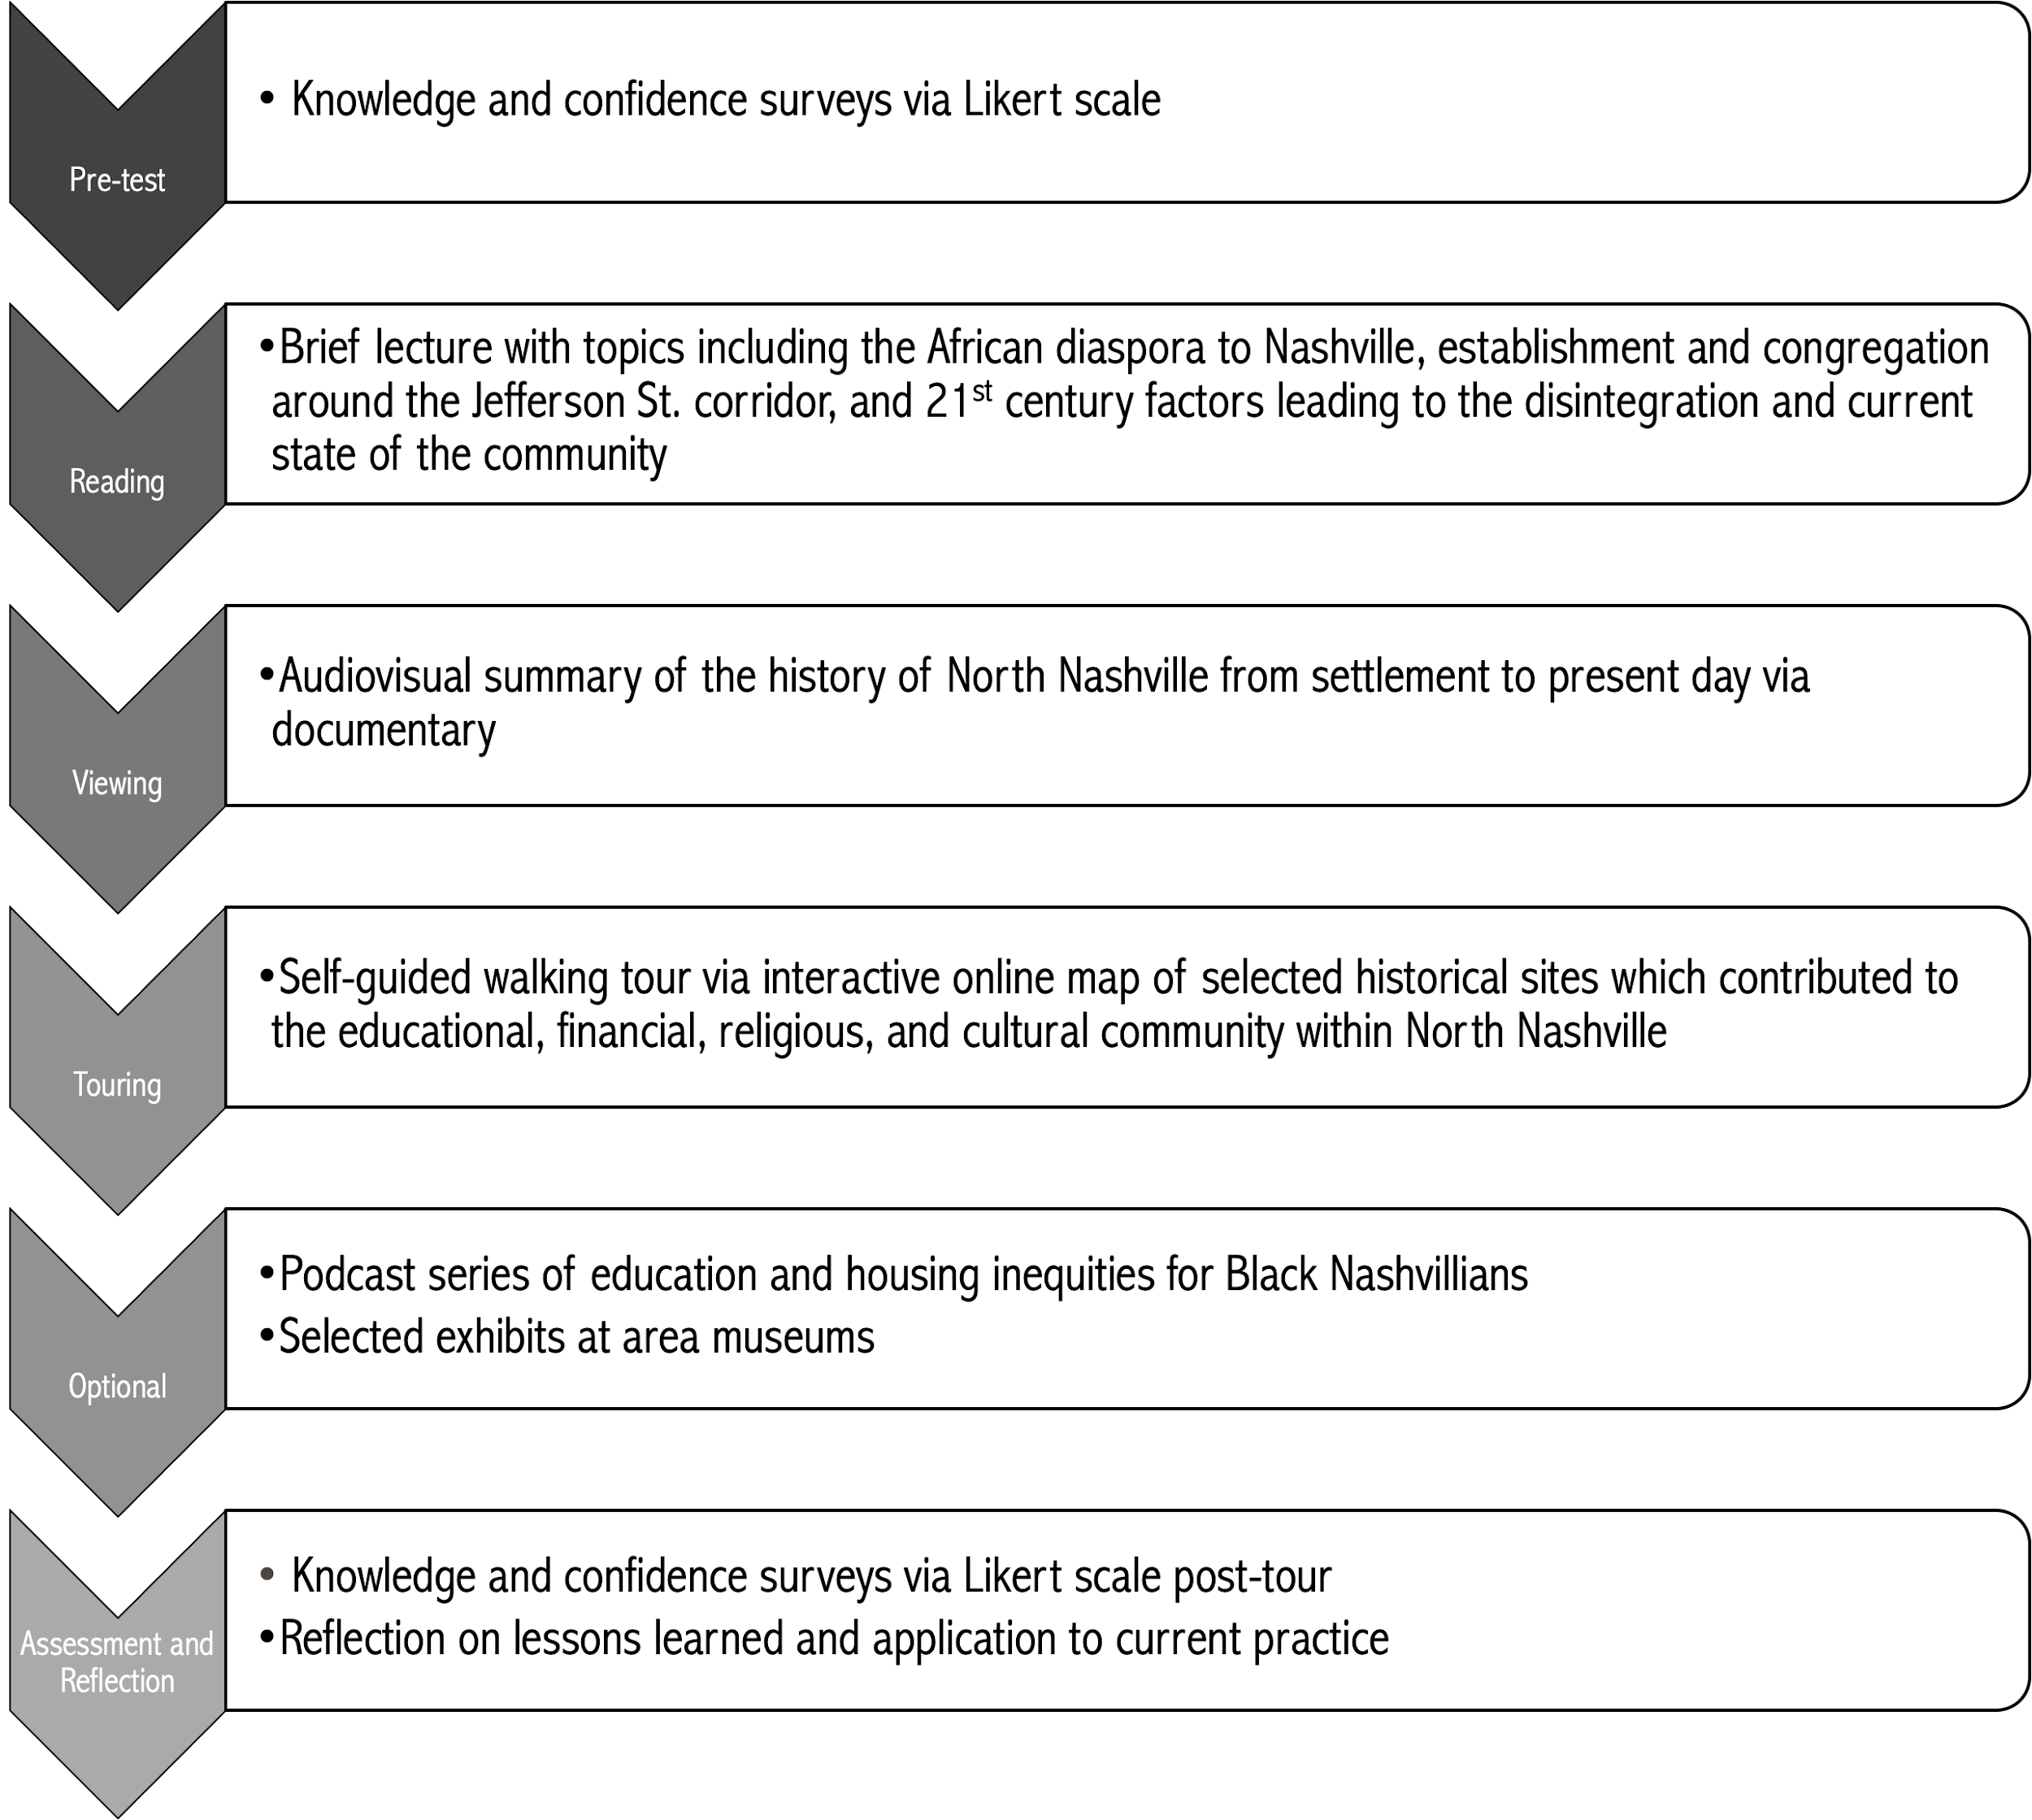
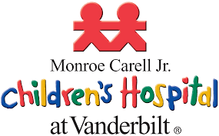
A Multimodal Black History Tour: Increasing Physician Comfort with Critical Race Theory and Trauma-Informed Care
Natalia Sidhu, MD; Rosemary Hunter, MD
BACKGROUND
METHODS
DISCUSSION
With increased national tension among communities of color, there exists an ever-increasing recognition and responsibility for medical providers to have awareness of the historical roots of structural racism that impacts their patient population. Such understanding is critical in mitigating racial bias in medicine and allows for the provision of culturally competent and compassionate care.
At present, although no formal curriculum for Vanderbilt pediatrics trainees exists regarding implicit bias, we find it prudent that we first gain perspective on the historic background that has led to the pervasive bias and current marginalization of Black residents in North Nashville. Pertinent topics include slavery and the African diaspora to Nashville, the establishment of a culturally-rich Black community along iconic Jefferson Street, and the subsequent destruction and unraveling of the area following the construction of I-40, redlining, and gentrification. This look into history elucidates why children and adolescents in North Nashville require trauma-informed care secondary to systemic racism which has led to multigenerational poverty and incarceration.
One principle of the pedagogy of racial justice education includes engaging learners with affective and multidimensional learning. Thus, we aimed to produce a multimodal Black history tour of North Nashville via exploration of historically significant locations in the area coupled with more in-depth historical investigation via museum visits, selected readings, podcasts, and documentaries in order to increase physician awareness of and prompt reflection on the history of North Nashville and its residents.
Pending response collection following the intervention, statistical analysis of pre- and post-tour surveys (both knowledge and confidence) will be undertaken. We anticipate this multimodal tour will create a statistically significant increase in trainees’ ability to discuss the deep racial history of North Nashvillians and confidence in providing personalized, trauma-informed care.
FUTURE DIRECTIONS
Following cohort study, we aim to disseminate the tour to all pediatrics residents and faculty. Resource guides and community partnerships can be established so that we may provide targeted, tangible resources to our families by way of youth mentorship opportunities, parenting classes, and mental health resources. Moreover, such a tour can be used to explore race relations among the other minority groups we serve including the Latinx and Egyptian populations in South Nashville.
REFERENCES
Amie T, Harbin MB, Bandy J. Teaching Race: Pedagogy and Practice. Vanderbilt University. https://cft.vanderbilt.edu/guides-sub-pages/teaching-race/. Published September 3, 2020. Accessed February 8, 2021.
Artwork: Facing North: Jefferson Street, Nashville: NPT. WNPT. https://www.wnpt.org/jefferson-street/artwork/. Accessed February 20, 2021.
Facing North: Jefferson Street, Nashville: NPT: Facing North: Jefferson Street, Nashville.; 2020. https://video.wnpt.org/video/facing-north-jefferson-street-nashville-yow19n/. Accessed February 8, 2021.
Lovett BL. The African-American History of Nashville, Tennessee, 1780-1930: Elites and Dilemmas. Fayetteville: Univ. of Arkansas Press; 1999.
Nashville. Historical Site Markers in Nashville. Nashville > Historical Commission > Services > Historical Markers > Historic Sites. https://www.nashville.gov/Historical-Commission/Services/Historical-Markers/Historic-Sites.aspx. Accessed February 8,, 2021.
Story Map Series. arcgis.com. https://www.arcgis.com/apps/MapSeries/index.html?appid=8dba65584072450ca8928a5f3408373f. Accessed February 8, 2021.
Trent M, Dooley DG, Dougé J. The Impact of Racism on Child and Adolescent Health. Pediatrics. 2019;144(2). doi:10.1542/peds.2019-1765
Tsai J, Crawford-Roberts A. A Call for Critical Race Theory in Medical Education. Academic Medicine. 2017;92(8):1072-1073. doi:10.1097/acm.0000000000001810
Williams P. Broken: Listening to the children of 37208. WTVF. https://www.newschannel5.com/news/newschannel-5-investigates/broken-listening-to-the-children-of-37208. Published July 2, 2020. Accessed February 8, 2021.
OBJECTIVES
To perform a targeted cohort educational intervention with survey of second-year pediatrics residents at Vanderbilt to meaningfully increase knowledge of racially-significant historical themes affecting North Nashvillians
To provide an arena by which pediatrics residents reflect on critical race theory, specifically the causes and effects of systemic racism and intersectionality for Black residents of North Nashville to provide trauma-informed care and address medical and societal inequities faced by this patient group
Fig. 1. Custom-made, online map for self-guided walking tour of North Nashville

