Slide 1
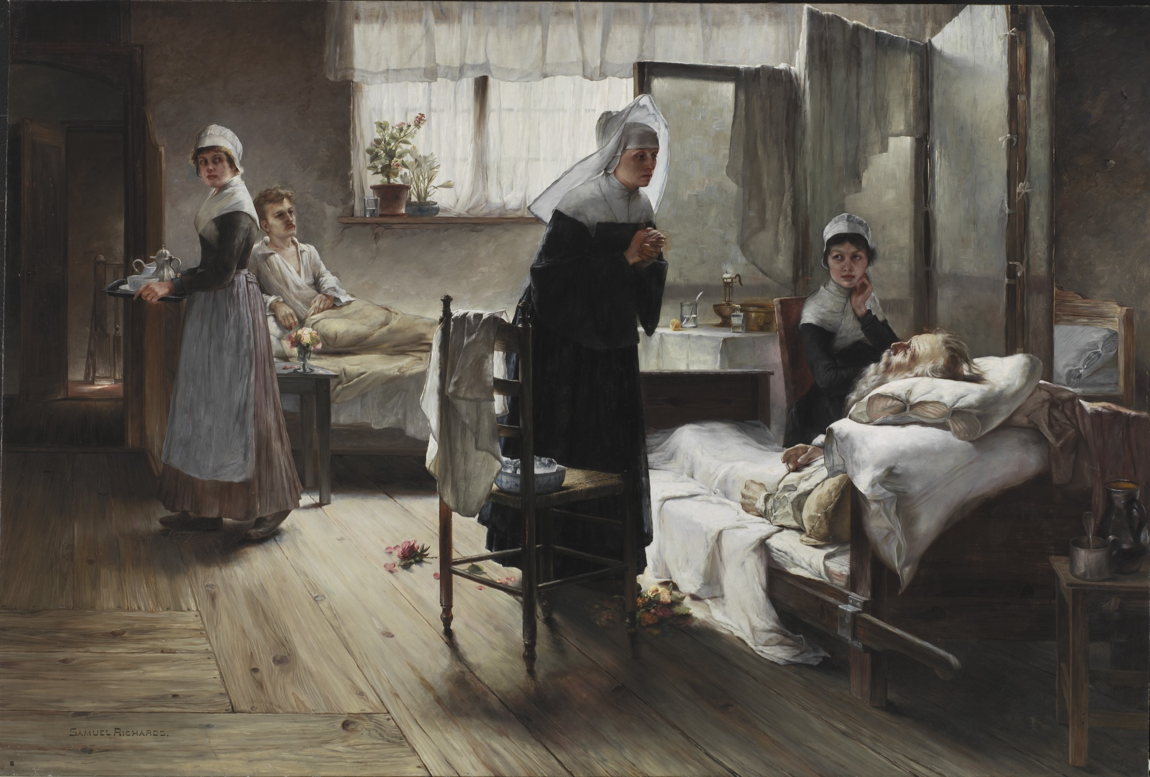
Visual Thinking Strategies (VTS): A New Role for Art in Teaching Physicians About Implicit Bias
Heba Osman DO, Suma Alzouhayli MS3, Ijeoma Nnodim Opara MD
Wayne State University School of Medicine
Introduction
Conclusions
Strong evidence highlights the link between implicit bias among healthcare providers and poor health outcomes in marginalized populations.
The COVID-19 pandemic has further emphasized existing health inequities
Government officials have mandated implicit bias training for licensure of all healthcare professionals in the state of Michigan.
Virtual Thinking Strategies (VTS) offers an innovative teaching approach to implementing implicit bias training
VTS uses art to help students improve observational, critical thinking, and communication skills.
It requires a trained facilitator to engage students with a work of art, encouraging thought and interpretation of what they perceive is happening.
Upon reflection and verbalization of one’s thoughts, students are able to learn and understand better.
Implicit bias among physicians is a manifestation of institutionalized racism and has been associated with poor health outcomes in marginalized populations
Existing health disparities highlighted by the COVID-19 pandemic
VTS is an effective and a creative method of raising awareness of implicit biases among physician trainees and can be a valuable model for bias training
It is imperative now more than ever that physicians undergo the appropriate training to become aware of these biases.
Future Directions
The WSUSOM/DMC Internal Medicine residency program will continue to implement VTS training
We plan to implement more session throughout the year to encourage continued reflection and acknowledgement of implicit bias, as literature supports continuity for long-term retention and implementation
We plan to transition VTS training for medical students and other residency programs in our hospital, state, and hopefully throughout the nation
More consistent interactions with art and applications in a clinical context is needed in order to solidify these skills for clinical practice
Figure 1. Image credits: Samuel Richards, Evangeline Discovering Her Affianced in the Hospital, 1889. Oil on canvas. Detroit Institute of Arts, Detroit, MI
Methods
We collaborated with the most visited museum in Michigan, the Detroit Institute of Arts (DIA)
The WSU/DMC Internal Medicine Residency program delivered a two-hour VTS workshop in the DIA with VTS-trained DIA facilitators, to elicit reflections on implicit bias.
Our VTS workshop entailed 3 components:
Open-ended questions about a work of art designed to provoke participants to look closer, put observations into words, and provide visual evidence for what they were seeing
Practice of learned skills in front of visual art and receive feedback to strengthen their understanding of VTS
Reflective group discussion to help participants understand how VTS can be used in patient interactions and reduce implicit bias
Results
Quantitative analysis:
Mean number of observations between pre- and posttests had significantly increased after the workshop: n = 59 pre-test, n=28 post-test: 3.86 vs. 5.29, p = 0.0013
Qualitative analysis of image included revealed some of the following themes:
Use of subjective terminology
Speculative thinking
Use of visual analogies
50% of participants responded that VTS has a role in medical training
40% reported that the workshop will change the way they practice medicine
References
Housen, A. C. (2002). Aesthetic thought, critical thinking and transfer. Arts and Learning Journal. 18(1), 99-131. Retrieved from http://educacaoartistica.dge.mec.pt/assets/aesthetic_thought.pdf
Reilly, J. M., Ring, J., &amp; Duke, L. (2005). Visual Thinking Strategies: A New Role for Art in Medical Education. Family Medicine, 37(4), 250–252.
National Center for Health Statistics (US). (2016). Health, United States, 2015: With Special Feature on Racial and Ethnic Health Disparities. National Center for Health Statistics (US).
Alliance for Health Reform (2004). Closing the gap: racial and ethnic disparities in healthcare. Journal of the National Medical Association, 96(4), 436–440.

