Slide 1
Evaluation of a Bilingual Cultural Hispanic/Latinx Workshop on Diabetes
Reniell Iniguez, BS
Pilar Ortega, MD
University of Illinois college of medicine, Chicago, IL

Slide 2
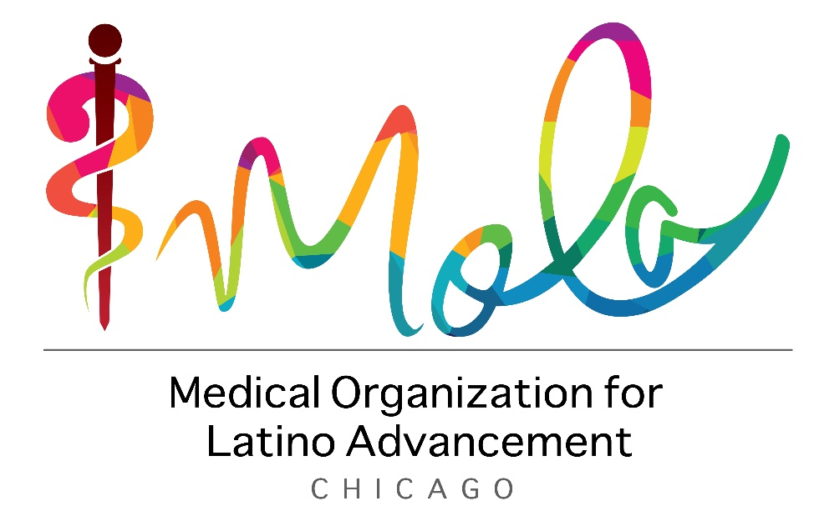
Project Funding
Research scholarship provided by Medical Organization for Latino Advancement, Chicago, Illinois

Slide 3
Background
Spanish heritage
and
second language learners
Medical education
Lack of resources that invest in the unique skills of students with some Spanish language or cultural experience
Health professions students may be underprepared to care for Hispanic/Latinx patients
Structural barriers in Latinx communities that perpetuate health disparities
Understanding and respecting the culture and language of the Hispanic/Latinx community are fundamental elements of combating structural barriers and racism in medicine.

Slide 4
Background
Spanish-speaking patients with Diabetes who have a Spanish-speaking doctor have better blood sugar control¹.
Providing linguistically and culturally appropriate health services is a recognized strategy to reducing general² and diabetes-specific health disparities³ in the Hispanic/Latinx community.

Slide 5
Our Workshop
Objectives
Apply bilingual diabetes knowledge in language-appropriate discussions with Hispanic/Latinx individuals.
Identify common Hispanic/Latinx beliefs and practices related to diabetes.
Describe the impact of clinician language and cultural skills on Hispanic/Latinx patients with diabetes.

Slide 6
Workshop Illustrations

Slide 7
Participant Demographics
92%
(47/51) participants identified as identified as Hispanic/Latino/Latina/Latinx
6%
(3/51) as White
2%
(1/51) as Black

Slide 8
Participants
Notes:
Of the 51 pre-workshop respondents, 47 (92%) identified as Hispanic/Latino/Latina/Latinx
Other category: (5) learners- (2) high school students, (1) taking a gap year, (1) post bac, (1) certified medical administrative assistant

Slide 9
Results
Question | Pre-Test |  | Post-Test |  | Difference | Effect size (Cohen's d) | P-valueª
 | Mean^{b} | SD | Mean^{b} | SD
Confidence explaining diabetes | 2.38 | 0.83 | 1.47 | 0.73 | 0.91 | 1.17 | < .001
Confidence explaining diabetes’ relation to general health | 2.20 | 0.84 | 1.42 | 0.62 | 0.77 | 1.05 | < .001
Familiarity with Latinx cultural beliefs about diabetes | 2.00 | 0.74 | 1.27 | 0.45 | 0.73 | 1.23 | < .001
Attitudes about diabetes prevention | 1.96 | 0.67 | 1.42 | 0.54 | 0.53 | .88 | < .001
Attitudes about prevention of complications | 2.04 | 0.82 | 1.47 | 0.62 | 0.58 | .81 | < .001
Attitudes about language skills | 1.82 | 0.91 | 1.44 | 0.76 | 0.38 | .46 | < .001
Intent to improve language skills | 1.31 | 0.51 | 1.13 | 0.34 | 0.18 | .42 | 0.02
Attitudes about cultural skills | 2.69 | 1.94 | 1.29 | 0.55 | 1.40 | 1.12 | < .001
Intent to improve cultural skills | 1.36 | 0.48 | 1.20 | 0.40 | 0.16 | .36 | 0.02
Key Findings
Statistically significant improvement in survey responses- marked increase in learners self rated confidence with diabetes cultural concepts in Spanish.
The workshop was effective across learners with variable Spanish-proficiencies.
High perceived class usefulness. All participants felt the workshop was valuable (44/51, 86%) strongly agreed and 14% agreed that they learned valuable cultural skills
4 point-Likert scale: 1=Strongly Agree, 2= Agree, 3= Disagree, 4=Strongly Disagree

Slide 10
Conclusion
Bilingual pedagogies may be an effective educational tool
Building upon the bilingual, bicultural skills of Spanish heritage or second language learners may better prepare future healthcare workers to care for Hispanic/Latinx communities
The workshop was beneficial across participants with varying levels of Spanish proficiency

Slide 11
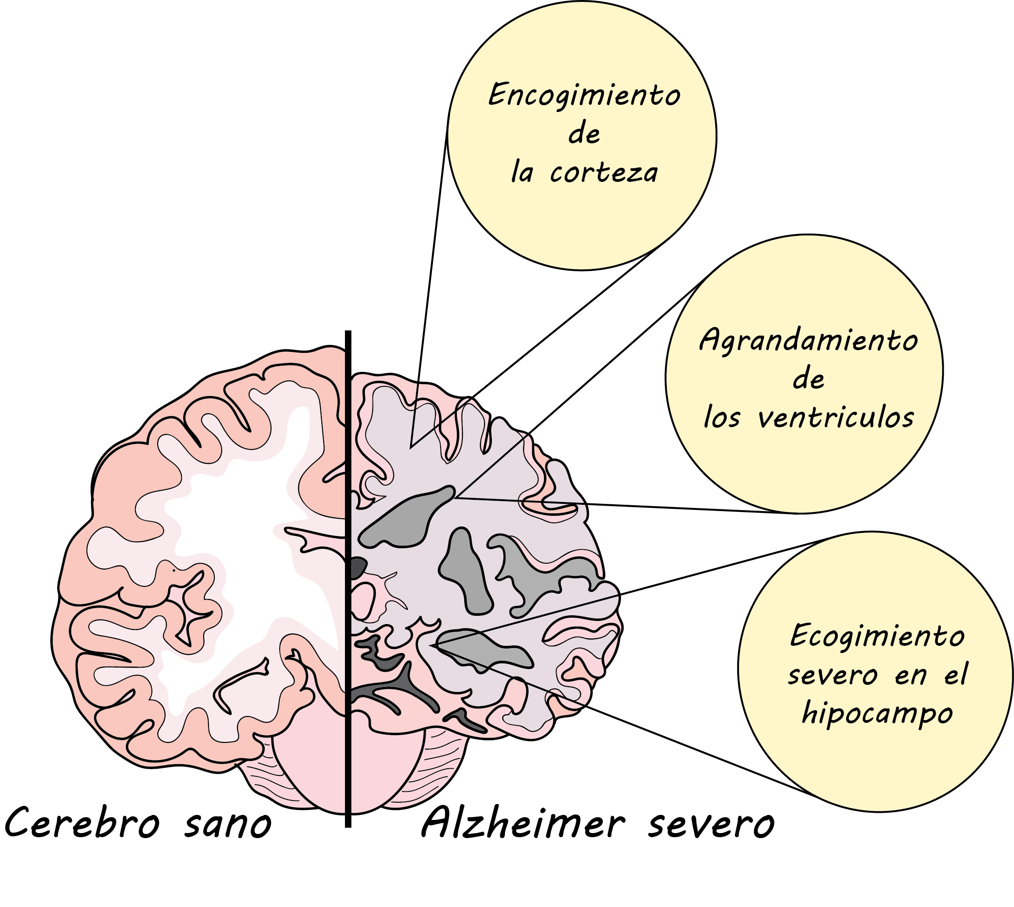
Future Study
Implement current module at other institutions
Create bilingual workshops centered around other health topics (dementia, cardiovascular disease, substance abuse, etc.)
Integrate bilingual formats into other educational opportunities

Slide 12
References
1. Fernández A, Schillinger D, Warton EM, et al. Language barriers, physician-patient language concordance, and glycemic control among insured Latinos with diabetes: the Diabetes Study of Northern California (DISTANCE). J Gen Intern Med. 2011;26(2):170-176. doi:10.1007/s11606-010-1507-6
2. Park, L., Schwei, R. J., Xiong, P., & Jacobs, E. A. (2018). Addressing cultural determinants of health for Latino and Hmong patients with limited English proficiency: Practical strategies to reduce health disparities. Journal of racial and ethnic health disparities, 5(3), 536-544.
3. Alvidrez, J., & Pérez-Stable, E. J. (2017). Diabetes Care in Latinos With Limited English Proficiency: What Do Language Concordant Clinicians Add?. JAMA internal medicine, 177(3), 313-315.

