Slide 1
Using a Systems Perspective to Transform Pediatric Clinical Practice:
Teaching & Clinical Improvement Opportunities
Lindsay Rosenfeld, ScD, ScM Jonathan Litt, MD, MPH, ScD
Research Staff, NICU GraDS Program
Boston Children’s Hospital, Division of Newborn Medicine
Institute for Child, Youth, & Family Policy, Heller School
for Social Policy & Management, Brandeis University
Social & Behavioral Sciences, Harvard TH Chan School
of Public Health
Undiagnosed Diseases Network, Harvard Medical School
Director, NICU GraDS Program
Boston Children’s Hospital, Division of Newborn Medicine
Pediatrics, Harvard Medical School
Social and Behavioral Sciences, Harvard TH Chan School of
Public Health
Neonatology, Beth Israel Deaconess Medical Center
Notes:
LINK with all handout links: https://docs.google.com/document/d/1FpCXW0VgUbvZoJwEkS_12h6pZ51g-7pCxRnFErE2eqg/edit
Slides 1-7 – LER; Slides 7-13 – JSL; Slides 14-28 – LER; Slides 29-33 JSL

Slide 2
Conflicts of Interest
We have no conflicts of interest to disclose nor do we have any financial relationships relevant to this talk.
The content of this presentation is, to the extent possible, fair, balanced, and free from bias.

Slide 3
Zoom & Group Expectations
Keep yourself muted unless participating in that moment.
Use the chat feature to engage with other participants.
Use the “raise hand” or chat feature to ask questions of the presenters. If we don’t respond in a timely manner, please unmute and ask your question / share your comment (in case we aren’t able to keep up with the chat!).
Respect for group / individual ideas.
Respect for each person in the Zoom room.
Meet people where they are.
Use video whenever possible to engage in active listening and foster collaboration/community.

Slide 4
Learning Objectives
Participants will be able to define developmental disability, racial and health equity, literacy environment, life course, and family engagement.
Participants will be able to practice applying racial and health equity, (health) literacy environment and family engagement for teaching and clinical improvement purposes.
Participants will be able to identify how this approach can help generate ideas for systems-change strategies (whether for classroom work or for testing in programs and institutions).

Slide 5

Roadmap
Introductions (5 min)
Frameworks (15 min)
  Social Ecological/Multi-level
  Social Determinants of Health
  Life Course
  Health Literacy
  Racial Equity
  Family Engagement
  ICF-CY
  Example: Participation, PREPARED
Case Study - Breakouts (20 min)
Large Group Debrief / Questions (20 min)

Slide 6
Roadmap
Introductions (5 min)
Frameworks (15 min)
  Social Ecological/Multi-level
  Social Determinants of Health
  Life Course
  Health Literacy
  Racial Equity
  Family Engagement
  ICF-CY
  Example: Participation, PREPARED
Case Study - Breakouts (20 min)
Large Group Debrief / Questions (20 min)

Slide 7
Introductions
Jonathan Litt (Jonathan.Litt@childrens.harvard.edu)
Neonatologist, Social Epidemiologist
Lindsay Rosenfeld (Lindsay.Rosenfeld@childrens.harvard.edu)
Social Epidemiologist
Parent of Former Micropreemies with Developmental and Medical
Complexity
Collaboration: Systems-Focused Approach
  Undergraduate and graduate classrooms (public health, public policy, health professional practice)
  Residency training (Rounds)
  Process improvement for clinical practice

Slide 8
Roadmap
Introductions (5 min)
Frameworks (15 min)
  Social Ecological/Multi-level
  Social Determinants of Health
  Life Course
  Health Literacy
  Racial Equity
  Family Engagement
  ICF-CY
  Example: Participation, PREPARED
Case Study - Breakouts (20 min)
Large Group Debrief / Questions (20 min)

Slide 9
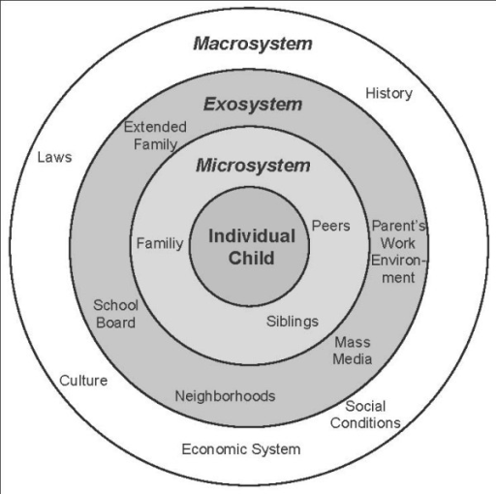
Bronfenbrenner’s Social Ecological Model
Figure 1 (Niederer, et. al.)
http://openi.nlm.nih.gov/detailedresult.php?img=2676270_1471-2458-9-94-1&req=4
Family
Niederer I, et al. (2009). Influence of a lifestyle intervention in preschool children on physiological and psychological parameters (Ballabeina): study design of a cluster randomized controlled trial
BMC Public Health .

Slide 10
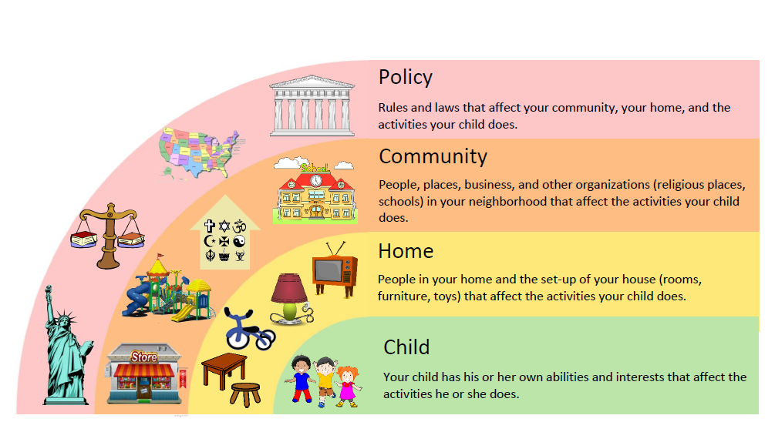
Social Ecological Model, PREPARED, Kramer & Rosenfeld, 2018

Slide 11
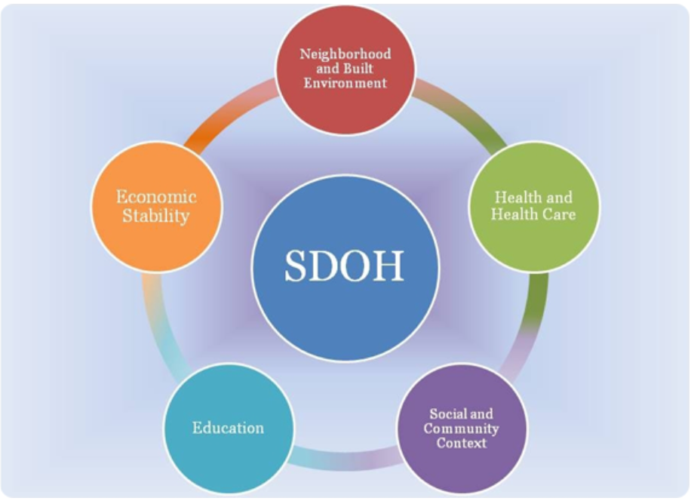
http://www.healthypeople.gov/2020/topicsobjectives2020/overview.aspx?topicid=39
Social Determinants of Health

Slide 12
Life Course
“A life course approach offers an interdisciplinary framework for guiding research on health, human development, and aging.”
Impact of early life exposures on later life outcomes
Timing and chronicity of exposures
Vulnerability, resilience, plasticity
Critical/Sensitive period
Kuh, Ben-Shlomo, et al, 2003

Slide 13

Life Course Pathways

Slide 14
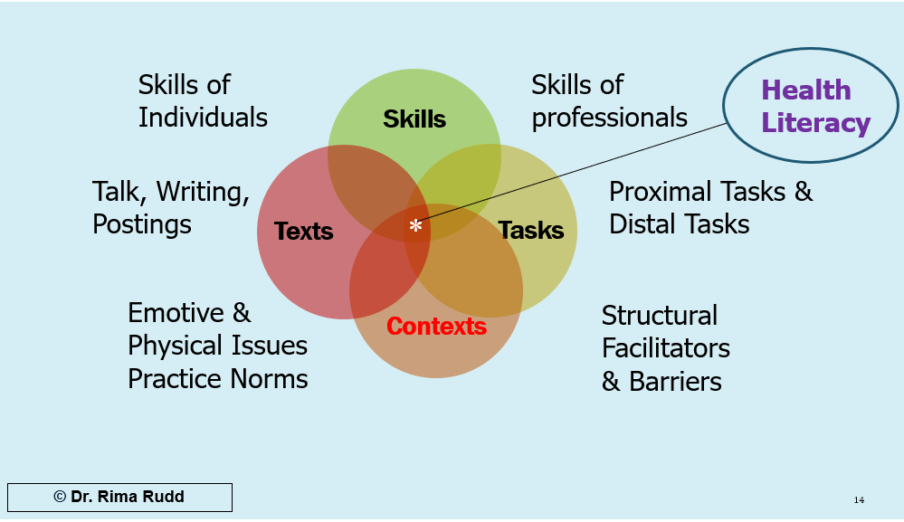
Health Literacy Environment
Users and Systems: Interaction

Slide 15

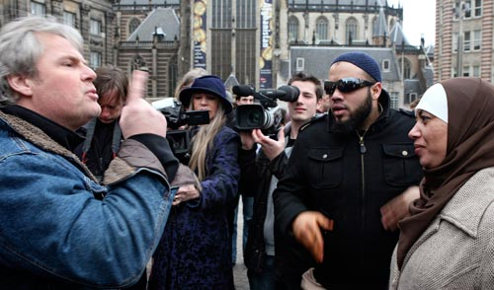

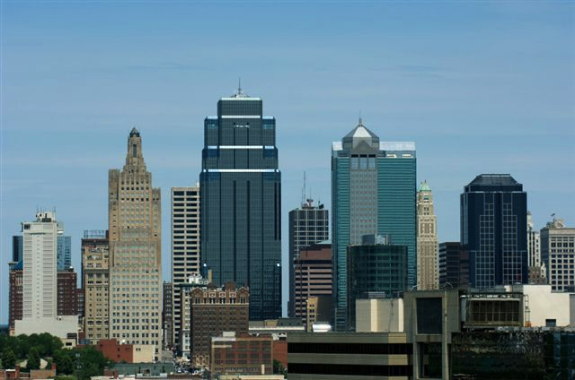
Levels of Racism
Adapted from the Applied Research Center & Southern Jamaica Plain Health Center, Boston, MA
INTERNALIZED
Interpersonal
MICRO LEVEL
INSTITUTIONAL
STRUCTURAL
MACRO LEVEL

Slide 16
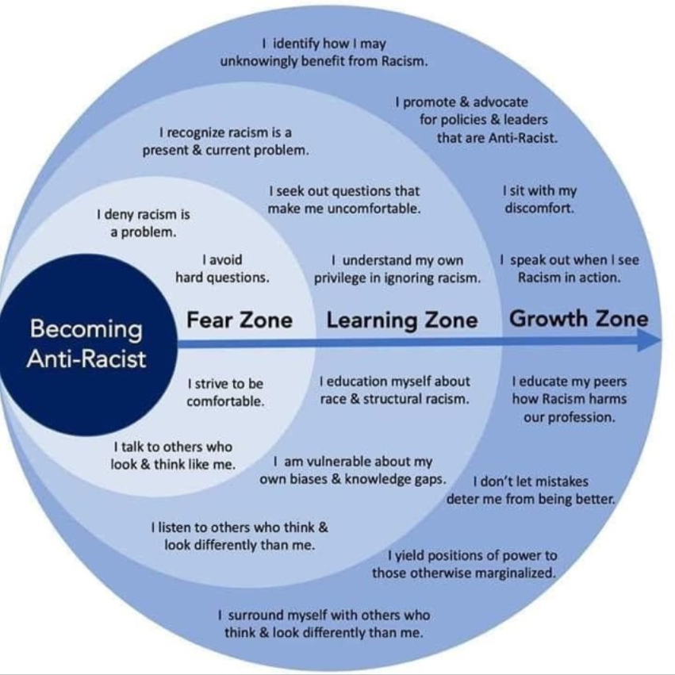
Becoming Anti-Racist
- Individual
- Population
surgeryredesign.com

Slide 17
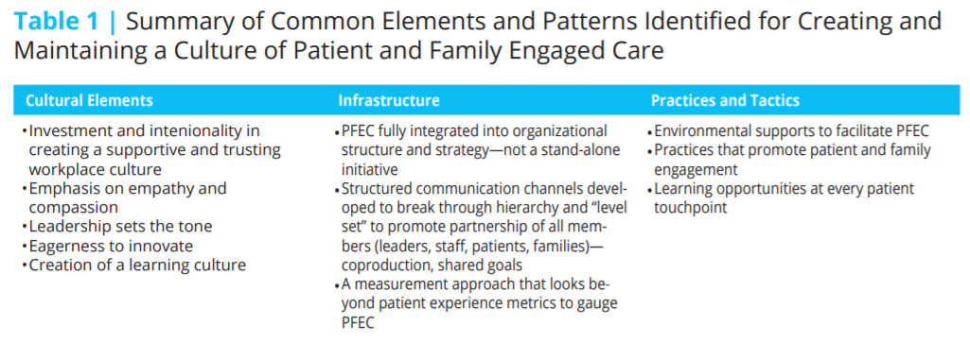
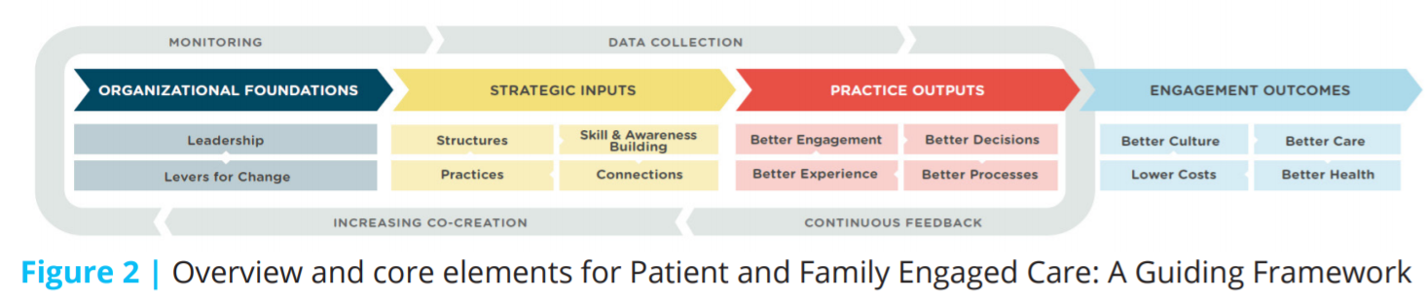
Patient and Family Engaged Care
Frampton, S. B., S. Guastello, L. Hoy, M. Naylor, S. Sheridan, and M. Johnston-Fleece. 2017. Harnessing Evidence and Experience to Change Culture: A Guiding Framework for Patient and Family Engaged Care. NAM Perspectives. Discussion Paper, National Academy of Medicine, Washington, DC. doi: 10.31478/201701f

Slide 18
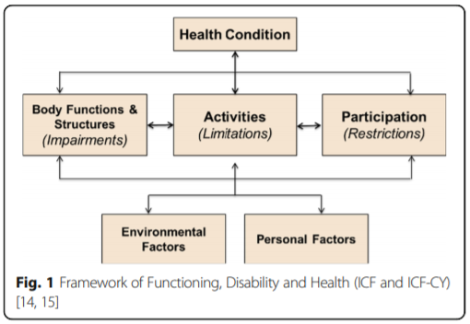
International Classification of Functioning, Disability & Health
Children & Youth (ICF-CY)
https://www.researchgate.net/publication/316012161_Methods_for_conceptualising_'visual_ability'_as_a_measurable_construct_in_children_with_cerebral_palsy

Slide 19
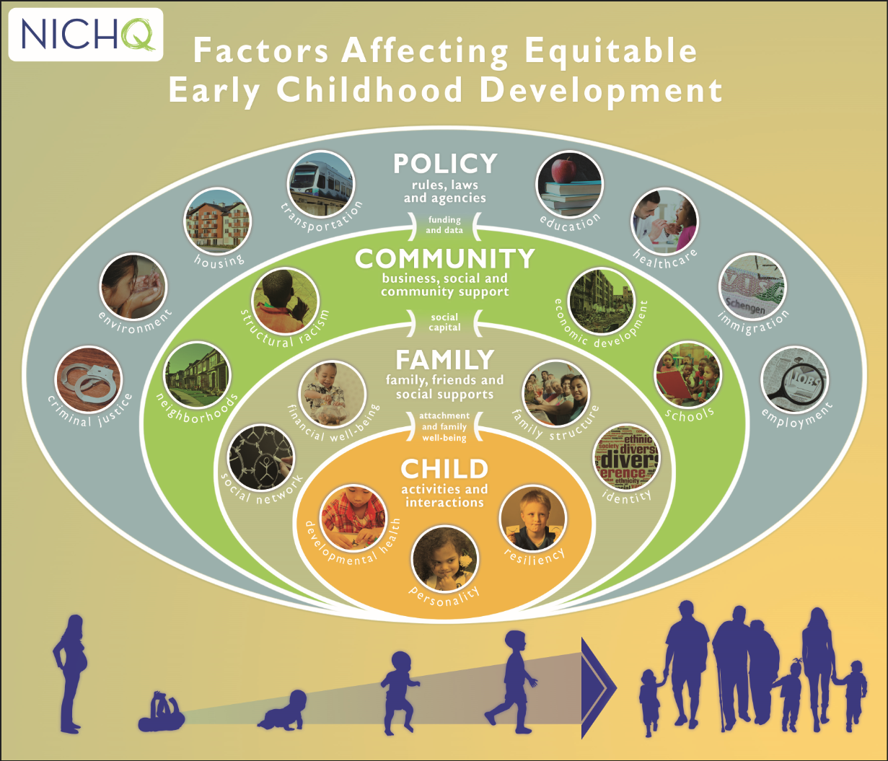

Slide 20
Common approach to thinking about disability and participation
Physical Impairments and Disabilities
Difficulties moving around
Difficulties using hands to work with things
Sensory Impairments and Disabilities
Difficulties hearing
Difficulties seeing
Difficulties communicating with others
Cognitive Impairments and Disabilities
Difficulties with attention and memory
Difficulties understanding
Difficulties communicating with others
Difficulties doing activities at school, work, and the community
Kramer & Rosenfeld, 2018
Notes:
Jessica

Slide 21
Environmental approach to thinking about disability & participation
Physical Impairments and Disabilities
Difficulties moving around
Difficulties using hands to work with things
Sensory Impairments and Disabilities
Difficulties hearing
Difficulties seeing
Difficulties communicating with others
Cognitive Impairments and Disabilities
Difficulties with attention and memory
Difficulties understanding
Difficulties communicating with others
Environmental Barriers
Stairs
Small materials
Tight spaces
Noisy environments
Low lighting
Lack of translators
Confusing materials
Talking too fast
Rigid rules for task completion
Difficulties doing activities at school, work, and the community
Kramer & Rosenfeld, 2018
Notes:
Jessica

Slide 22
Environmental approach to resolving participation challenges
Physical Impairments and Disabilities
Difficulties moving around
Difficulties using hands to work with things
Sensory Impairments and Disabilities
Difficulties hearing
Difficulties seeing
Difficulties communicating with others
Cognitive Impairments and Disabilities
Difficulties with attention and memory
Difficulties understanding
Difficulties communicating with others
Ramps, elevators, and curb cuts
Specialized technology
Spacious rooms and hallways
One person talks at a time
Individualized lighting
Translators
Materials in braille
Directions written in clear language with pictures
Speaking at a slower pace
Providing extra time or breaks
Environmental Supports
Able to do activities at school, work, and the community
Kramer & Rosenfeld, 2018
Notes:
Jessica

Slide 23
Tips for Staying Healthy: Individual/Lifestyle Perspective
1. Don’t smoke. If you do, stop.
2. Eat a balanced diet, include fruits/vegetables.
3. Keep physically active.
4. If you drink, do so in moderation.
5. Cover up in the sun and protect your children.
6. Practice safe sex.
7. Participate in appropriate health screenings.
8. Drive defensively; don’t drink and drive.
9. Manage your stress.
10. Maintain social ties.
Adapted from Southern Jamaica Plain Health Center, Boston, MA

Slide 24
Tips for Staying Healthy: A Social Determinants Perspective
1. Don’t be poor. If you can, stop. If you can’t, try not too be poor for too long.
2. Don’t have poor parents.
3. Don’t live in a poor neighborhood.
4. Own a car – but use only for weekends and walk to work.
5. Practice not losing your job and don’t become unemployed.
6. Don’t be illiterate.
7. Avoid social isolation.
8. Try not to be part of a socially marginalized group.
Adapted from Southern Jamaica Plain Health Center, Boston, MA

Slide 25
Example: Respite Hours
Problem: Families describe receiving different respite benefits, despite same needs.
Solution 1: Tell families what they must say or do to get more hours.
Solution 2: Work with home health care, insurance providers, etc. to discuss family coverage needs and figure out inequities in receipt of services. Create systems changes.

Slide 26
Roadmap
Introductions (5 min)
Frameworks (15 min)
  Social Ecological/Multi-level
  Social Determinants of Health
  Life Course
  Health Literacy
  Racial Equity
  Family Engagement
  ICF-CY
  Example: Participation, PREPARED
Case Study - Breakouts (20 min)
Large Group Debrief / Questions (20 min)

Slide 27
Case Study: Finding a Preschool
Case Study: Finding a Preschool (Adapted from PREPARED, Kramer & Rosenfeld, 2016)
Ms. Martin has a two-and-a-half-year-old son, Daniel. Daniel will not get Early Intervention once he turns three in a couple of months. Mom wants Daniel to keep trying new activities and learning new skills. Daniel is working on getting dressed without help, playing with other kids, and paying attention. He is starting to enjoy playing with other kids. Another one of Daniel’s IFSP* goals in Early Intervention is to be “preschool ready.”
Mom is thinking about putting Daniel in pre-school after he finishes up Early Intervention. She would really like Daniel to go to the private preschool down the street where all the neighborhood kids go. Mom’s friend, whose kids went to the neighborhood preschool, said she’s never seen any children with disabilities in this preschool.
Mom asks Daniel’s Early Intervention coordinator how to apply to preschool. Mom is most worried about her son getting his medicine during the day. Mom also wants to find out if the preschool knows how to work with children with disabilities. The coordinator says Mom should call the preschool to get information.
Mom calls the preschool. The preschool says Mom needs to fill out application forms before they can answer all of her questions. The application forms are long and confusing. The preschool tells her to hurry up with her forms because there are not many spaces left in the classroom.
Mom meets again with the coordinator. She tells the coordinator that she tried, but couldn’t get information about the preschool. The coordinator asks if Mom might feel more comfortable keeping her son at home for another year. Mom is worried, but really wants her son to go to preschool.
* IFSP (Individualized Family Service Plan): The IFSP is developed together by parents and early intervention service providers to meet the special needs of young children.

Slide 28
Case Study Questions
Join your assigned breakout rooms.
Use the Jamboard to take notes. Questions to work on are in the Jamboard [Slide 1 = Breakout Room 1]
Go through the questions and use frameworks to help you explore the questions.
Levels: Child, Home/Family, Community, Policy
Frameworks
Social Determinants of Health | Racial Equity
Life Course | Family Engagement
Health Literacy | ICF-CY (Disability)

Slide 29
Roadmap
Introductions (5 min)
Frameworks (15 min)
  Social Ecological/Multi-level
  Social Determinants of Health
  Life Course
  Health Literacy
  Racial Equity
  Family Engagement
  ICF-CY
  Example: Participation, PREPARED
Case Study - Breakouts (20 min)
Large Group Debrief / Questions (20 min)

Slide 30
Large Group Debrief / Discussion
- What was the experience like?
- What do you want to know more about for teaching or clinical application?
- Other questions?

Slide 31
Pick an action – for tomorrow, next week, next month
As a professional:
Consider how to apply a systems and equity approach universally
Share something you learned – benefits and challenges
  Talk to one colleague
  Plan a lunch seminar
  Plan a day-long professional development training
Plan a short-term action to one assignment or one question raised in a meeting
Plan a long-term action, e.g. infuse a course or department/clinic
Create classroom and clinic materials that account for issues across levels, experiences, disability
Strive and check for clarity/understanding (print and oral/aural); pilot materials & processes
Remove institutional barriers
Make time to talk about how it is going – practice & rethink strategy
Advocate – be a champion, find a partner: a “universal precautions lens” is crucial for
  Colleague collaboration
  Patient/family engagement
  Racial equity, ICF-CY, life course, social determinants of health
  Adherence to treatment and recovery plans
  Continuous quality improvement

Slide 32
Pick an action – for tomorrow, next week, next month
As a community member:
Support education and health care; community and adult education
Support clearer signage
Support good community and building design
Ask questions about how equity and systems are being considered – are they?
Ask questions about racial equity, family engagement, life course, children and disabilities, social determinants of health
Tell everyone about the interconnections between health and all of these things – it affects us all
Vote! Write op-eds! Join local government!

Slide 33

THANK YOU!
We’re happy to plan and strategize with you!
Lindsay Rosenfeld, ScD, ScM
Lindsay.Rosenfeld@childrens.harvard.edu
Jonathan Litt, MD, ScD, ScM
Jonathan.Litt@childrens.harvard.edu

