Slide 1
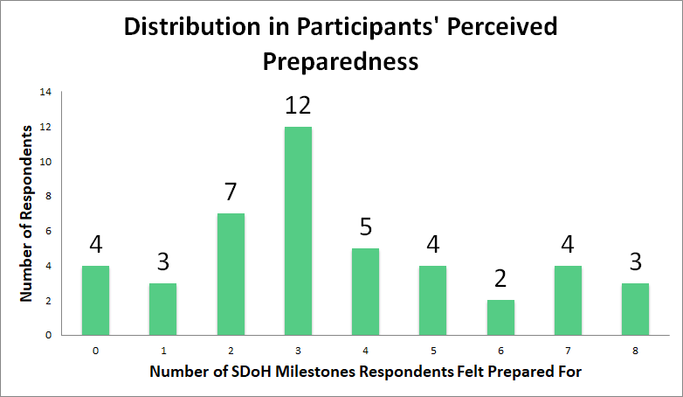
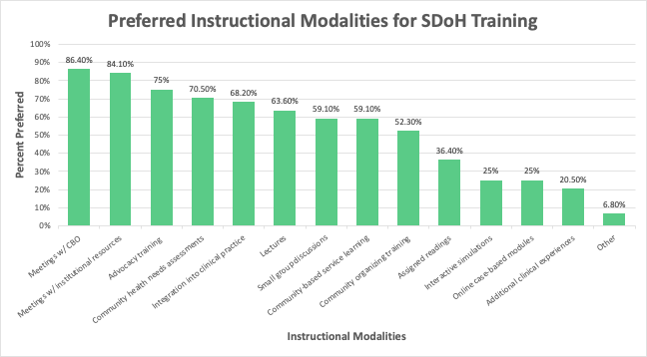
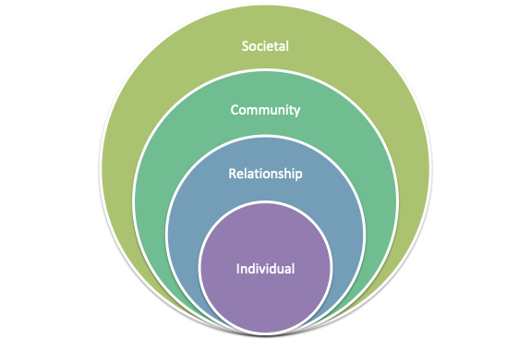
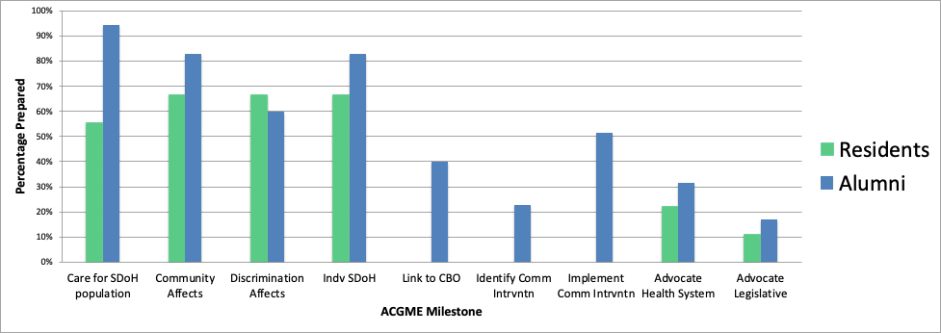
Perceptions on Family Medicine Residency Training in the Social Determinants of Health
Morgan Beatty MD MPH, Matthew Rudolph MD, Leslie Smebak MD,
Thomas Kim MD MPH, Amber Alencar MD MPH, John Hertenstein-Perez MPH
Background
Results
Discussion
Family physicians are well-situated to address the social determinants of health (SDoH), but often feel underprepared to do so.
This study aimed to characterize the perceived preparedness of current residents and recent graduates of an urban community-based family medicine residency program to address SDoH.
The Social-Ecological Model
Advocate within health system for policies that promote community health
Advocate for legislative policies that promote community health
Partner with community-based organizations to implement community health interventions
Understand the ways in which structural discrimination affects the health of patients
Identify areas for community health intervention
Understand the ways in which community characteristics affect the health of patients
Participants’ Perceived Preparedness in SDoH Milestones
0% of all participants
89% of residents and 69% of alumni
41% of all participants
37%* of alumni and 11%* of residents
Link patients to community-based organizations addressing social needs
Identify the role of SDoH in individual patient encounters
Methods
94%
83%
83%
*
67%
67%
67%
Many competencies outlined by the Milestones require family physicians act on the community- or societal-level. Participants felt less prepared to address the milestones (highlighted in red) that relate these higher tiers of the socio-ecological model for change.
56%
60%
*
*
40%
51%
The Social-Ecological Model: A Framework for Prevention.
https://www.cdc.gov/violenceprevention/publichealthissue/social-ecologicalmodel.html
23%
31%
Attribute preparedness to curriculum exposure only
Attribute preparedness to clinical exposure only
Attribute some preparedness to outside work/volunteer experience
Attribute some preparedness to outside educational experience
Participants: Current senior residents and alumni of the past 10 years
Tool: Mixed-methods, online survey disseminated Summer 2020
Participant demographics
Perceived preparedness in SDoH-related competencies outlined in the 2015 ACGME Family Medicine Milestones (“Milestones”)
Open-ended curricular feedback
Data Analysis:
Quantitative: Descriptive statistics, Chi-square tests, odds ratios, and Mann-Whitney-U tests
Qualitative: Thematic analysis
22%
17%
11%
Conclusions
* = statistical significance
* indicates statistically significant difference
Preparedness was greatest in domains of SDoH knowledge and individual patient care.
A majority attributed their preparedness to clinical as opposed to curricular exposures.
Individual factors conferred greater odds of preparedness in some domains:
Alumni were more likely to report preparedness in community-level milestones (p<0.05)*.
Those who attributed preparedness to residency curriculum exposures had greater odds of preparedness in community-level milestones (OR 4.4, p=0.01; OR 7.0, p=0.01)*.
Those who attributed preparedness to educational experiences outside of residency had greater odds of preparedness in societal-level milestones (OR 10.0, p=0.03; OR 12.6, p=0.04)*.
Those who identified with one or more demographic factors of the patient population had greater odds of preparedness in community-level milestones (race: OR 83.0, p<0.01; SES: OR 45.0, p=0.01)*.
*some but not all community- or societal-level milestones
Curricular interventions that teach community- and societal-level engagement may lead to improved preparedness to address SDoH.
Adequate training to address SDoH requires both clinical exposure and formal curriculum; the latter may have an important role in filling residency training gaps.
Future Directions
Implement curricular interventions on the community and societal levels
Design tool to assess provider competence in addressing SDoH
Improve recruitment of residents that identify with our patient population
Contact: morganbeatty11@gmail.com, mattrudolph91@gmail.com
Adapted ACGME Milestone | Abbreviation
“Care for a population that is negatively impacted by SDoH” | Care for SDOH Population
“Understand the ways in which community characteristics affect the health of patients” | Community Affects
“Understand the ways in which structural discrimination affects the health of patients” | Discrimination Affects
Adapted ACGME Milestone | Abbreviation
“Identify the role of SDoH in individual patient encounters” | Indv SDoH
“Link patients to local community-based organizations that provide services addressing social needs” | Link to CBO
“Identify areas for community health intervention” | Identify Comm Intervention
Adapted ACGME Milestone | Abbreviation
“Partner with local community-based organizations to implement community health interventions” | Implement Comm Intervention
“Advocate within health system for policies that promote community health” | Advocate Health System
“Advocate for legislative policies that promote community health at the local, state, and federal levels” | Advocate Legislative
ACGME 2015. The Family Medicine Milestone Project: A Joint Initiative of the Accreditation Council for Graduate Medical Education and the American Board of Family Medicine. acgme.org/Portals/0/PDFs/Milestones/FamilyMedicineMilestones.pdf.

